Slide 1
High Power RF and Distribution
John Reid / Accelerator Division
MaRie Team Visit
March 9, 2016

Slide 2
Four High Power 1.3 GHz RF Systems at NML / FAST
5 MWatt 1.3 GHz RF system for the RF Gun
Klystron Thales TH2104C + Pulse Transformer
Fermilab Bouncer Modulator & Charging Power Supply
SPA WR650 5 Mwatt Isolator
Fast Interlocks (PMT, FEP, FP,& RP) + PLC Interlocks (LCW, Temp, Vacuum, Cryo, Etc.)
300KWatt 1.3 GHz RF system for Capture Cavity I (CCI)
Valvo-Philips YK1240 300 kWatt klystron
Fermilab Series Tube pulsed modulator & charging power supply
Circulator + Dual directional couplers
Fast interlocks (PMT, FEP, FP,& RP) & PLC interlocks (LCW, Temp, Vacuum, Cryo, Etc.)
300 KWatt 1.3 GHz RF system for Capture Cavity II (CCII) –
Valvo-Philips YK1240 300 kWatt klystron
Fermilab Series Tube pulsed modulator & charging power supply
Circulator + Dual directional couplers
Fast interlocks (PMT, FEP, FP,& RP) & PLC interlocks (LCW, Temp, Vacuum, Cryo, Etc.)
5 MWatt rf system for Cryomodule # 1 test – Can be upgraded to a 10MW klystron.
Klystron Thales TH2104C + Pulse Transformer
Fermilab Bouncer Modulator & Charging Power Supply
SPA WR650 5 Mwatt Isolator
Fast Interlocks (PMT, FEP, FP,& RP) + PLC Interlocks (LCW, Temp, Vacuum, Cryo, Etc.)

Slide 3
5 Mwatt 1.3GHz Thales TH2104C Klystron with Pulse Transformer, Oil Tank, & Waveguide Isolator
Waveguide
Isolator
TH2104C Klystron
Pulse Transformer + Oil Tank

Slide 4
5 Mwatt Klystron Modulator and Charging Supply
Bouncer Modulator
Charging Power Supply

Slide 5
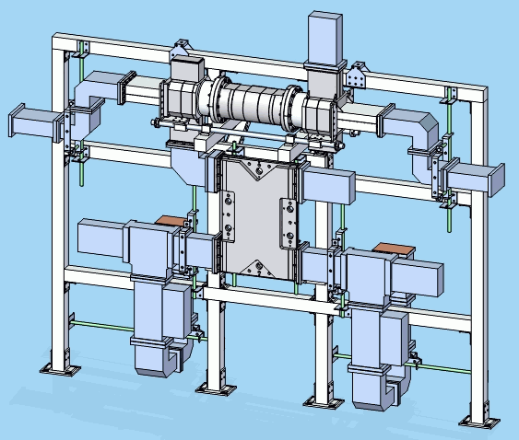
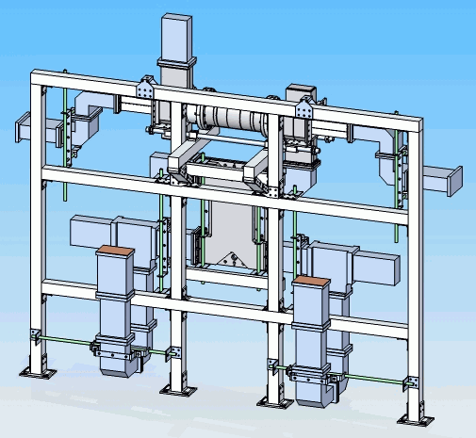
WR-650 Waveguide Distribution Twin Pack
SLAC Collaboration – Design & Deliver Distribution System
4 Twin Packs required for an 8 cavity cryomodule assembly
Hybrid
High Power Phase Shifter
Circulator

Slide 6
FAST - 1.3 GHz Waveguide Distribution System

Slide 7
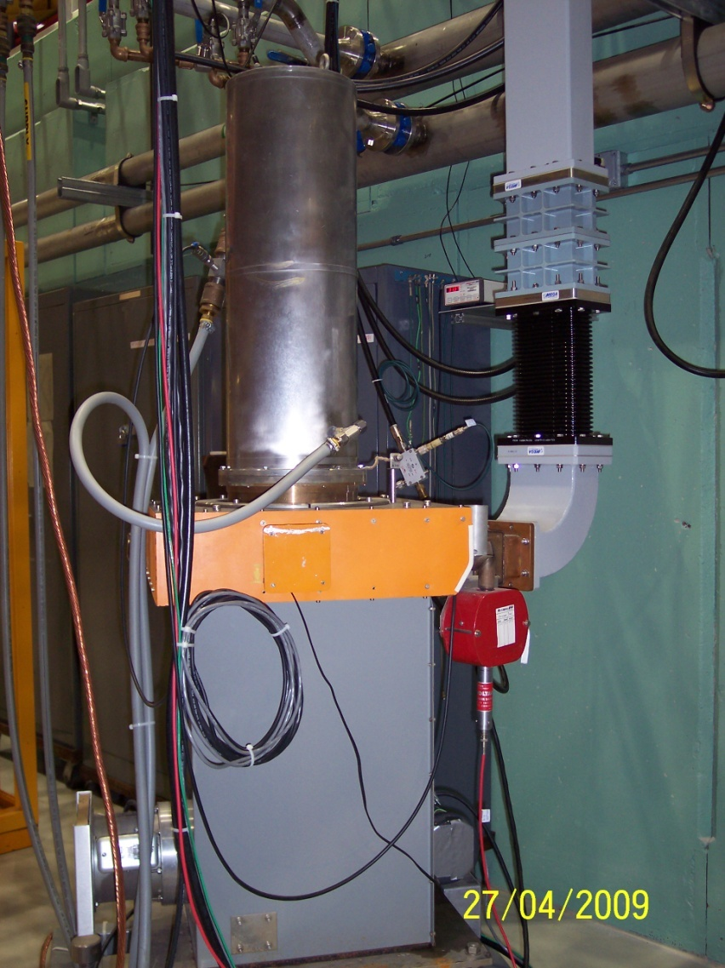
300 kWatt Modulator & Charging PS for YK1240 1.3GHz Klystron
Modulator + Charging Supply/Capacitor Bank
Valvo-Philips YK1240 Klystron with Solenoid

Slide 8
LCLS-II Testing at CMTS
SSA’s with waveguide to cryomodule, one SSA per cavity

Slide 9
Summary
Fermilab has designed, developed, and demonstrated high power 1.3GHz RF systems to operate SRF cavities at NML / FAST.
Worked with collaborators (SLAC) to develop waveguide distribution system for 8 cavity cryomodule for CM operation at NML / FAST.
High power RF for LCLS-II cryomodule testing at CMTS.
Expertise in high power RF systems

