Slide 1
Fermilab Control System
Jim Patrick - AD/Controls
MaRIE Meeting
March 9, 2016

Slide 2
Controls Scope
Main Complex
Accelerator Test Facilities
NOvA experiment slow control system
Future Projects (PIP-II)

Slide 3
Fermilab Control System (ACNET)
Unified system for the entire complex
All accelerators, all machine and technical equipment
Common console manager can launch any application
Common software frameworks
Common timing system
Three tier system
Applications, central services, front-ends
Custom system developed for the Tevatron in early 80’s

Slide 4
Fermilab Control System
Modular architecture
Many major upgrades over the years w/same core architecture
Almost all computers and much hardware
Supports simultaneous operation of variety of beam modes
Timing system and much infrastructure to support this
Custom communication protocol (ACNET)
Supports data request on any timing event (+delay)
Supports blocks of high rate readings (Fast Time Plot request)
Custom timing system
TCLK – event link
Central Timeline Generator (TLG) + remotely generated events
MDAT – “fast” data link

Slide 5
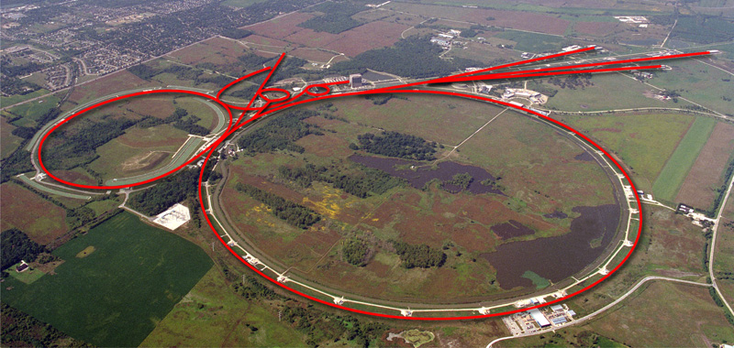
Fermilab Accelerator Complex – Collider Era
NUMI
Fixed Target
miniBooNE
Main Injector
pbar
Linac
Booster
Recycler
e-cool
Tevatron

Slide 6
Fermilab Control System
Front-ends
Wide variety of hardware – CAMAC, VME, GPIB, Ethernet…
Internet Rack Monitor – turnkey ADC, DAC, digital I/O package
HRM front-end – Modernized IRM
VME/VxWorks front-ends
Java “Open Access Client” (OAC) front-ends
Non-realtime, full Linux OS + database access
For ethernet connected hardware, access groups of devices
Labview front-ends (via OPC to Java OAC)
Erlang language front-ends
Recent development, mainly Ethernet connected hardware
Also runs on Linux

Slide 7
Fermilab Control System
Central (“Middle Layer”) Services
Custom alarm system
Data logging - ~80 parallel loggers
Save/Restore, etc…
Applications
“Parameter Pages”
C/C++ based framework, (very) old graphics
Java based framework – modern GUI
Custom Accelerator Control Language (ACL)
Synoptic display – drag and drop builder
Java based, view with Java application or web browser
Adapted by RHIC/BNL

Slide 8
Accelerator Test Facilities
High Intensity Neutrino Source (HINS)
Low energy pulsed proton linac
no longer active
Fermilab Accelerator Science & Technology facility (FAST)
300 MeV ILC style SC electron linac
IOTA ring under construction
Project X Injector Experiment (PXIE)
CW capable SC proton linac
Front end of future PIP-II accelerator

Slide 9
Test Facility Control Systems
HINS and FAST started as independent EPICS systems
Core tools + EDM and data archiver from SNS, …
FAST was ILC test facility, other US labs expected to participate
ILC became unlikely, external participation never happened
Control systems were put under ACNET infrastructure
Console manager, code management system
EDM displays could speak ACNET as well as CA
EPICS parts all eventually ported to ACNET
PXIE is all ACNET
Avoid older hardware and hardware platforms
Avoid writing old graphics apps (use Synoptic, Java, scripts)

Slide 10
NOvA Experiment Slow Controls
Detector power supplies
Rack and environmental monitoring
Two parts
Part runs on data acquisition system hardware and buses
EPICS – done by experiment DAQ group and not us
IOCs with Control System Studio for user interface
Remainder is ACNET and done by us
All synoptic displays, no custom applications
Independent installation in Minnesota – “ACNET in a Box”
We wrote a gateway and do get some EPICS data into ACNET

Slide 11
Future Projects & the Control System
PIP-II accelerator is a substantial controls project
Considerable infrastructure modernization is needed to support PIP-II and existing complex for decades to come
Timing System
Communication protocol
Fully support EPICS front-ends?
Hardware platforms – which new ones to support?
Front-end processors and field equipment
Middle layer services – alarms, logging etc.
Exploring experiment DAQ system for waveform logging
Application environment
PIP-II must interface well to the rest of the complex
We can’t replace everything there all at once

Slide 12
Summary
We support a large control system for the main complex with a variety of interleaved operational modes
It is a mostly custom system that originated in the early 80’s but has been continually upgraded since then
We have significant experience with EPICS
PIP-II + major upgrades to the current complex are planned
The control system must be upgraded for these new projects and to make the existing complex supportable for the future
Planning of these upgrades is underway
It is a good time to explore synergy with other projects

