Slide 1
LCLS-2 PROJECT AT FERMILAB
Genfa Wu
2016-03-09

Slide 2
Outline
LCLS-2 Project Overview
Technical Development of R&D, Engineering Design, Design Verification, Prototype Cryomodule and Production
QA/QC
Summary

Slide 3
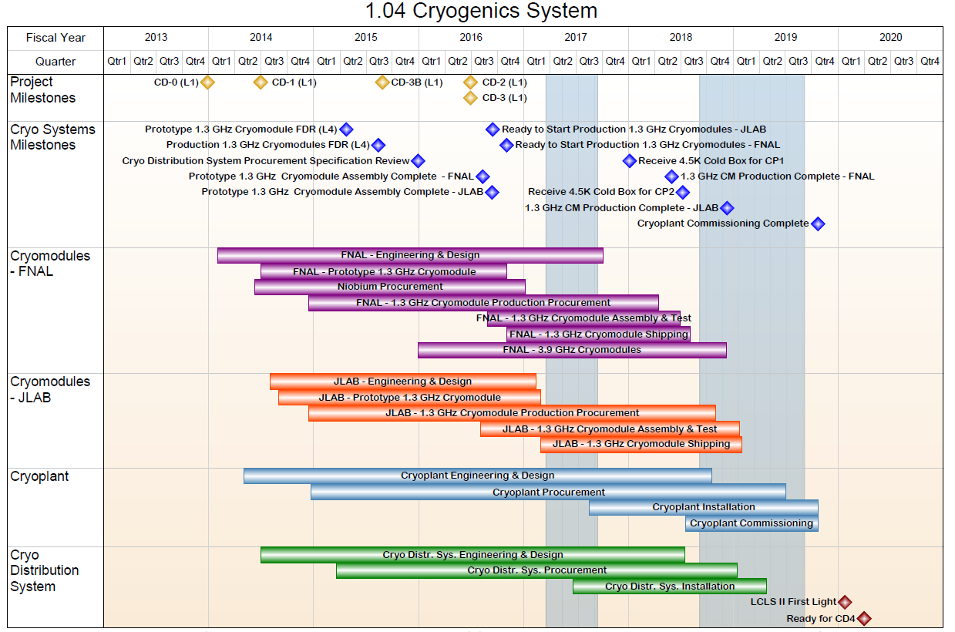
LCLS-2 Project Overview
Cryomodule Scope
R&D: Fermilab, Cornell, JLAB, etc
Design: Fermilab, JLAB, SLAC
Procurement: JLAB, Fermilab
Prototyping: Fermilab and JLAB
Production: Fermilab 15 1.3GHz CMs
Production: JLAB 16 1.3GHz CMs
Production: Fermilab 2 3.9GHz CMs

Slide 4
LCLS-2 Project Overview
  Oversight and integration of all WBS 1.04.05 related activities
  Overall CM support in areas incl. ES&H, QA/QC, supporting engineering
  CM related travel M&S (including vendor visits)
Slides from C. Ginsburg

Slide 5
Technical Systems
High Q R&D produced record setting performance
Design engineering utilized and upgraded proven cryomodule design
Design verification demonstrated robust components design
Prototype cryomodule will test system integration
Production cryomodule utilizes lessons learned from prototyping

Slide 6
Design Verification
Sixteen cavities have been processed to obtain high Q via the 2/6 doping protocol at Fermilab, Jefferson lab and Cornell, and dressed at FNAL
Cavity performance exceed specifications pre and post dressing vertically and horizontally Q ~ 3e10 at 16 MV/m, 2K
Losses per trapped flux and efficiency of flux expulsion have been extensively studied for the pCM cavities and for the 2/6 doping recipe vertically and horizontally
A optimal fast cooldown procedure has been found repeatedly leading to Q>2.7e10 at 2K, 16 MV/m, under < 5 mGauss remnant field conditions
High Power coupler and HOMs modifications for CW operation successful: no additional heating and no effect on Q

Slide 7
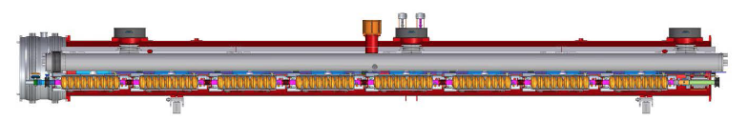
Prototype Cryomodule
Develop and finalize assembly procedures for production
  Develop and validate assembly procedures
  Validate assembly tooling and infrastructure
  Deliver a demonstrated assembly plan for the balance of the 33 CMs
  Train staff
Validate design changes compared to XFEL module
  CW operation
    Cavity, HOM, Coupler, Cryogenics
  High Q operation
    Fast cool down
    Magnetic shielding
    Active field compensation
  Tuner

Slide 8
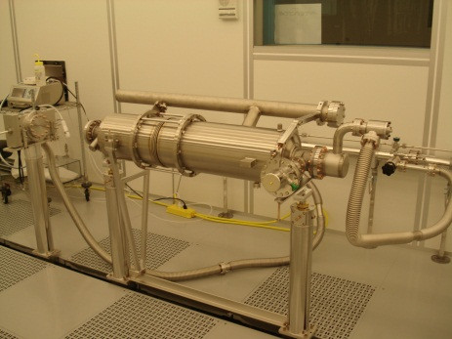
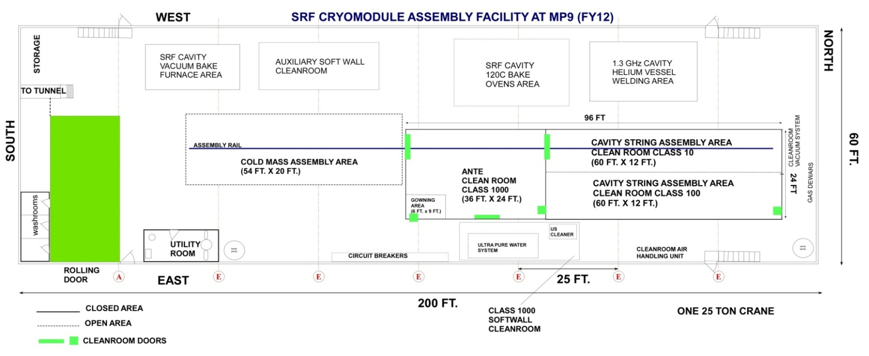
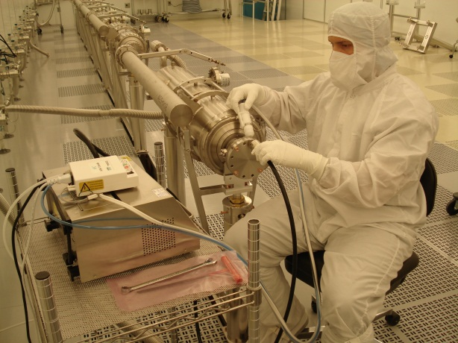
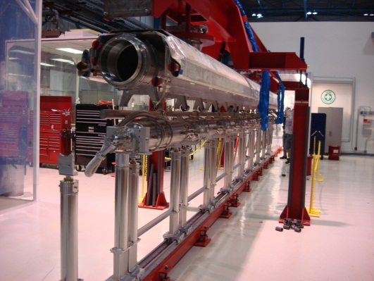
CAF-MP9 LCLS-II Production
WS2
WS1
WS0

Slide 9
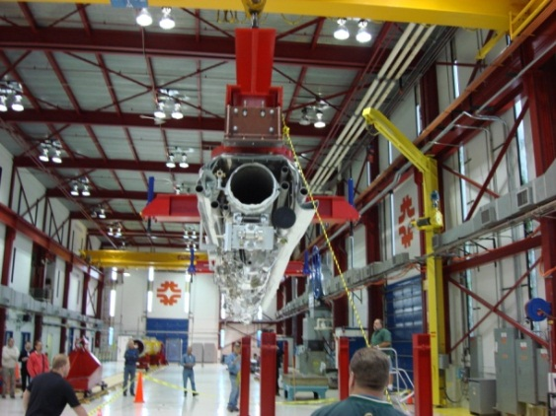
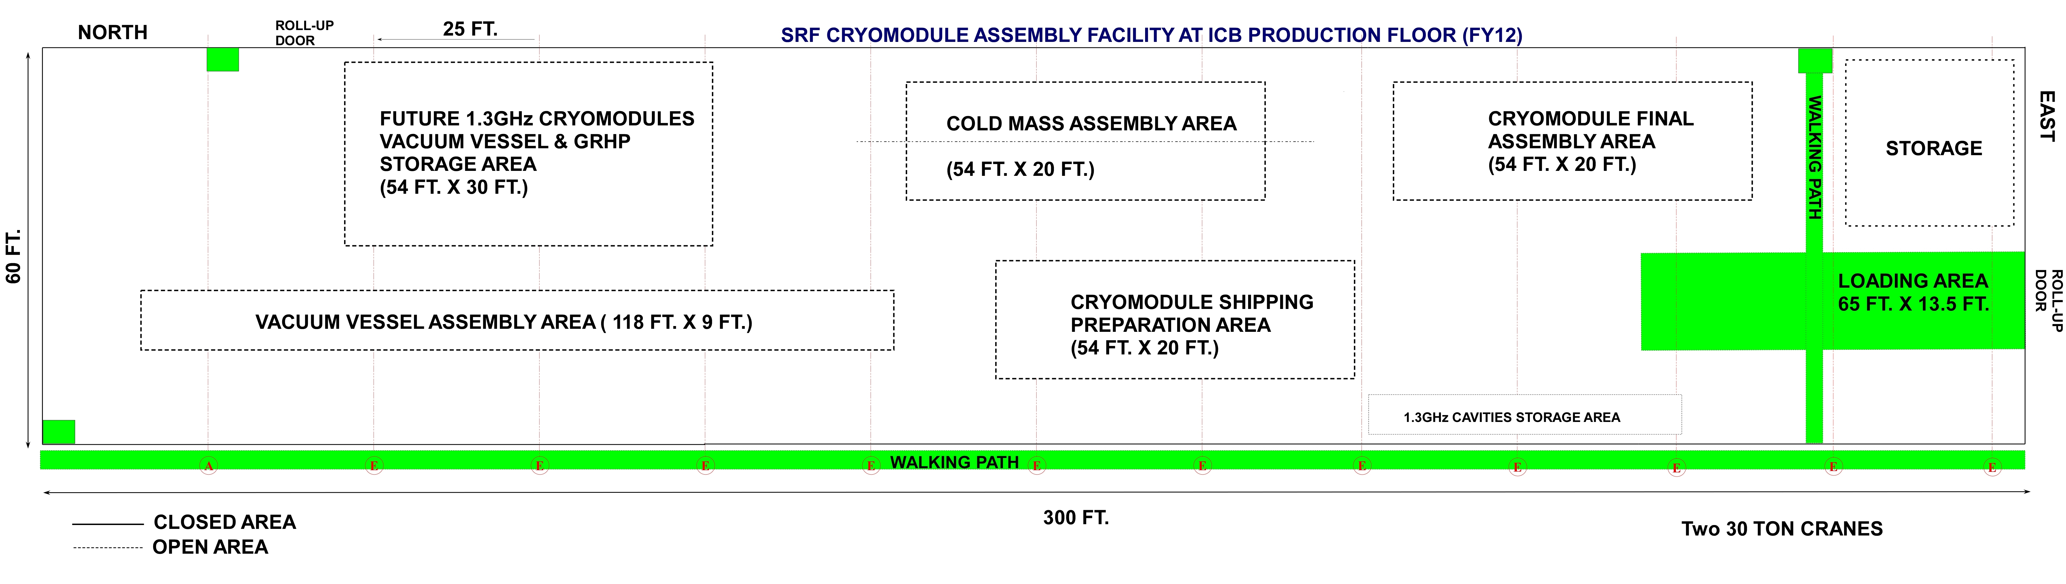
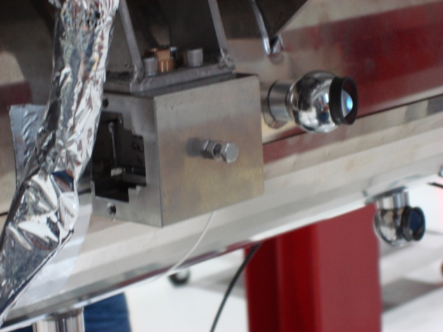
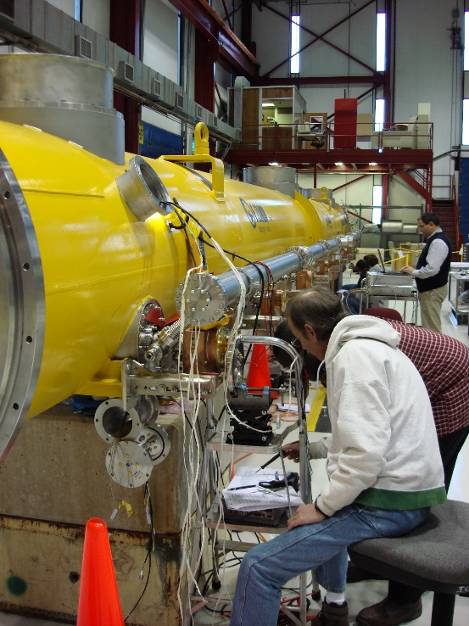
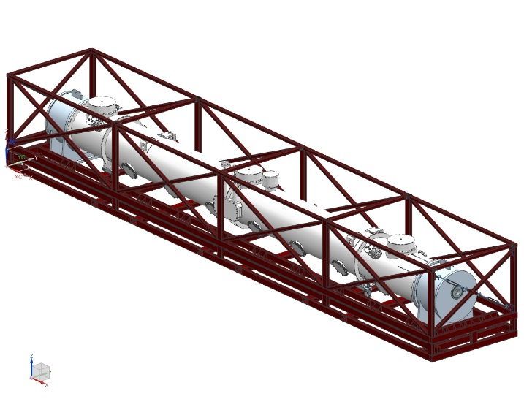
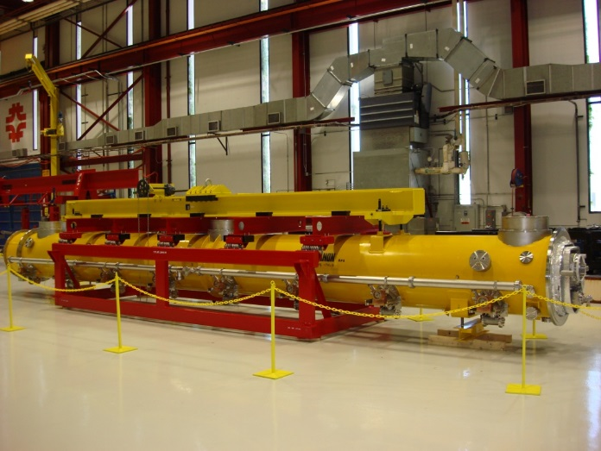
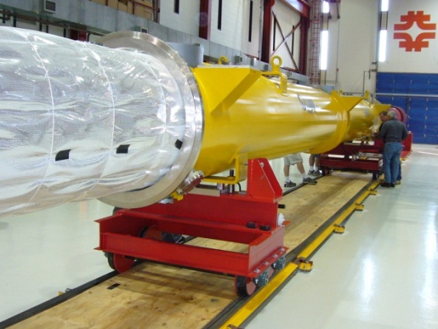
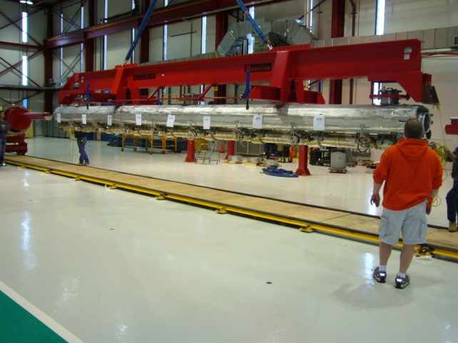
CAF-ICB LCLS-II Production
Sick CM
repair area
WS5
WS3
WS4
WS6
Notes:
WS5 final assembly and QC check

Slide 10
Throughput
WS0: Cold End Coupler Assembly - 7 days
WS1: Cavity String Assembly – 13 days
WS2: Cold Mass Assembly Phase I – 10 days
WS3: Cold Mass Assembly Phase II – 8 days
WS4: Vacuum Vessel Assembly – 7 days
WS5: Final Cryomodule Assembly – 15 days
WS6: Prep & Shipping – 2 days
Total duration for assembly:
~60 days (12 weeks)
pCM assembly duration: ~ 6 months planned
CM2-CM4 (ramp-up) assembly duration: 14~16 weeks per module, assembled in series
CM5-CM16 (peak rate) assembly duration: 12 weeks per module, assembled in parallel with the required throughput of one cryomodule per month
Slide from T. Arkan

Slide 11
QA/QC
Engineering Design utilizing Team Center
Vendor QA process standardized
Acceptance Criteria Strategy Developed for each components
Non conformance reports/Deviation report is managed by vector database
Traveler system managed by vector system

Slide 12
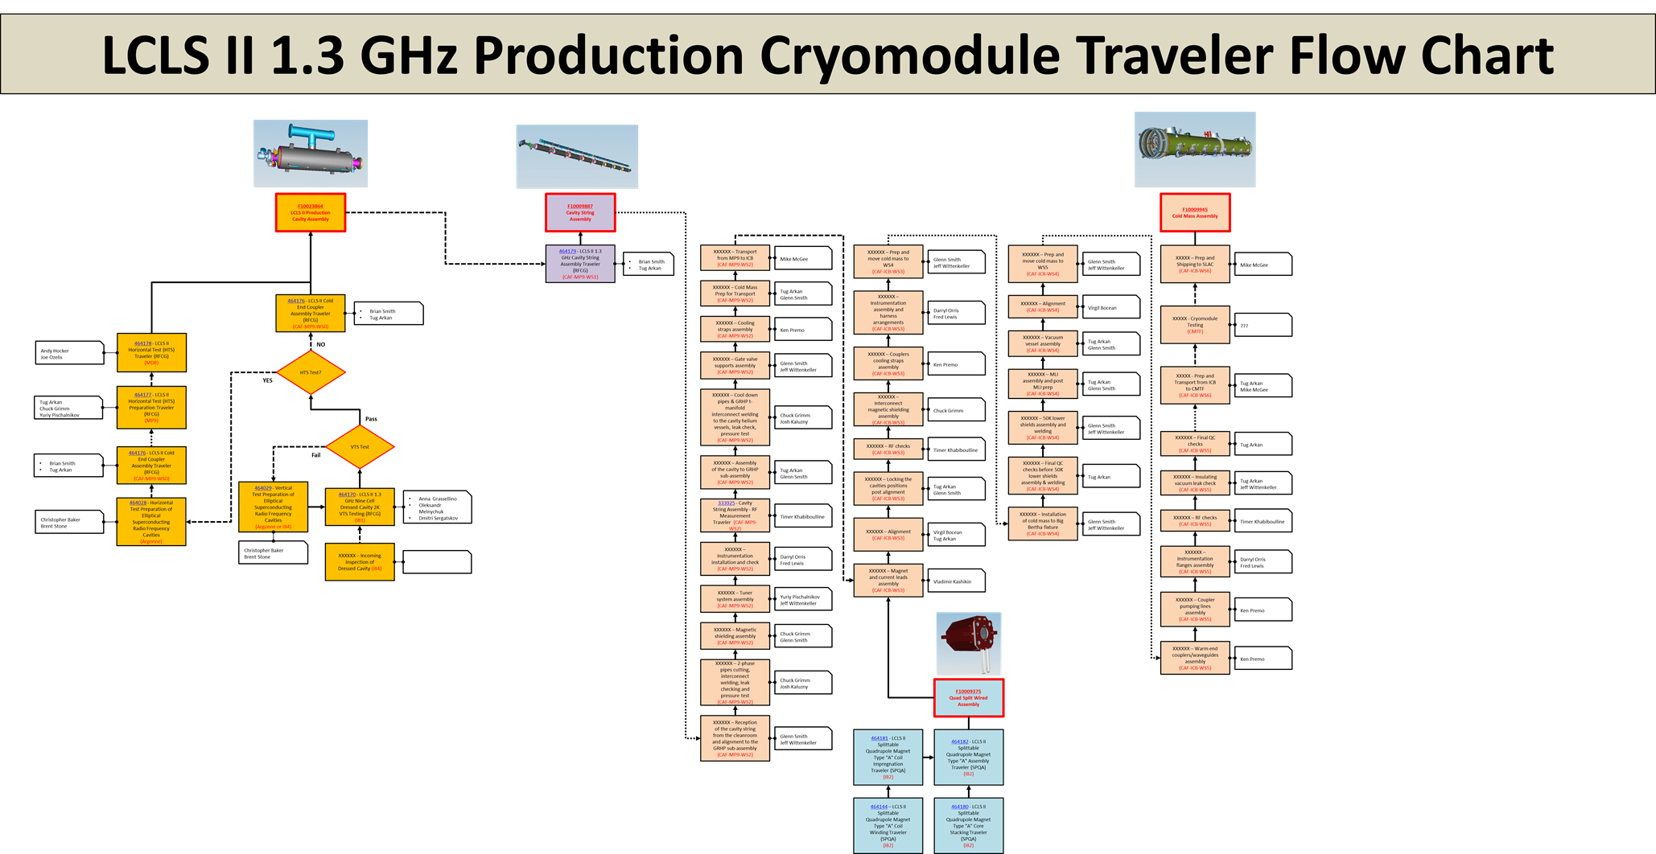
Travelers / Procedures
Detailed Assembly Travelers / Procedures Flow Chart is created. Most of the travelers are in place from CM2 assembly (vector.fnal.gov). Some updates are being done for LCLS-II, travelers will be fully tested during pCM assembly.
Slide from T. Arkan

Slide 13
Summary
Fermilab’s scientific and engineering knowledge is key to the success of LCLS-2
Technical team is fully capable as demonstrated in LCLS-2 project
Facilities are the state of the art in supporting large SRF project

