Slide 1
Initial thoughts on the concept of SC RF for MaRIE Slava Yakovlev (FNAL) March 9, 2016

Slide 2
Possible issues:
Incoherent losses (wakes);
HOMs (including BBU and resonance excitation)
Main coupler
Q₀ at operation gradient
Field emission
Cryo-load
LFD and microphonics
Control

Slide 3
Parameters of the MaRIE*
Energy 12 GeV
Operation mode pulsed
Operation frequency, 1.3 GHz
Acceleration gradient 31.5 MeV/m
Pulsed current 0.26 mA
Beam duty factor 0.6%
Pulse rep. rate 60 Hz
Pulse width 100 μsec
Bunch population Q_{b1,2} 0.2 (XFEL), 2 (eRad), nC
Number of bunches in a pulse N_{1,2} 30 (XFEL), 10 (eRad)
*J. W. Lewellen, et al., IPAC 2015, TUPMA026

Slide 4
Effects of HOMs (collective instabilities, cavity heating) depend on the beam current, beam spectrum (beam timing) and cavity HOM spectrum.
“Average” HOM power per cavity (incoherent losses – figure of merit):
P_{av} = k_{loss}Q_{b}I_{av}
For MaRIE:
P_{av} = k_{loss}[Q_{b1}²N₁+Q_{b2}²N₂]f_{rep}
 |  | ILC | LCLS-II | MaRIE
I_{av}, mA |  | .048 | 0.3
Q_{b}, pC |  | 3200 | 300 | 200/2000, 30/10
k_{loss}, V/pC |  | 14.6 | 14.5* | ~16**
P_{av}, W/cavity |  | 2.2 | 1.3 | 0.04
*for r.m.s. bunch length of 45 μm
**for r.m.s. bunch length of 3.6 μm (12 fs)
Looks like there is no problem

Slide 5
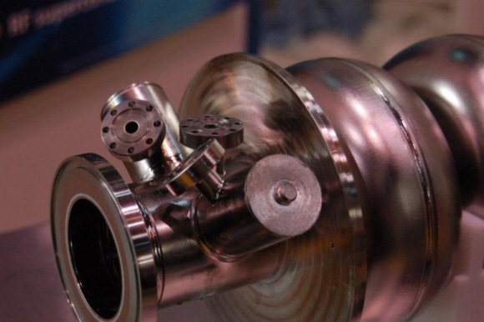
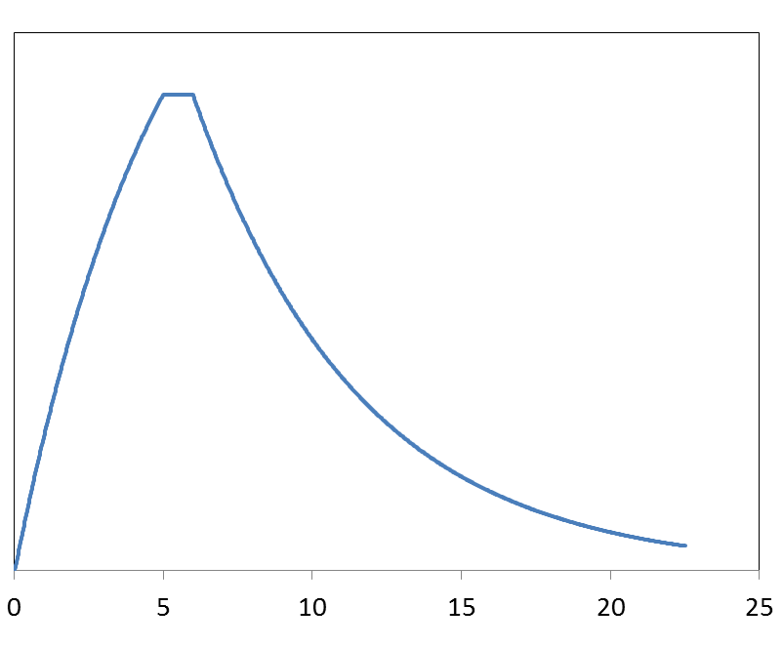
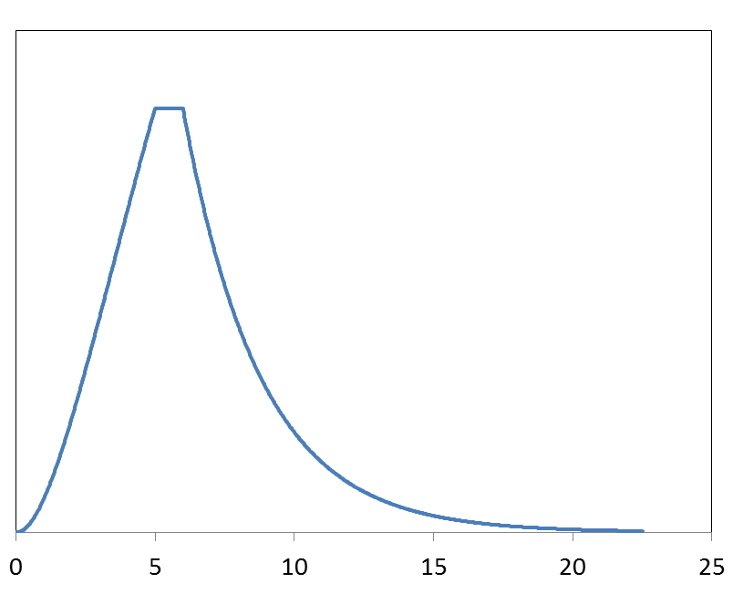
HOM couplers:
Filling time is 0.9 msec;
Time constant is 0.71 msec (Q_{loaded} = 2.9e6)
“RF load duty factor” (filling, flattop and discharge) is 5.1%
Gradient is 31.5 MeV/m
RF load in HOM couplers is 20% of the LCLS II (16 MeV/m, CW)
Looks like no problems with HOM couplers
E_{acc}²∝ RF load
RF duty

Slide 6
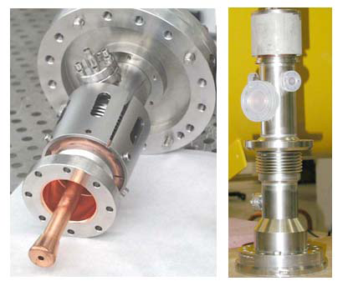
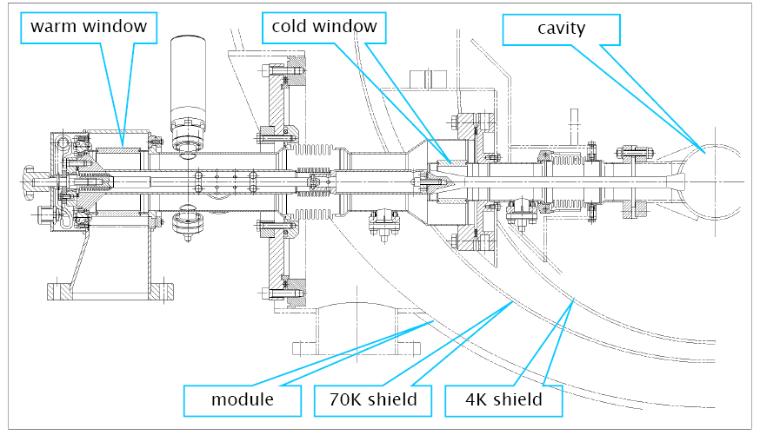
Main coupler issues:
ILC couplers (TTF-III) = 300kW pulse, 2.5 kW average
LCLS-II input power = 6 kW/cavity CW
.
ILC coupler development was done in collaboration with SLAC
ILC coupler was modified for use in LCLS-II

Slide 7
MaRIE :
Filling time is 0.9 msec;
Time constant is 0.71 msec (Q_{loaded} = 2.9e6)
Beam pulse is 0.1 msec
“RF source duty factor” (filling and acceleration) is 5.7%
Gradient is 31.5 MeV/m
The pulsed power during filling: 173 kW
The pulsed power during acceleration: 89 kW
The beam power in the pulse: 8.2 kW
Average power is 10 kW!
Modifications are necessary.
Air cooling?

Slide 8
Expected RF load on Cryogenics system:
XFEL: Q₀=0.8e10 at 31.5 MeV/m;
N-doping: needs additional R&D in order to operate at 31.5 MeV/m;
ILC: “RF load duty factor” is 0.8% (5 Hz reprate);
RF load at 31.5 MeV/m and Q₀=0.8e10 is 9 W/CM;
LCLS: CW operation, N-doping: 2.7e10 at 16 MeV/m
RF load is 75 W/CM;
MaRIE: “RF load duty factor” is 5.1%;
RF load at 31.5 MeV/m and Q₀=0.8e10 is 57 W/CM;
LCLS II – type cavity and CM look OK
High-Q₀ R&D are necessary
Field emission may be an issue at 31.5 MeV/m.

Slide 9
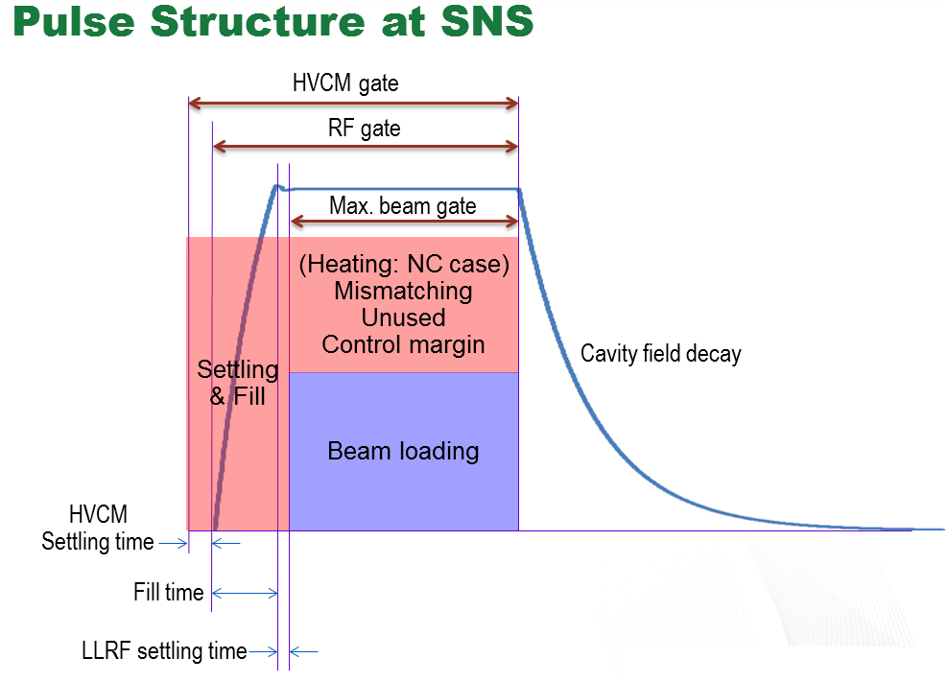
Lorentz Force Detune (LFD) and microphonics:
High Gradient: LFD factor ~1 Hz/(MeV/m)2; LFD = 1 kHz;
Bandwidth: 450 Hz.
LFD/BDW ≈ 2;
For XFEL LFD/BDW ≈ 2;
But: beam pulse is short, 0.1 msec → Resonance Control and LLRF settling time may be an issue to provide required amplitude and phase stability.
High repetition rate: piezo life time.
R&D on the resonance
control is needed

Slide 10
Possible issues:
Incoherent losses (wakes): Looks OK
HOM dampers: Looks OK
Main coupler: Improvement needed
Q₀ at operation gradient: R&D needed
Field emission: Improvement needed
Cryo-load: Looks OK for LCLS II CM
LFD and microphonics : R&D needed

Slide 11
Summary:
LCLS II-type cavity (no N-doping) can be used directly without any modification!
Existing dressed LCLS II -type cavities & tuners look OK WRT microphonics
Several qualified industrial 1.3 GHz cavity vendors
FNAL High-Q₀ program for LCLS II and PIP II is well aligned with MaRIE needs
FNAL Resonance Control and LLRF program is well aligned with MaRIE needs also.
The TTF-III coupler is not suitable, and should be modified
LCLS II cryomodule can be used directly.
RF source: 6 MW pulsed, 300 kW average?

