Slide 1
FNAL Cavity Test Capabilities and Synergy with High Q / High Gradient Research
Anna Grassellino
Cavity Performance and Test Group Leader, SRFDD, TD
Visit of MaRIE Team from Los Alamos
09/03/15

Slide 2
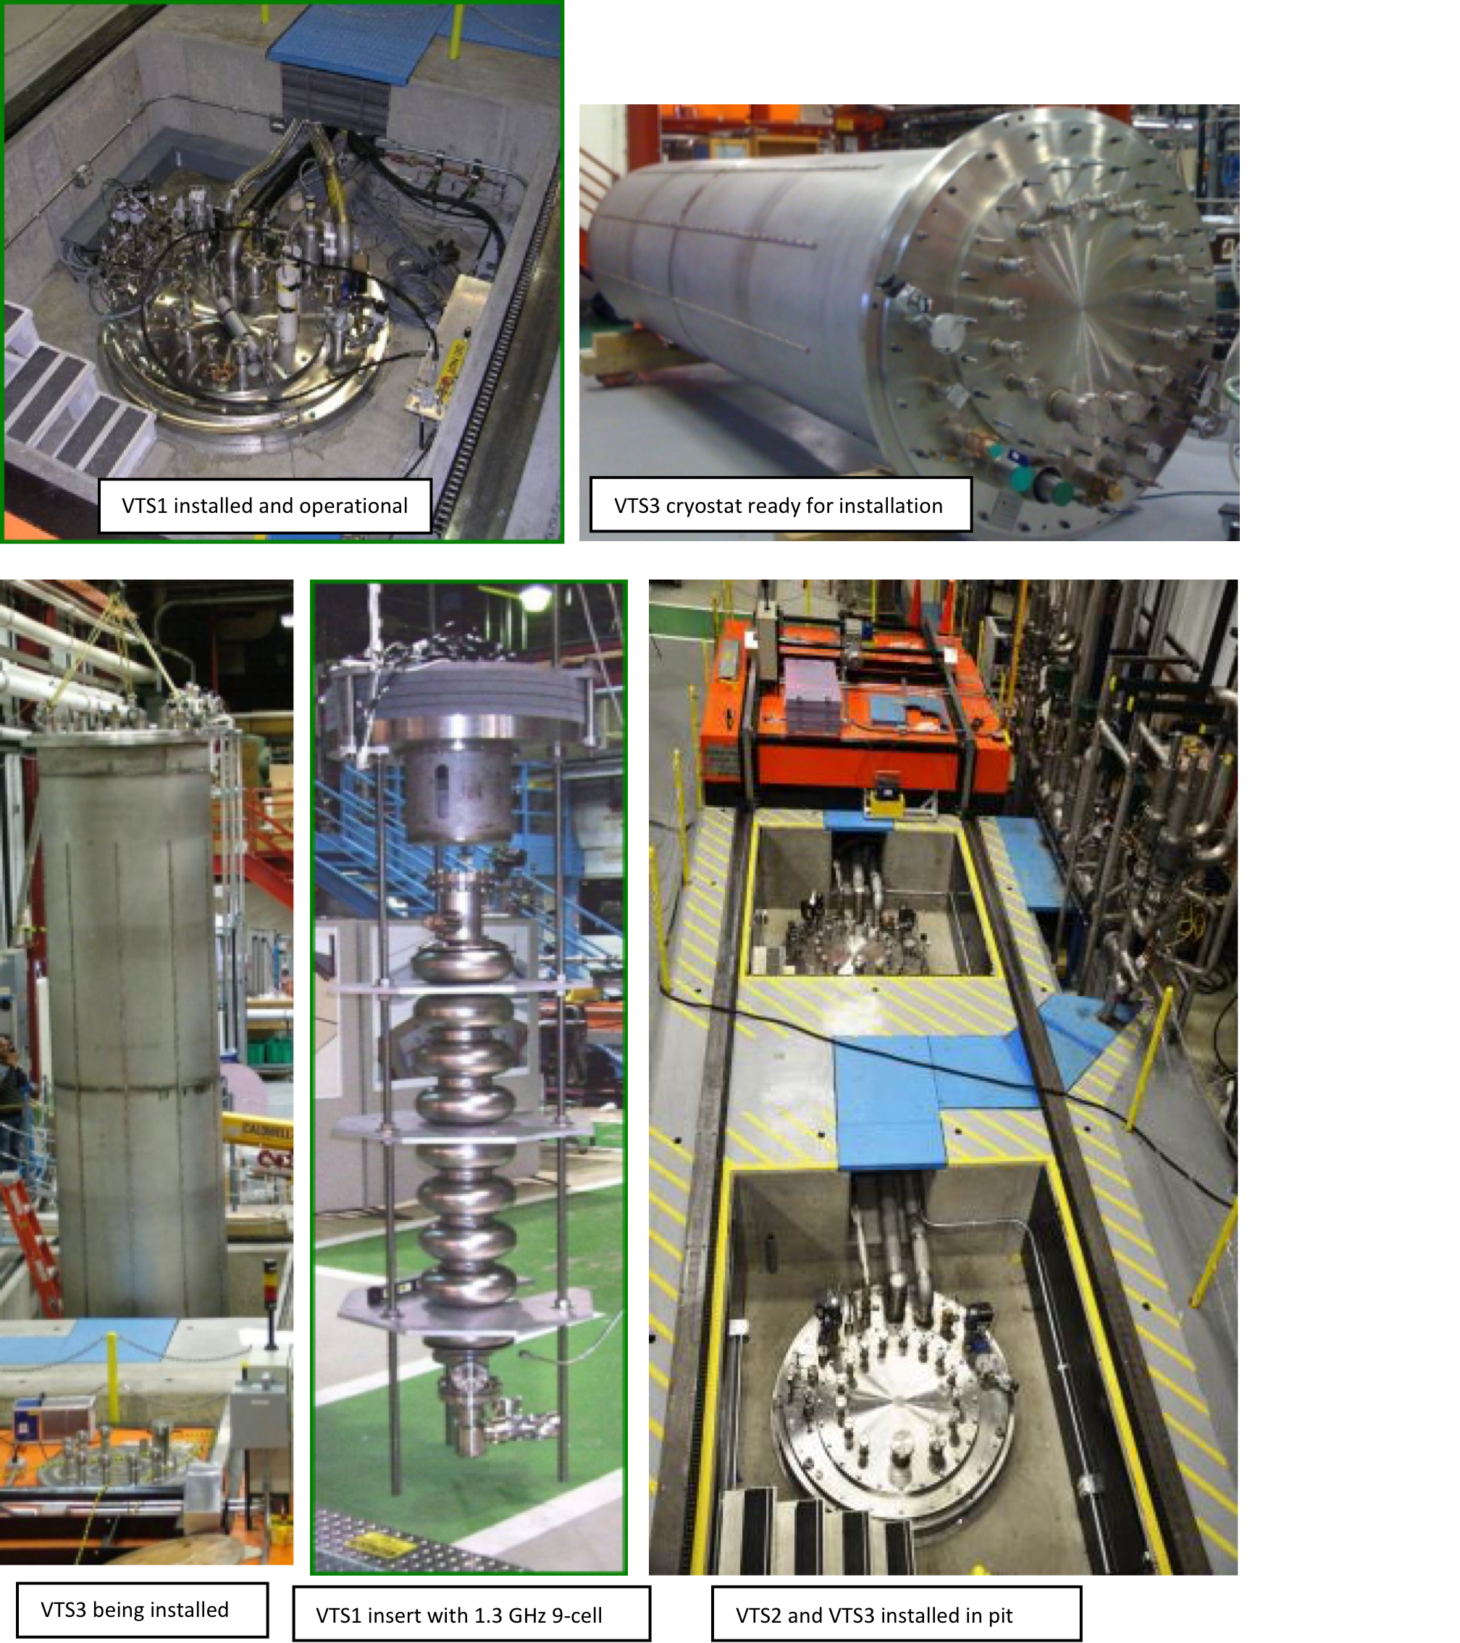
FNAL Vertical Test Facility

Slide 3
FNAL Cavity Test Capabilities
VTS: Three vertical test dewars with multiple frequency and testing capability:
  Frequencies: 325 MHz, 650 MHz, 1.3 GHz, (2.6 GHz), 3.9 GHz
  Temperature range 1.4K – 4K, fast and slow cooling capabilities
  Magnetic fields in dewar < 5 mGauss (dewar 1) and less then 10 mGauss in dewar 2 and 3
  Dewar 2 and 3 allow multiple cavity testing simultaneously – for LCLS2 production we plan on testing 3 cavities a week in VT2 (but throughput could be double that)
  Our main goal is to maintain a healthy balance between research and production activities

Slide 4
Content and Caption Slide [28pt Bold]

Slide 5
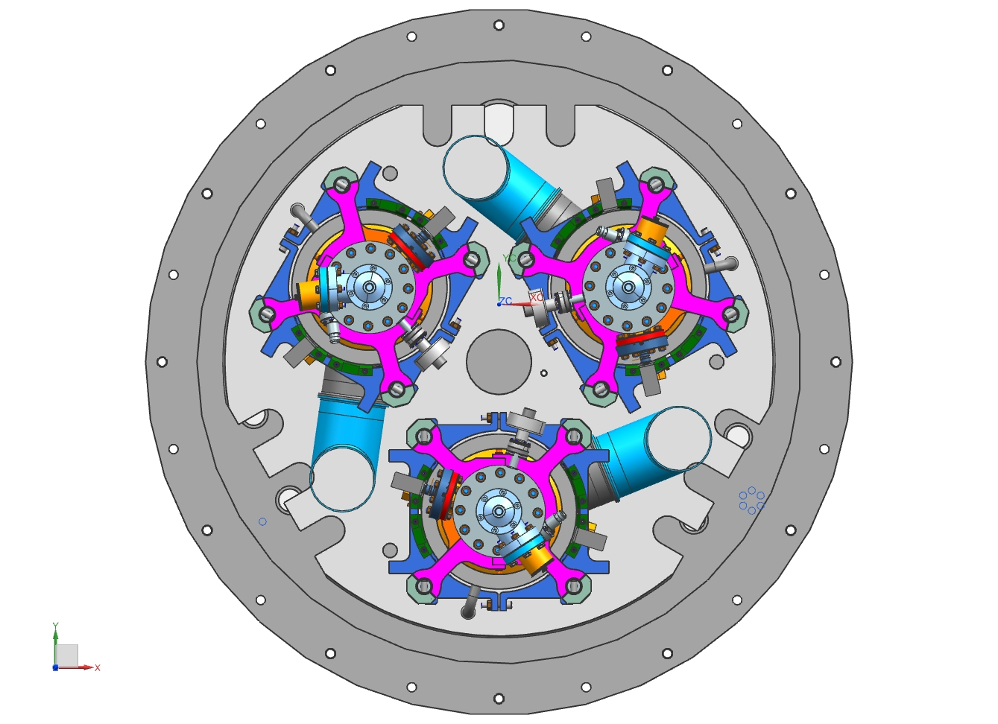

Slide 6
Instrumentation/diagnostics and test capabilities
Measurements:
  Q vs E and Q vs T RF measurements
  magnetic field expulsion studies
  multiple cool-down/warmup thermal cycles
  frequency vs T measurements
  cavity full body temperature mapping
  determining quench location via second sound
Temperature and magnetic field measurements
  Cernox temperature sensors, T- map, fast thermometry, Barrington Mag-01H cryogenic fluxgate magnetometers
Control of magnetic field on the cavity
  commercial and custom-made Helmholtz coils, PID controllers
Quench heaters, radiation monitors, pressure measurement system
Advanced field emission system being implemented now for LCLS2 (bottom and top rad detector, diodes surrounding cavities)

Slide 7
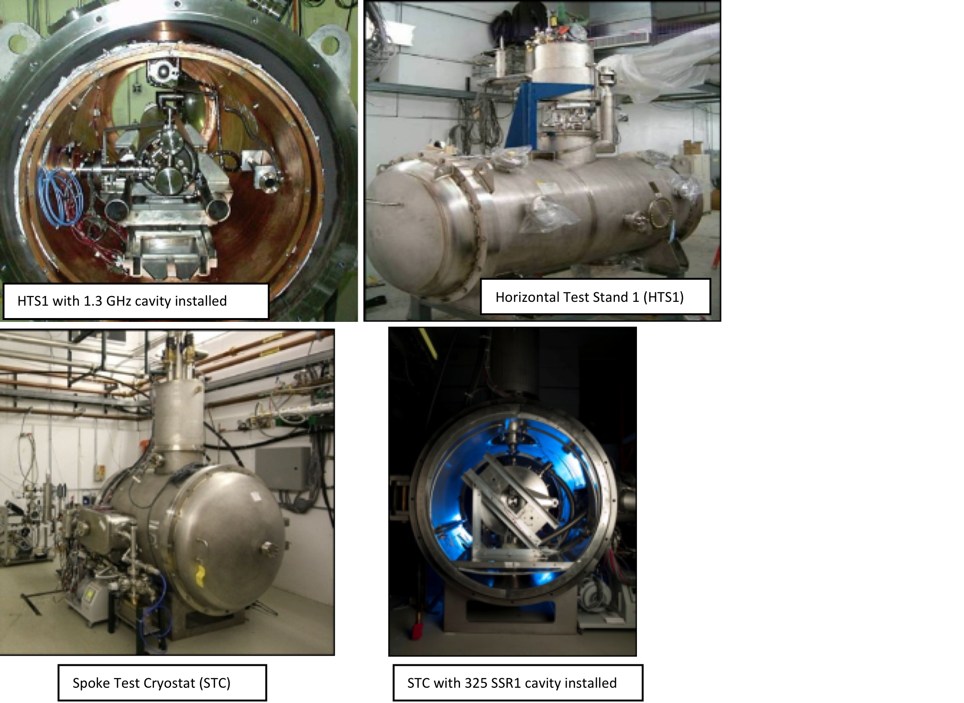
Horizontal Test Facility
CM like environment for integrated testing/ design verification

Slide 8
High Q – High Gradient importance for MaRIE
For MaRIE, gradient is certainly an important cost driver given the final desired energy of 12 GeV
  Operating at 31.5 MV/m → ~ 50 cryomodules
  If gradient goes up or down ~ 5 MV/m, depending on reachable performance, 10 cryomodule more or less will be needed
  Each CM costs ~ $3 million → impact of ~ $30 millions
But with 5% duty factor, if we consider the Q ~ 8e9 at 31.5 MV/m for ILC type processing (regular 120C bake, and yet challenging to achieve in CM if no particular attention is paid to cooling, mag field or FE), it looks clear that Q is a significant cost driver
  ~ 60W per CM x 50 CM → ~ 3KW just of DHL
  We are familiar with these numbers from LCLS-2 case (see next slides)
  Essentially, a 2K 4KW refrigerator is ~ $60 millions (plus civil)
  Therefore, if Q is twice worse or twice better, the impact is > +- $60 millions
  Q can significantly affect the capital and operating cost of MaRIE
  Moreover, a worse Q can also lead to premature quench (thermal runway) and reduce achievable gradients
  It may be beneficial to think/analyze the best operating gradient/Q point (may be lower than 31.5) for cost and reliability optimization

Slide 13
High Q -cost impact: the case of LCLS-II, capital costs
Courtesy of A. Klebaner, T. Peterson, FNAL

Slide 14
FNAL High Q and High gradient R&D
FNAL has in the recent years focused on High Q research
Two major breakthroughs: N-doping and Magnetic Flux expulsion/trapping manipulation via cooling
Also, active compensation of magnetic field
For LCLS2 – since it is a CW machine operating at ~16 MV/m, Q is crucial
For LCLS2 we embarked in a two year high Q collaboration (FNAL, Jlab, Cornell, SLAC) to develop doping for nine cell cavities and validate the cooling and magnetic field scheme
Series of tests were conducted at the vertical and horizontal test facilities for bare and fully dressed cavities
European vendors qualified for doping in industry
Next step: cryomodule validation (test this summer)
A. Romanenko, A. Grassellino, O. Melnychuk, D. A. Sergatskov, J. Appl. Phys. 115, 184903 (2014)
A.Grassellino, LCLS-II Technical Note,
LCLSII-8.2-EN-0523-R0 , 2015

Slide 15
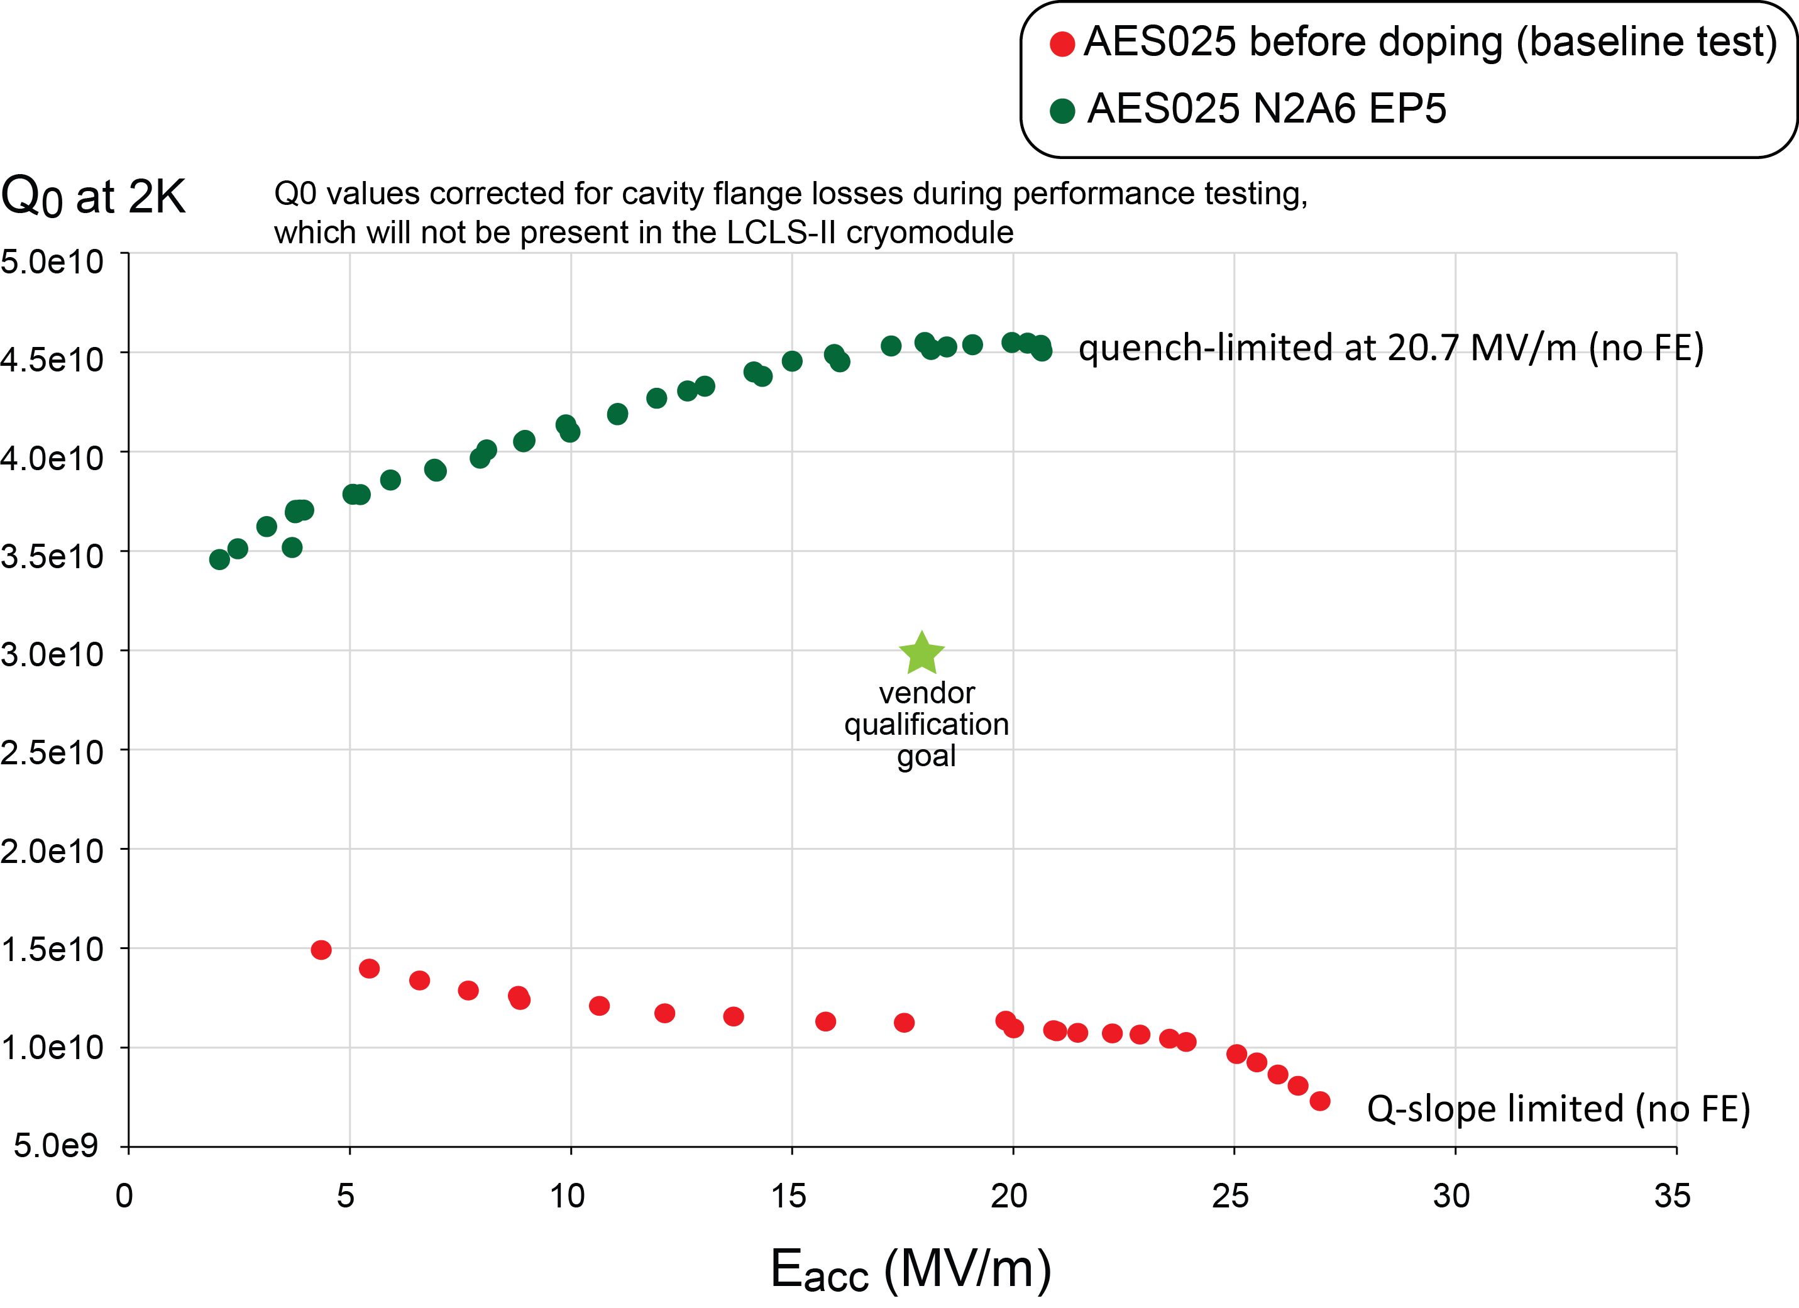

SRF Research milestone – Successful nitrogen doping technology transfer to industry for LCLS-II production
  Four times higher Q (cavity efficiency) at LCLS-II operating gradient
Courtesy of F. Marhauser

Slide 16
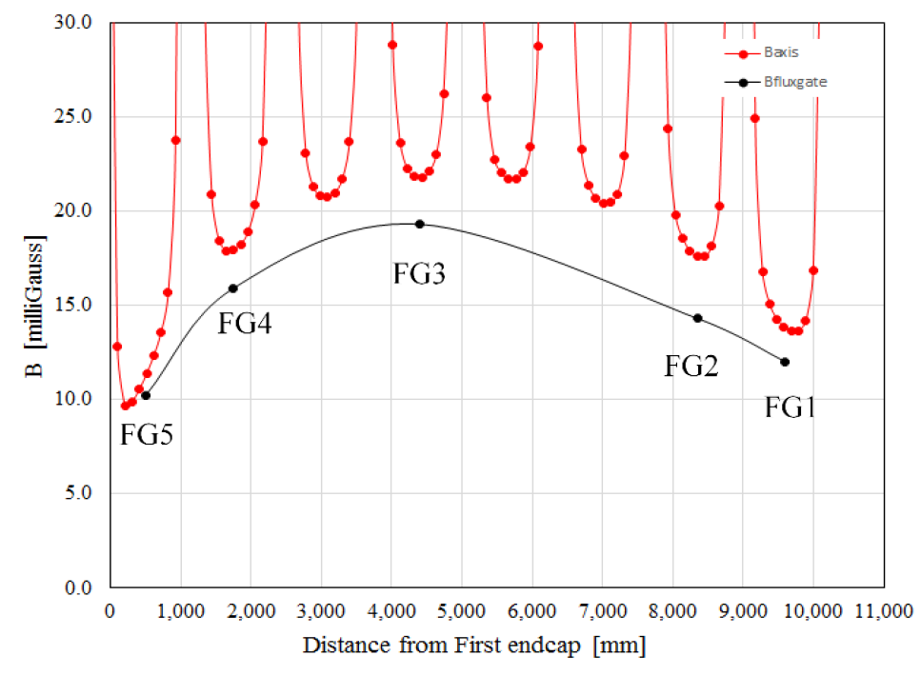
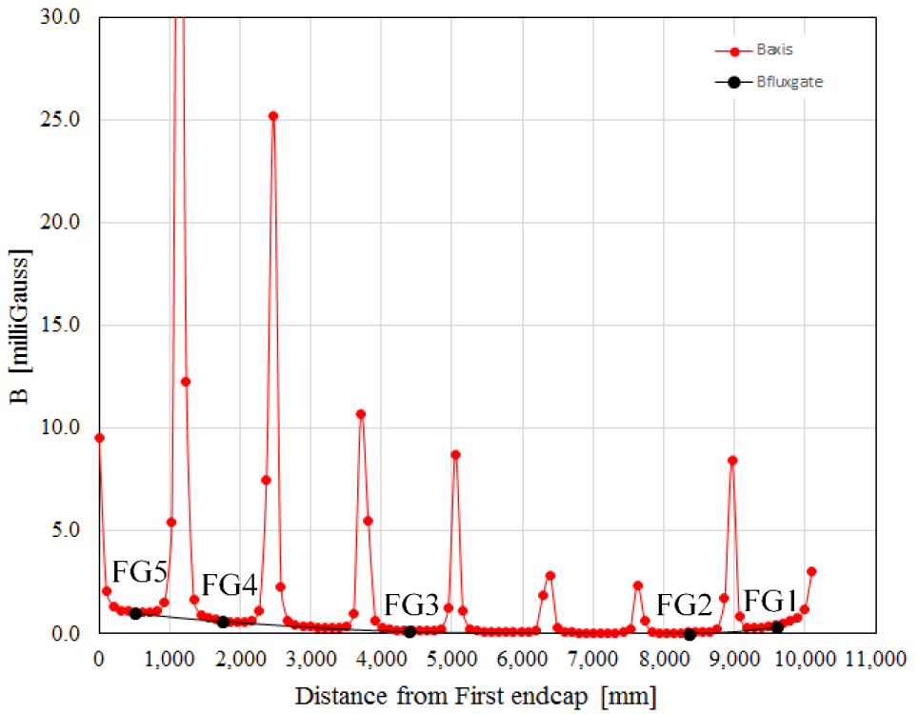
Active longitudinal field compensation
Need to shield longitudinal component of B
  Active cancellation proven to be effective method [7,8,9]
LCLS-II Spec.
LCLS-II Spec.
Without active cancellation (FEM calc.)
we expect B_{avg} ~ 15-20 mG
With active cancellation (FEM calc.)
we expect B_{avg} < 3 mG
[7] A. Crawford, arxiv.org/ftp/arxiv/papers/1507/1507.06582.pdf.
[8] The Conceptual Design Report for the TeSLA Test Facility Linac, Version 1, 1995.
[9] T. Bitter et al., Nucl. Instrum. Methods A, 309, 1991.

Slide 17
High Q AT high gradient?
The new challenge would be to maximize Q at higher gradients (for LCLS2 we focused at mid gradients)
Doping has an effect on quench field, and the best doping recipe today produces on nine cell cavities quench fields of ~ 26-29 MV/m with Q at highest gradients > 3e10
One can also trade off some Q for gradients – it is known that lowering the doping level increases the quench field – so best compromise/recipe may be quickly found
More R&D is needed to increase achievable gradient, but it is not a fundamental limit (single cells reached up to 39 MV/m with Q > 3e10)

Slide 18
High Q AT high gradient? Alternative methods
Recent effort has started for increasing achievable gradients via alternative surface treatments techniques
Example below shows a single cell cavity treated chemistry free post-annealing, with a 120C bake in the furnace (no reoxidation) with N2 for 48 hours
Very high Q and high gradients achieved > 2.2e10 at 31.5 MV/m
This effort is ongoing and we will continue pursuing this research pathway
Q
Eacc [MV/m]

Slide 19
Other relevant R&D aspects
Trapped magnetic flux sensitvity – we are doing detailed studies that enable us to predict Q in CM assuming certain amount of trapped magnetic field
Flux expulsion studies as function of material characteristics – soon to recommend new ideal annealing recipe/time for easy full mag flux expulsion
Plasma Cleaning for in situ recovery of field emission in CM – we have recently started a collaboration wit SLAC and ORNL on this subject which may very important for MaRIE
ORNL CM results
M. Martinello, proceedings of SRF15
S. Posen et al, arxiv.org/pdf/1509.03957
1000 C

Slide 20
Conclusions
FNAL has solid cavity test capabilities for research and production
FNAL has a strong program at the forefront of SRF technology, guiding the field in High Q/cavity performance research
Strong connection with projects, findings implemented in accelerators (doping, rapid cooling, shielding) will serve as example for MaRIE
We look forward to help MaRIE with research, parameters optimization, design verification and production, and hope it will be as fruitful (for the project and for the SRF technology) as for the LCLS-2 project

