Slide 1
SRF Processing Facilities Allan Rowe (FNAL/TD/SRFDD) March 9th, 2016

Slide 2
Facilities and Staff Capabilities
SRF Processing and Testing Team
FNAL/ANL staff designed, developed, and currently operate all processing facilities. (Strong ANL collaboration >10 years)
All processes and facilities are based on state-of-the-art developed for ILC by DESY/FNAL/JLab/KEK
Novel tooling and facility designs accommodate multiple cavity types, from LB QWRs, HWRs, SSRs, TWs, HB E-cells, etc.
In-house development of all processing and testing devices and procedures.
Industrial partnerships in place with new SRF processing capabilities
New processing R&D activities in-house and in industry
Many SRF cavity performance experts

Slide 3
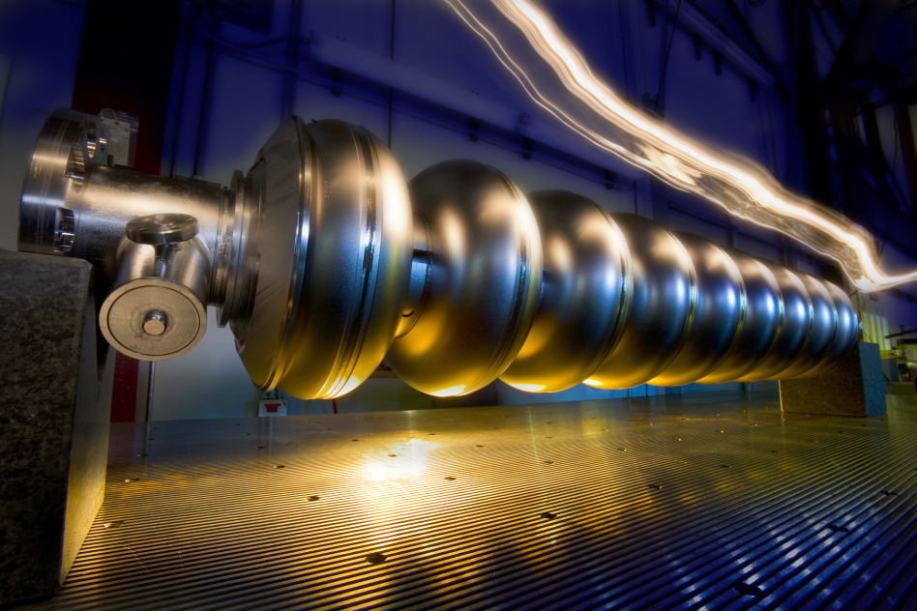
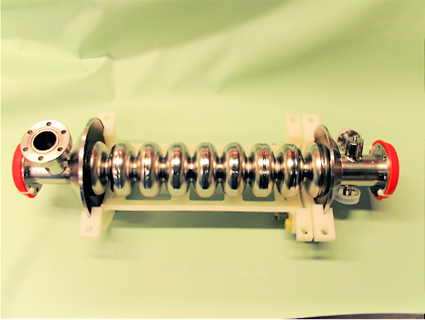
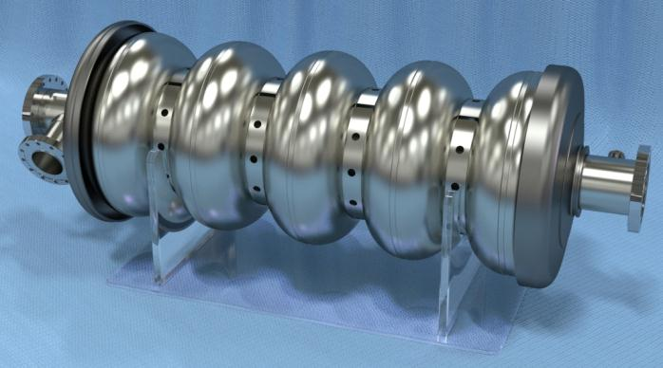
SRF Cavity Processing and Production Capabilities
1.3 GHz – LCLS-II
3.9 GHz – DESY FLASH/LCLS-II
650 MHz – PIP-II
325 MHz – PIP-II

Slide 4
Joint ANL/FNAL Superconducting Surface Processing Facility (SCSPF)
Primary production processing workhorse in SRF infrastructure
Collaborative facility located at ANL operated jointly by FNAL and ANL
Both FNAL and ANL employees staff facility full time
Developed with 1.3 GHz cavities as focus, but flexible tooling allows processing of multiple cavity types (650 MHz elliptical, 325 MHz spoke, QWRs, HWRs, 3.9 GHz elliptical)
Great example of a long and fruitful collaborative relationship with another DOE lab.

Slide 5
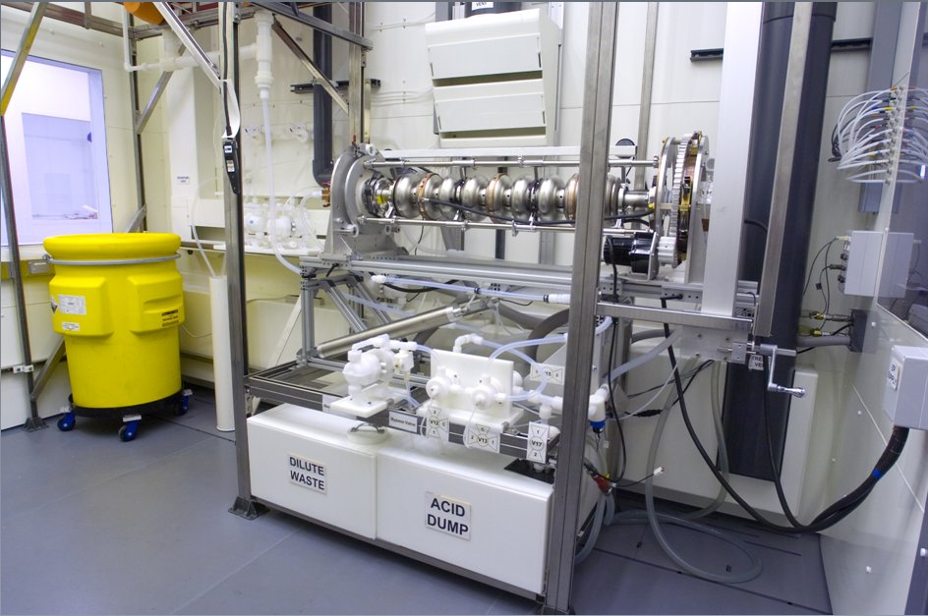
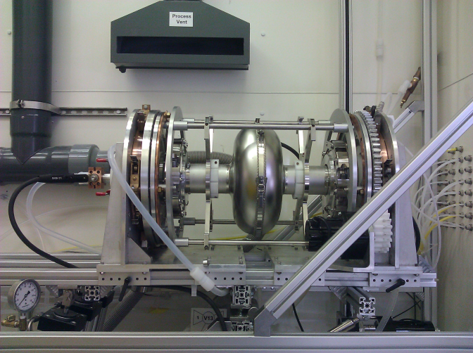
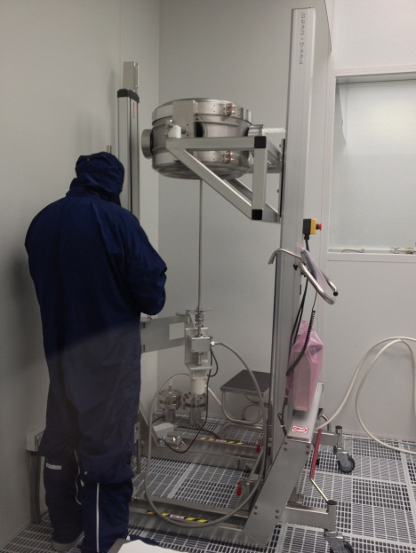
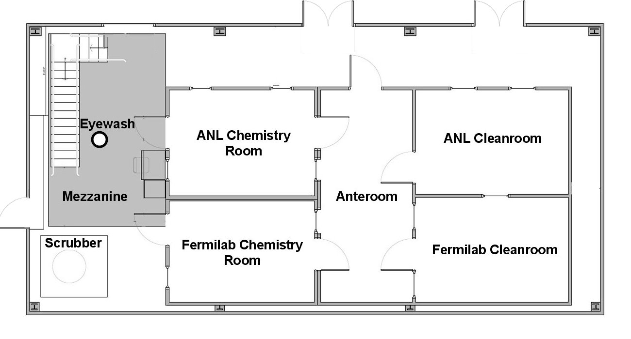
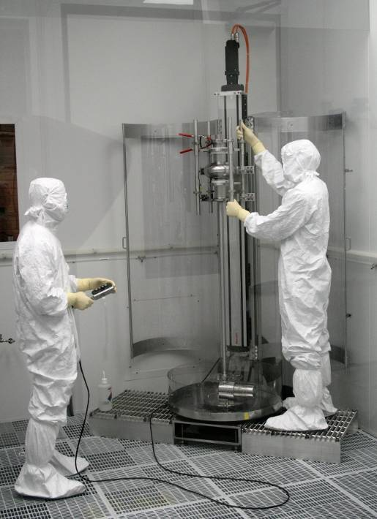
SCSPF Layout
1.3 GHz Cavity Electropolishing,
325 MHz BCP
650 MHz Cavity
Electropolishing
SSR Cavity Rinsing
Chemistry
Room 1
Chemistry
Room 2
1.3 GHz Cavity Rinsing/Assem

Slide 6
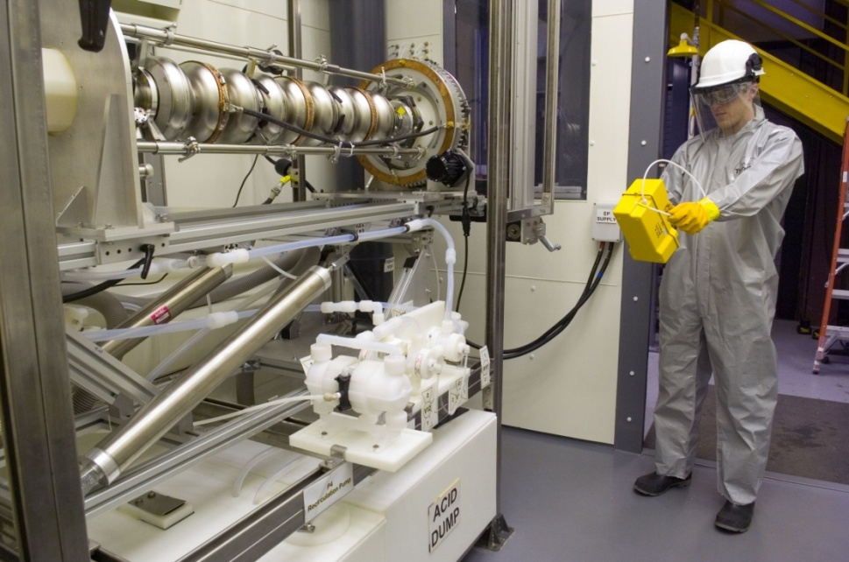
SCSPF 1.3 GHz EP/BCP Tool
*ANL designed/built—S. Gerbick
Tool capable of 1.3 GHz EP for bare AND dressed cavities + BCP of 325 MHz SSR and other cavity types.

Slide 7
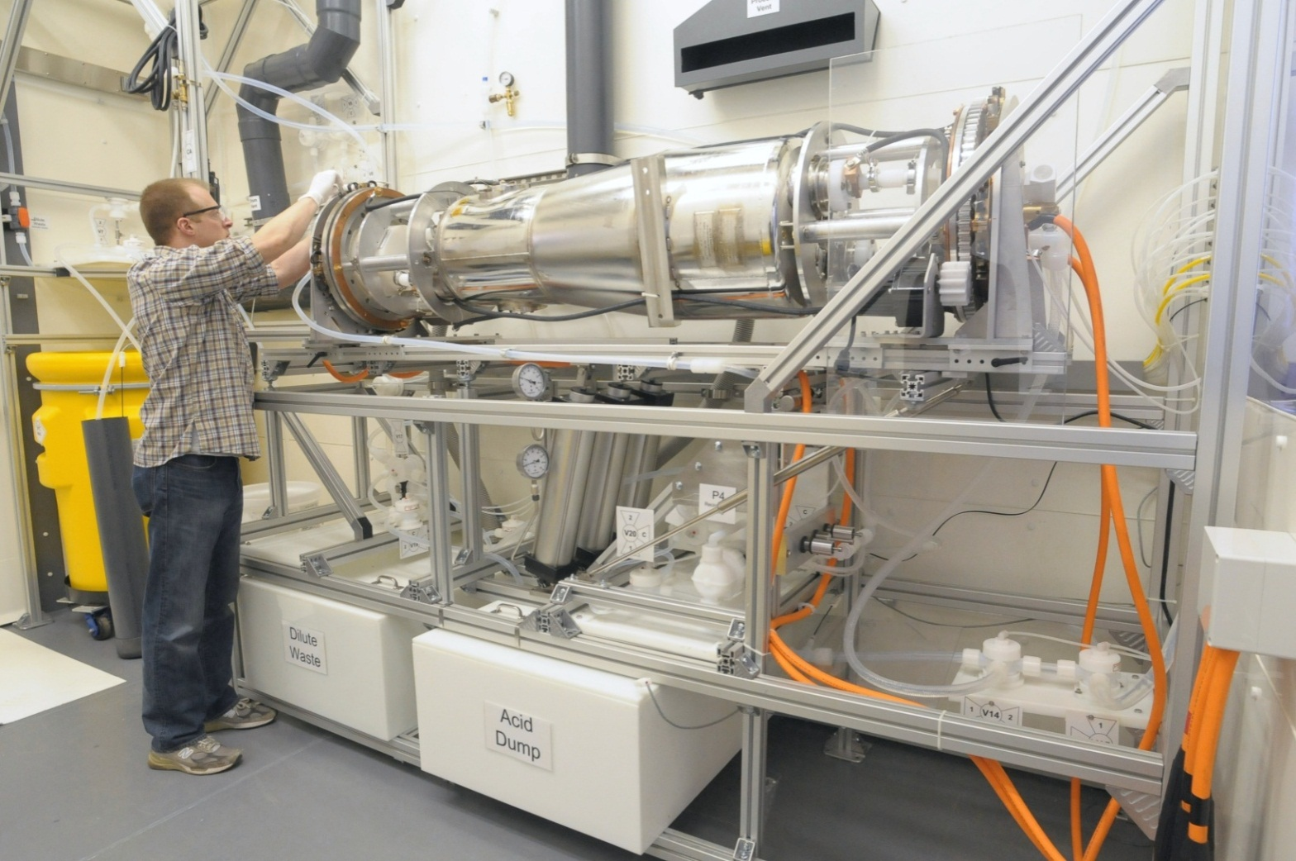
SCSPF Large Cavity EP/BCP Tool
*ANL designed/built—S. Gerbick
Designed for 72.5 MHz Low Beta QWR + 650 MHz Elliptical Cavities

Slide 8
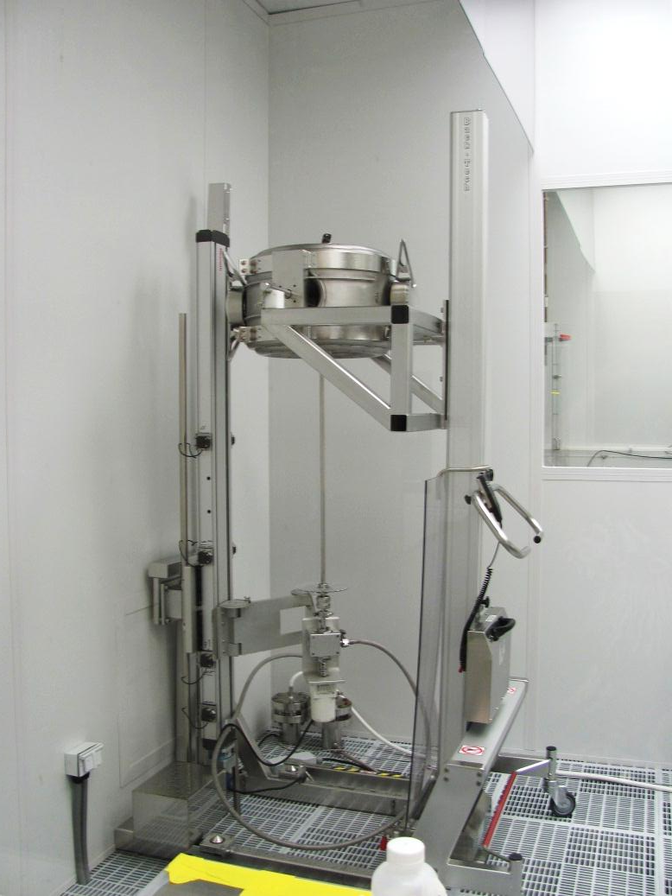
SCSPF High Pressure Rinse Tools
FNAL HPR Tool with 1.3 GHz 9-cell
ANL HPR Tool—325 MHz / QWR

Slide 9
IB4 CPL Summary (Cavity Processing Laboratory)
Cleanroom Preparation
HPR/clean assembly & test preparation
Hydrogen degassing of 1.3 GHz cavities
UHV Class 10 CR area/US cleaning (1.3 GHz + 650 MHz elliptical cavities)
Surface Removal/Repair R&D
1.3 GHz/650 MHz 1-cell R&D Facility
EP—alternative electrolytes, High Q, etc.
1.3 GHz/650 MHz cavity CBP development area
Future SRF advanced processing techniques (CVD, ALD)
New CBP machine capable of multiple 650 MHz elliptical cavities in-house to be commissioned
Production capabilities include EP, VT prep, HT prep, CBP for 1.3 GHz

Slide 10
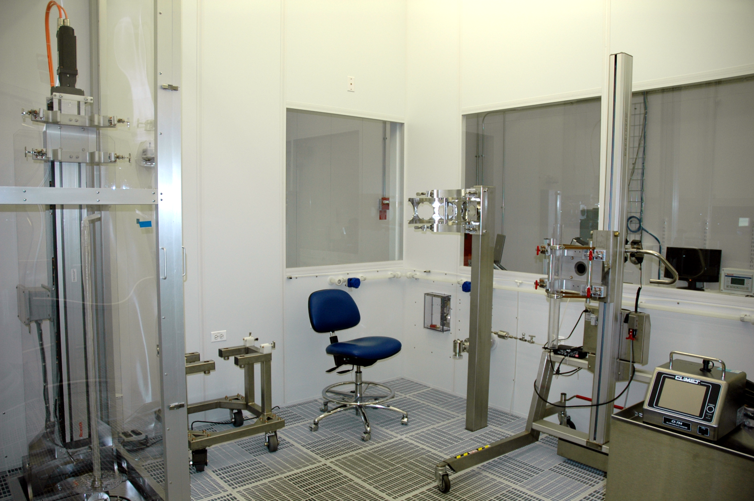
IB4 CPL Class 10 Cleanroom/HPR
HPR Tool, Clean Assembly Rail, Cavity Carts, 1.3 GHz, 650 MHz

Slide 11
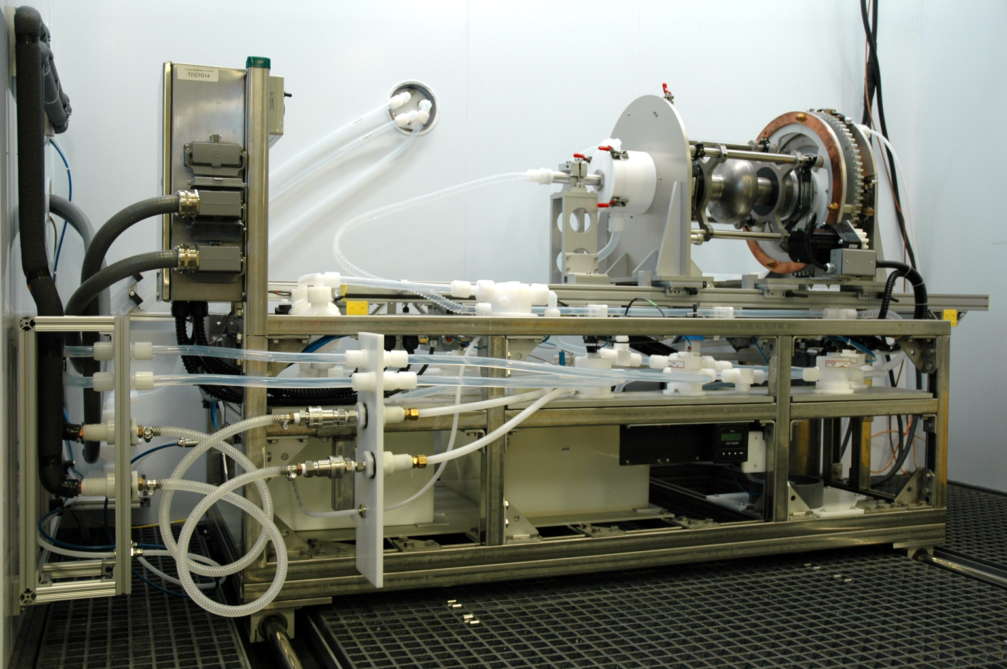
IB4 CPL EP Tool (1.3 GHz 1-cell R&D)
Upgradable EP tool may accommodate 1.3 GHz 9-cell.

Slide 12
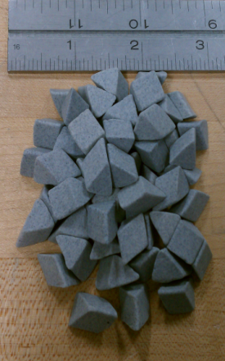
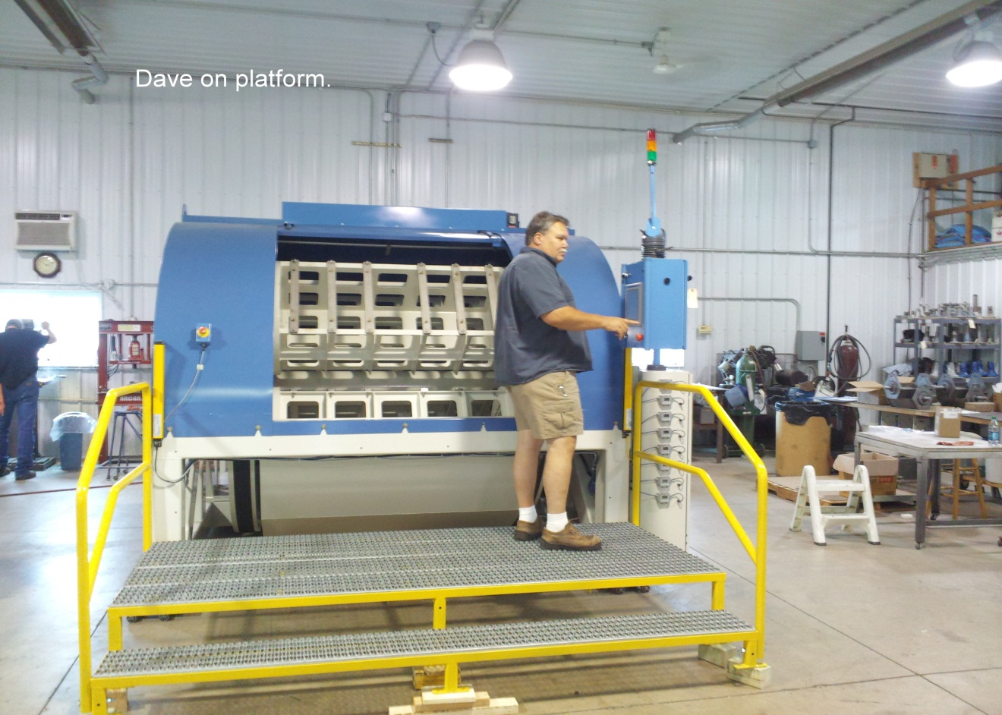
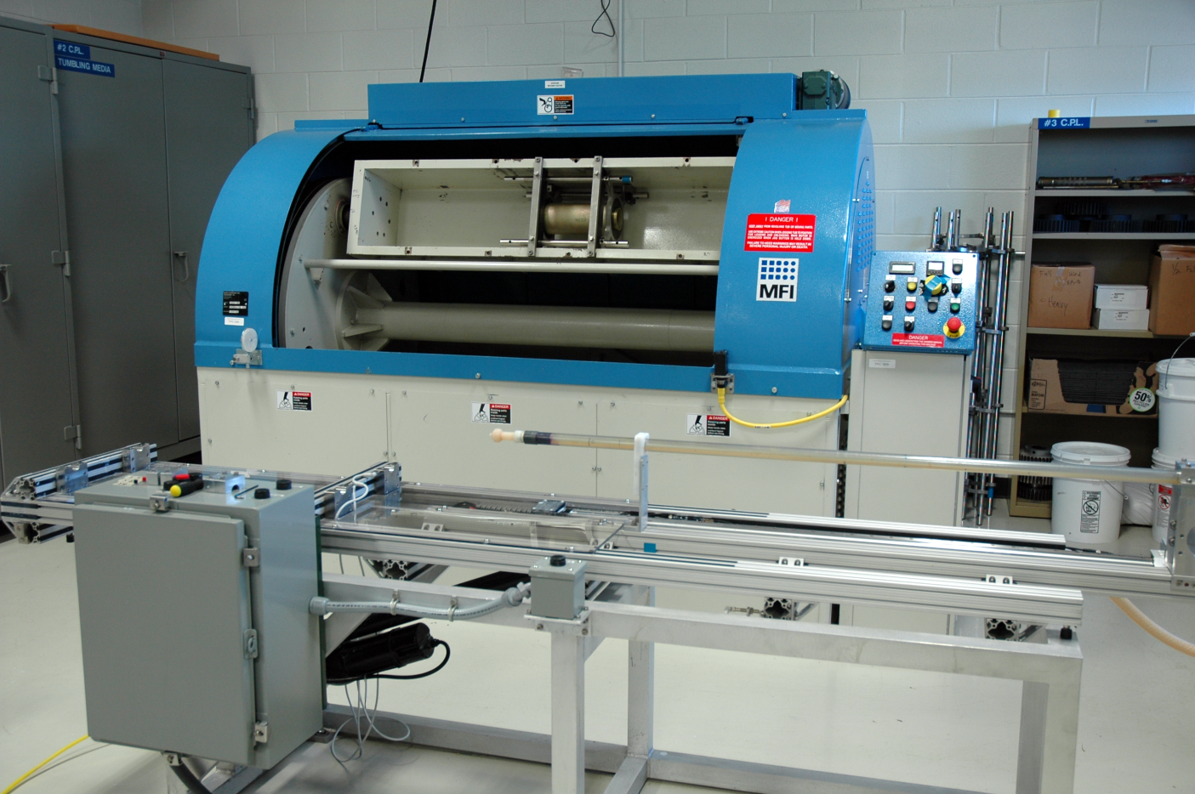
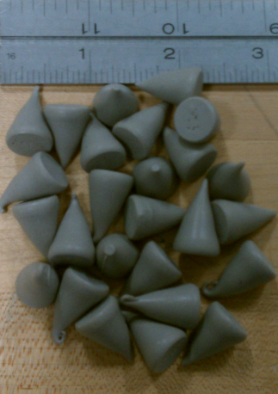
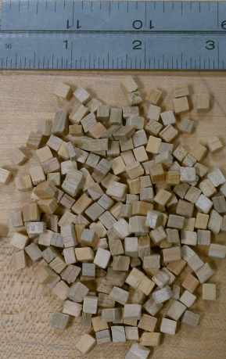
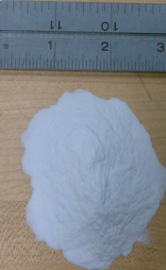
IB4 CPL CBP Machine
1.3 GHz Tumbler
650 MHz Tumbler
Tumbles 2 cavities/run, 2 complete cycles/week
C. Cooper Recipe Media

Slide 13
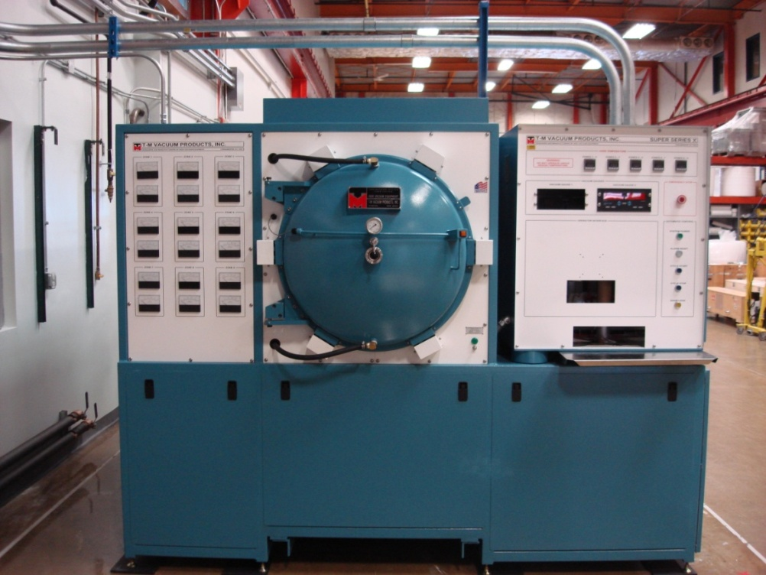
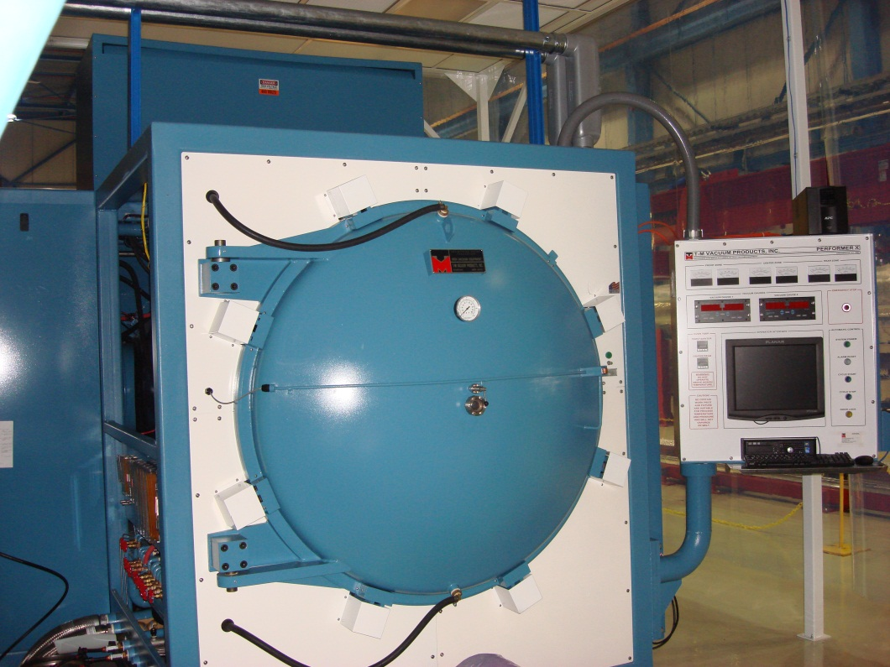
FNAL Vacuum Ovens Hydrogen Removal, N2 Doping, Nb3Sn
IB4 Vacuum Oven—1.3 GHz
MP9 Vacuum Oven – up to 400MHz Elliptical
Oven Parameters | Values
Bake cycles | 3/wk IB4, 2/wk MP9
Operating Temp | 1000C
Vacuum Pressure | <1 x10^-6 Torr
Hydrogen reduction | 99% drop in H2 RGA peak
Manufacturer:
T- M Vacuum Products Inc.
*Source: M. Wong (FNAL)

Slide 14
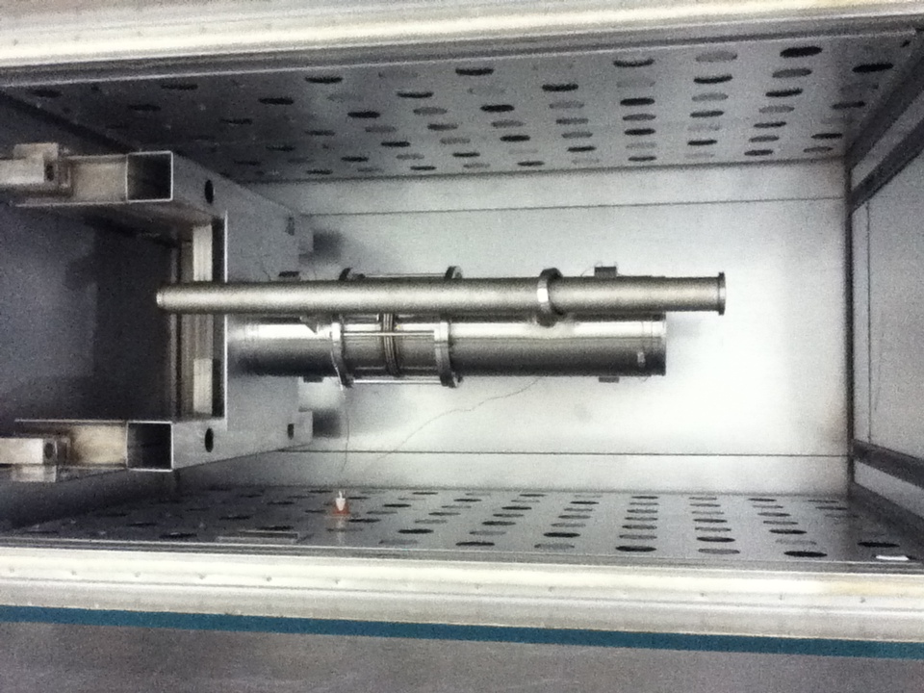
FNAL Low Temp (120-300C) Ovens
Two ovens
UHV RGA cavity monitoring

Slide 15
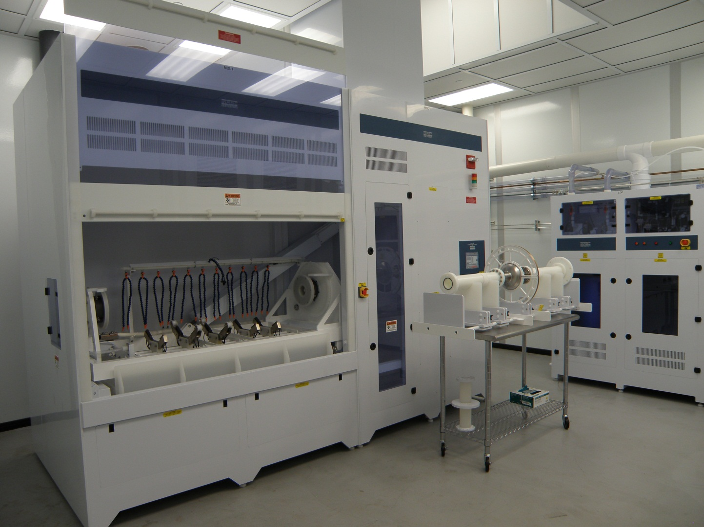
Industrial Capabilities - AES
EP Tool for elliptical cavities sized up to 650 MHz 5-cell.
HPR up to 1000 lb structures.
BCP up to 1000 lb. structures.
CR Area (adequate for basic CR work)
ARRA funded industrial EP Tool located at AES.

Slide 16
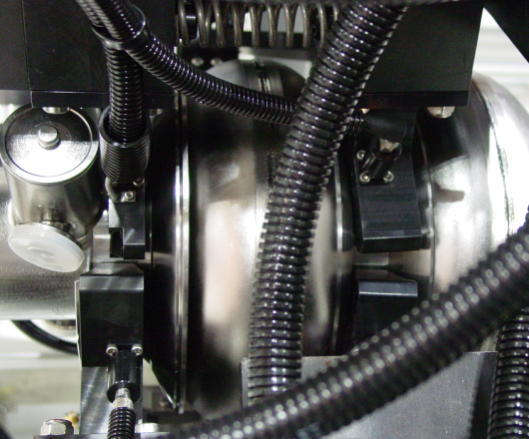
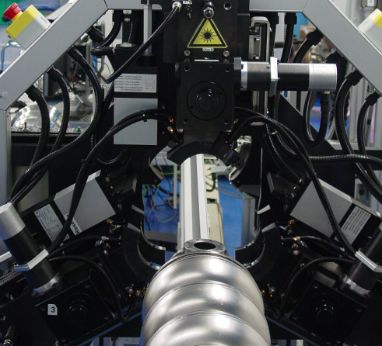
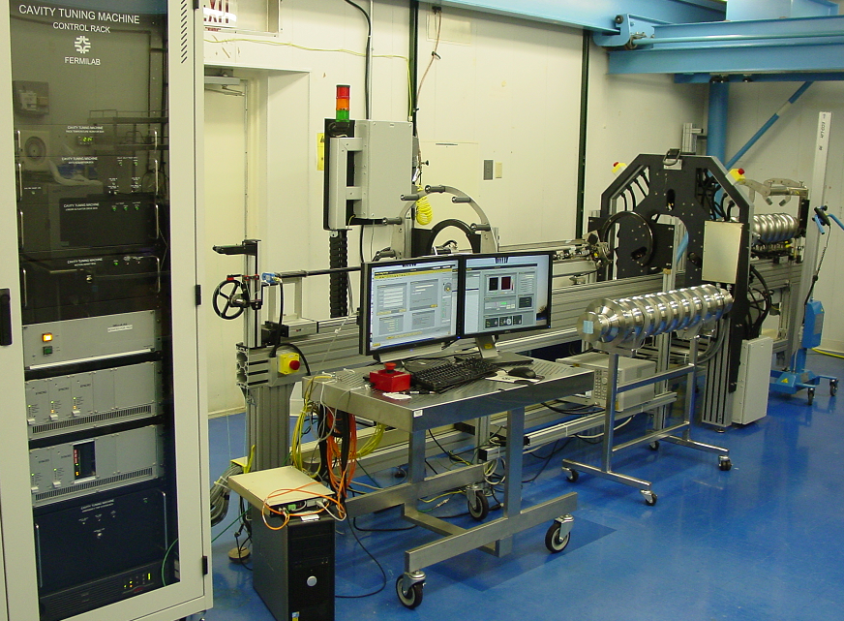
ILC/XFEL cavity RF Tuning Machine
Four Cavity Tuning Machines were built under FNAL/DESY/KEK collaboration. Mechanical components design and production made by DESY. Electronics and software developed by FNAL. Commissioning of all machines done in 2010.
High level of automation Labview based software control system allow to finish RF QC, frequency/field flatness tuning and alignment of the cavity in average of 4 hours.
Two Machines shipped to XFEL cavity production companies.
Operation of the Machine can be done in 24/7 regime.
*Source: T. Khabiboulline(FNAL)

Slide 17
Concluding Remarks
FNAL has developed substantial in-house and industrial SRF cavity processing capabilities, especially for 1.3 GHz.
Processing rate for > 1 CM/month possible in existing, or slightly modified facilities.
Wealth of cavity processing experts, especially in 1.3 GHz technology in all areas of development.
Strong, active collaborations with other SRF labs ensure FNAL remains ‘state-of-the-art’ in processing technology.
Field-leading processing R&D program tailored to LCLS-II, PIP-II, and other proposed machines.

