Slide 1
ILC/LCLS-II experience,
Power couplers and HOM couplers,
Dark Current and Radiation
3.9 GHz system
N.Solyak
March 9, 2016

Slide 2
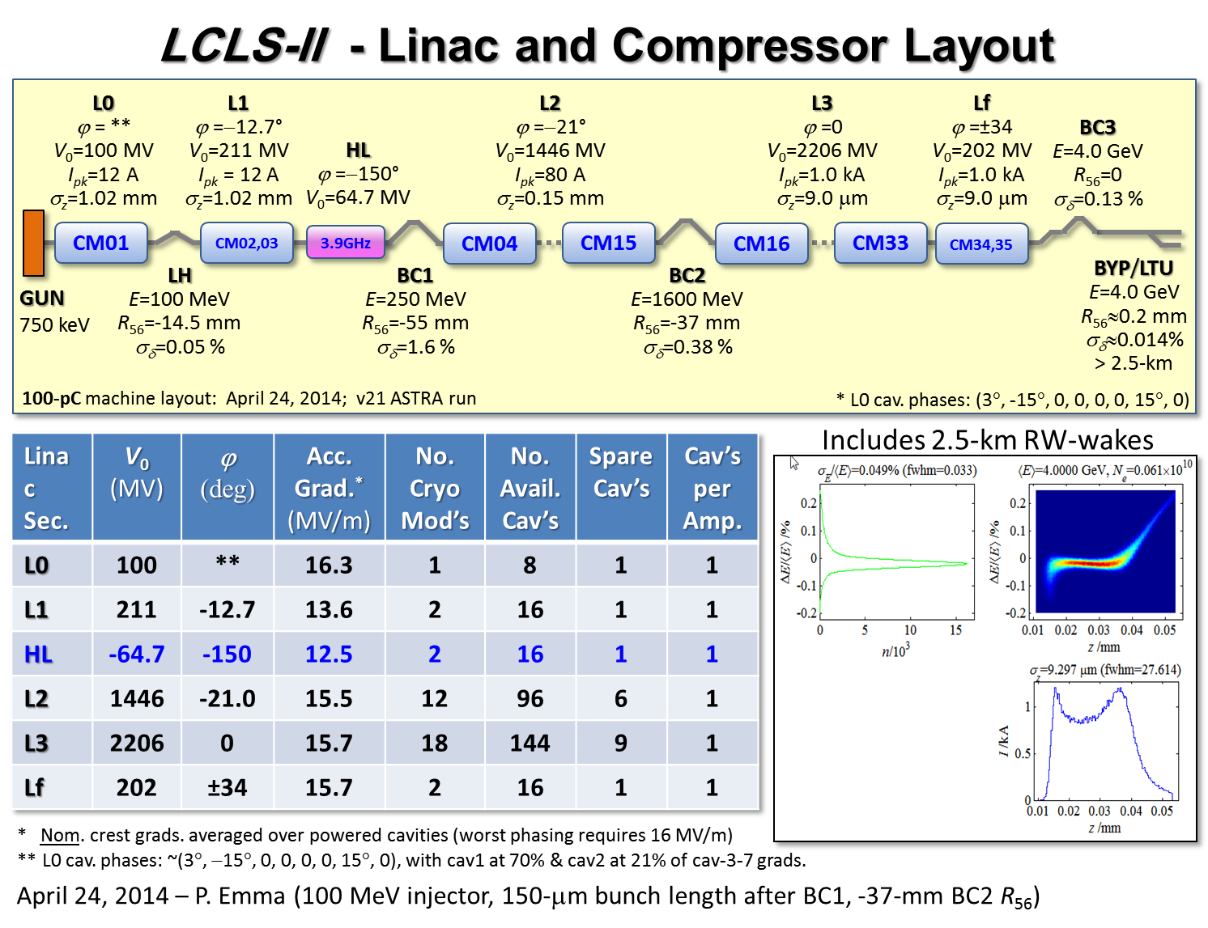
See PRD:
LCLSII-2.4-PR-0041
Linac RF and Compression
48
48
No CSR here

Slide 3
Major challenges of the LCLS-II
SCRF LInac is based on XFEL/ILC technology, but utilize 100% duty cycle
Some studies/experience on extension of this technology to high rep. rate or cw are at HZB/BESSY, Cornell, JLAB and DESY
High gradient (16MV/m) at CW regime:
  High dynamic heat loads in CM ~10W→ ~ 100W
  Redesign of the some components: coupler, HOM,
  Redesign 3.9GHz cavity, coupler
  Dark current and Radiation
High beam power (1.2 MW; 0.3mA x 4 GeV)
  - Collimation system and diagnostics
Very short bunch length ~ 9 µm, I_{pk} ~ 1kA
      - Wakefields, heating of the cavities and beampipes, BLA
Very low emittances (at undulators)
    Preservation of low emittances from injector to the end, alignments
Low injection energy (350-700 keV)
  - Sensitivity to misalignments/errors/field imperfections/

Slide 4
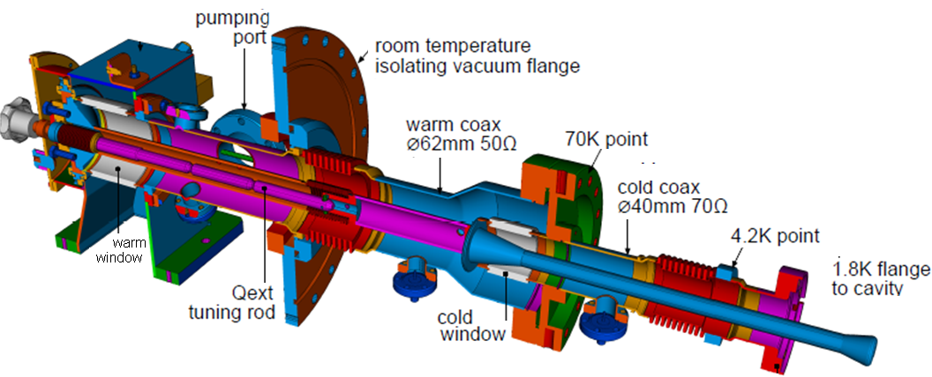
Fundamental Power Coupler (FPC)
XFEL coupler is not satisfy LCLS-II requirements
  Tuning range (1.e6-1.e7) not cover LCLS-II reqs: 4.e7
  Average power limited by ~3kW
For LCLS-II two modifications done:
  Cut antenna 8.5 mm to increase Q_{ext} = 1.e7-1.e8 Increase Cu plating of internal inner conductor of warm section from 30 to 100 μm to eliminate overheating. (power limit ~6kW at full reflection)
MARIE reqs: P_{av}~170kW x 5.7 % ~10kW → air cooled FPC (HZB)

Slide 5
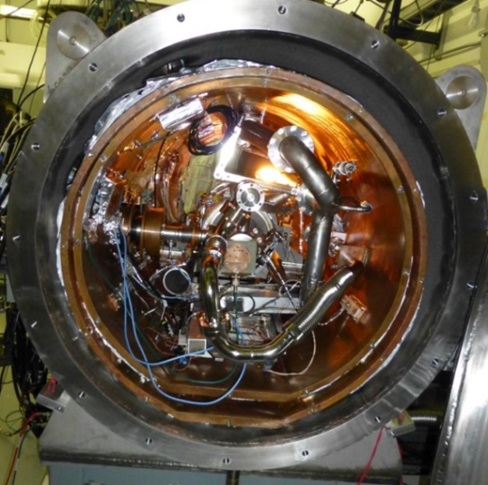
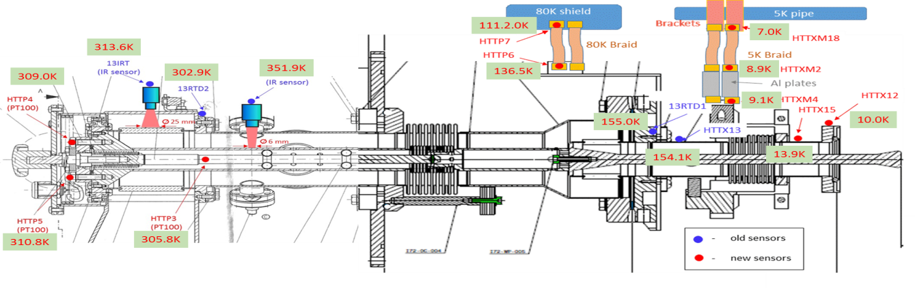
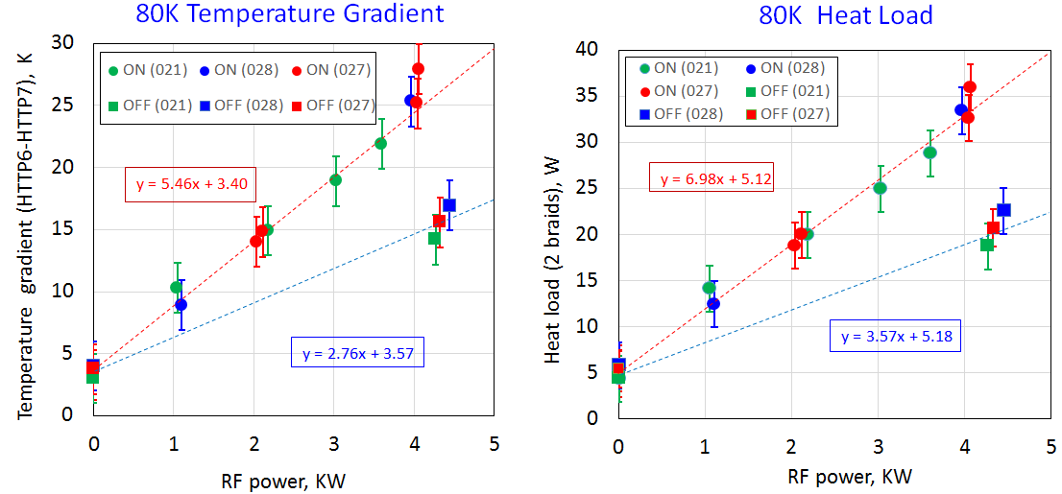
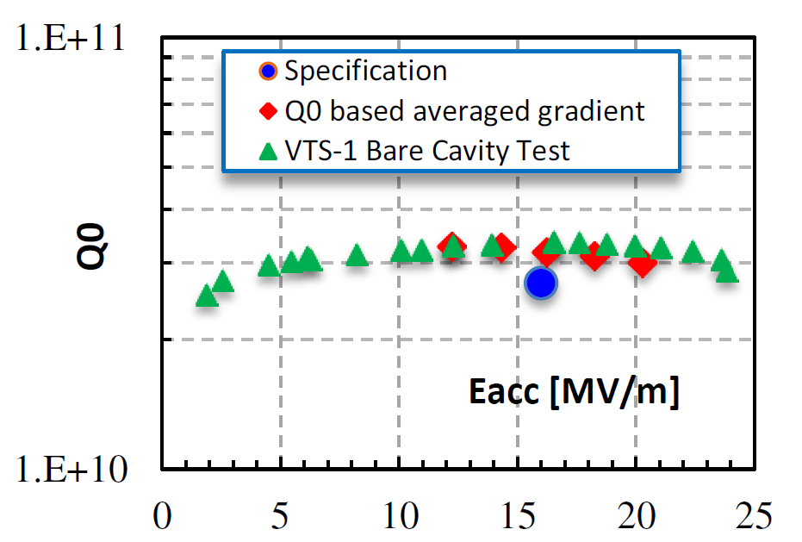
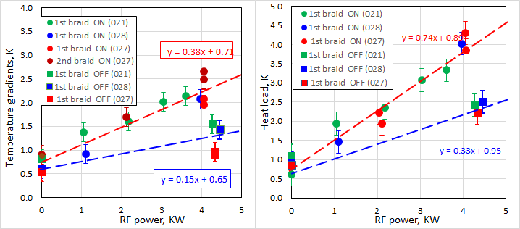
FPC test in HTS (DV)
AES028: 4kW, cav. on resonance
5K
5K

Slide 6
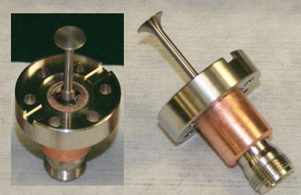
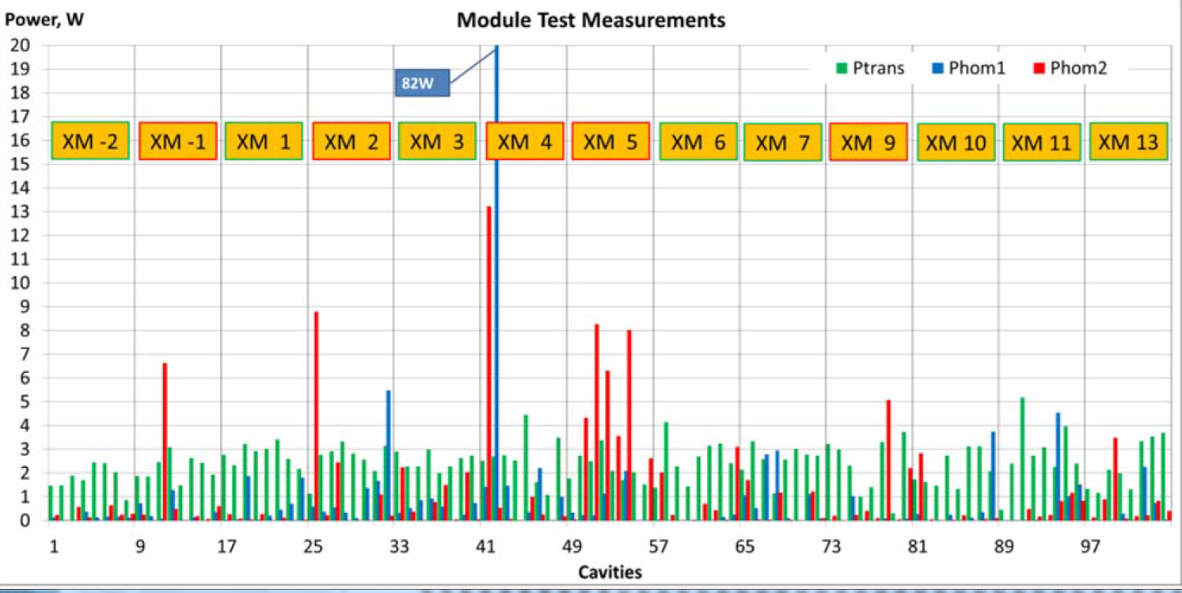
1.3GHz HOM couplers
Major Issues:
  MP free design, but few narrow bands at 1-2 MV/m and 33-34 MV/m; increased probability at 8-10 MV/m (soft MP).
    Need good cleaning and HPR to eliminate contaminations
  Antenna heating from accelerating field → improved in XFEL feedthrough
  Power leakage from fundamental mode (tuning notch filter)
    LCLS-II < 1W; XFEL: some cavities have ~10 W (24MV/m)
  HOM power from beam
  Total HOM power is limited by cable heat: LCLS-II <10 W; ILC ~ 3-4 W

Slide 7
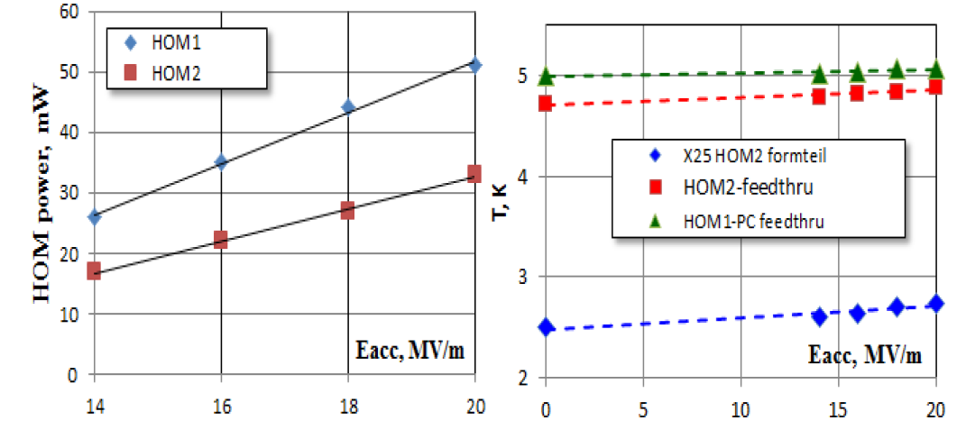
HOM measurements at HTS (DV)
Cavity AES021
In properly tuned HOM coupler, power leakage from fundamental mode well below 0.5W (max measured ~ 0.3W). Good thermal connection to 2K helium pipe is important.

Slide 8

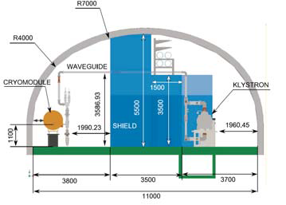
Dark Current and radiation in ILC and LCLS-II linac
Halo particle and Dark current in ILC Main Linac produce radiation, which affect:
  Beamline components and cables inside of CM
  electronics outside of CM in Main Linac section of tunnel
  Electronics and personnel in service tunnel
ILC DC model:
FN model with β=100
Cav2cav distance 5.75 λ ➔ DC acceleration only in one direction.
Uniform distribution of DC → 50nA/cavity (LCLS-II: 1-10 nA/cavity)
Thickness of wall (1.5-3.5m) separating service and operational facility is determined by max beam losses in tunnel
Cross section of Kamaboko tunnel
Notes:
Major contribution to beam losses comes from Failed elements.

Slide 9
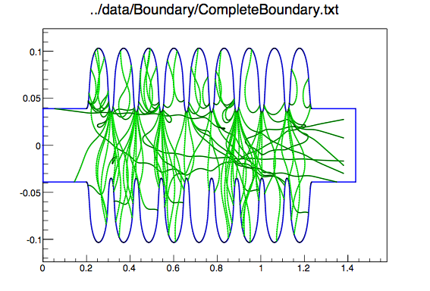
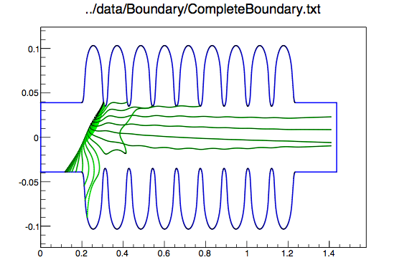
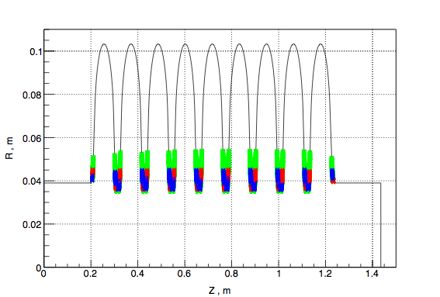
Trajectories
100 k trajectories | Sum of FN
Absorbed in cavity | 92.2 %
Exit to the left | 3.78 %
Exit to the right | 3.99 %
In ILC - DC accelerated upstream
LCLS-II both
100k emitters random in phase and location with weight > 0.01
  green - lost in cavity, red - exit to the right, blue - exit to the left

Slide 10
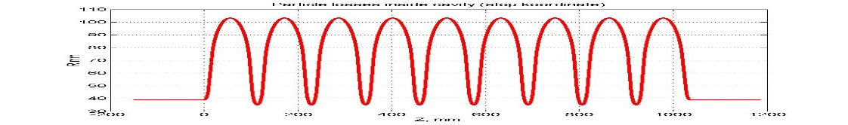
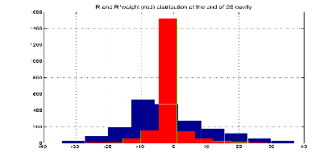
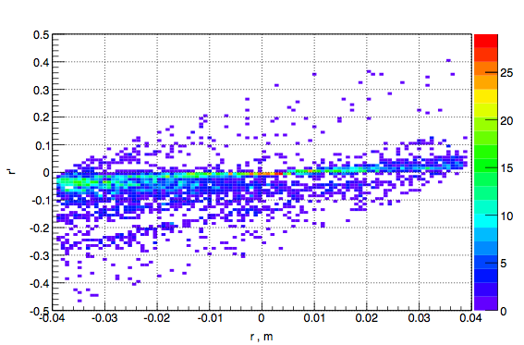
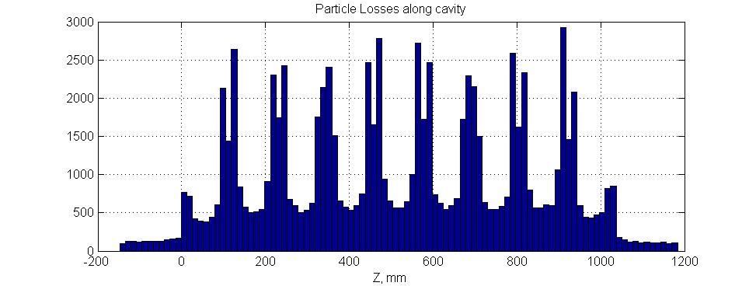
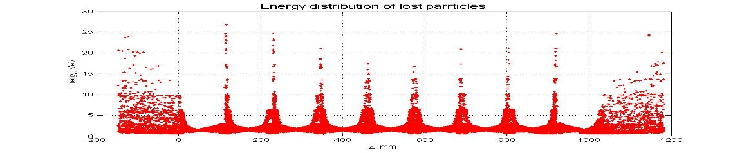
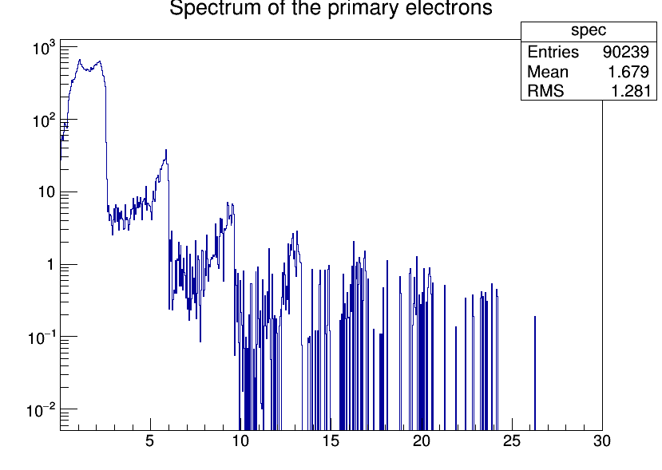
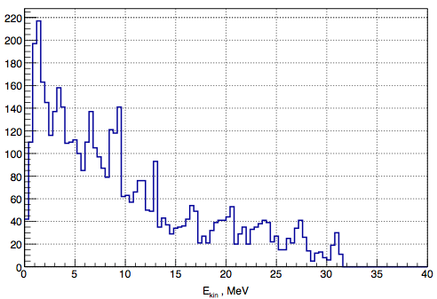
Particles leaving cavity(4%+4%)
Particles lost in cavity (92%)
R’ vs R
~ 3 MeV/cell
Spectrum
4cells
same cell
2cells
3cells

Slide 11
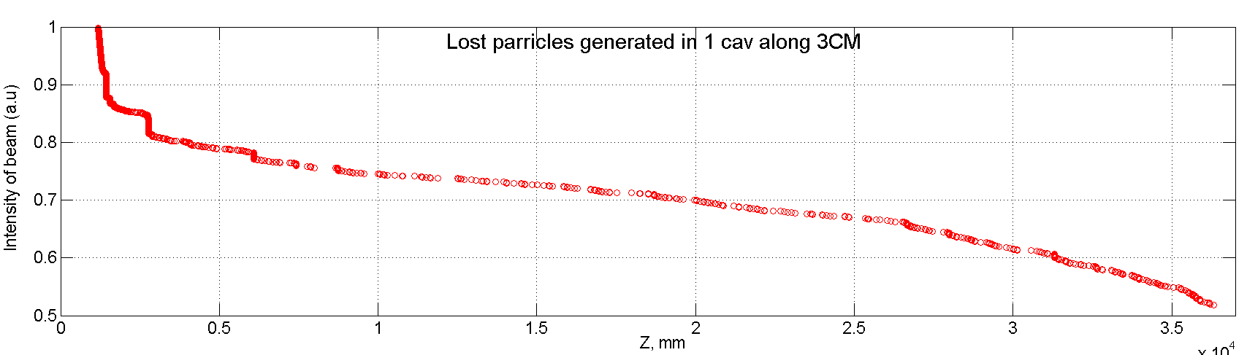
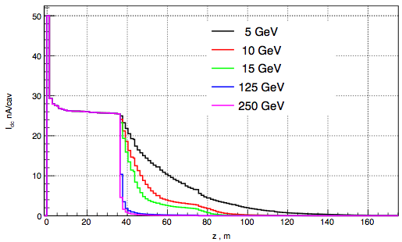
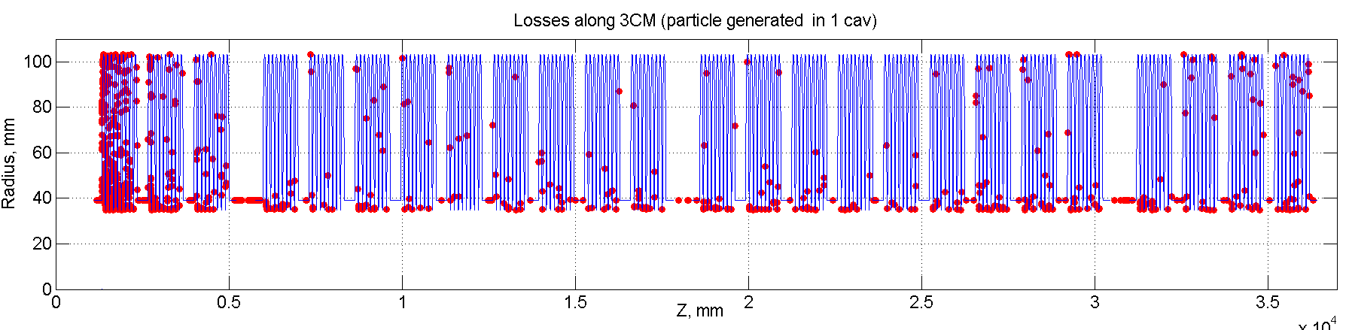
Losses in 3 CM’s (between nearest quads)
100K particle generated in 1st cavity, 4% survived and tracked thru 3CM’s
50% of them lost in chain of cavities, the rest will reach quad.
Most particles are lost at irisis. Decelerated particle can stop and kicked to the wall

Slide 12
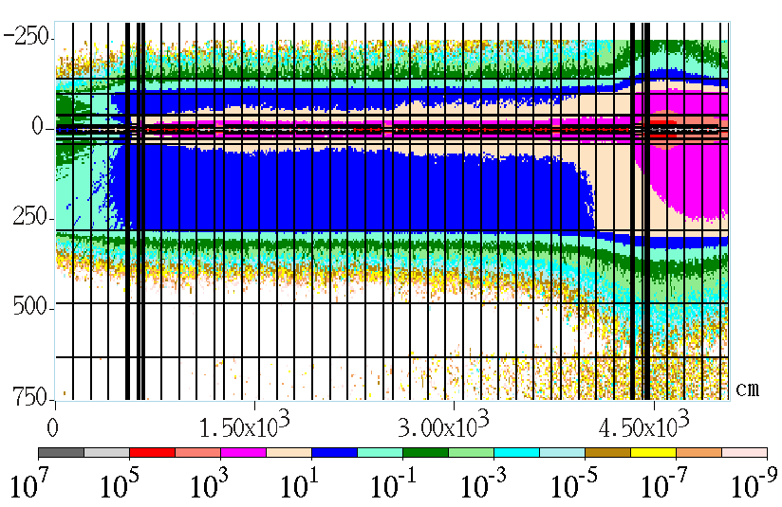
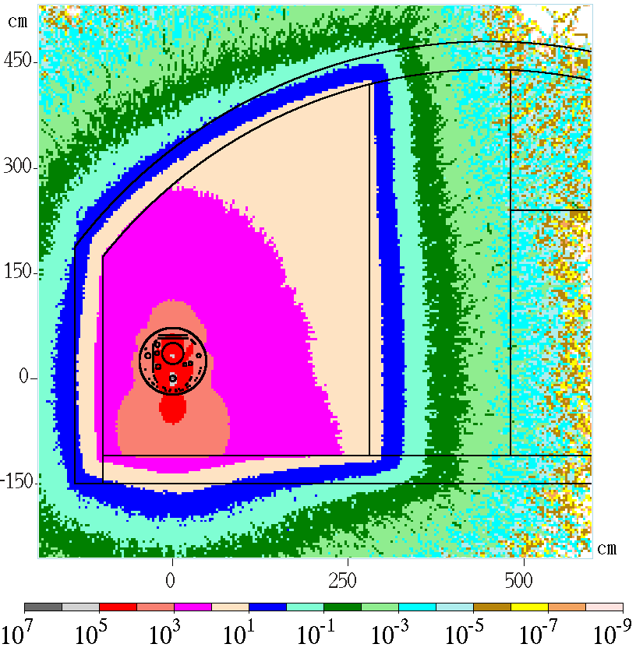
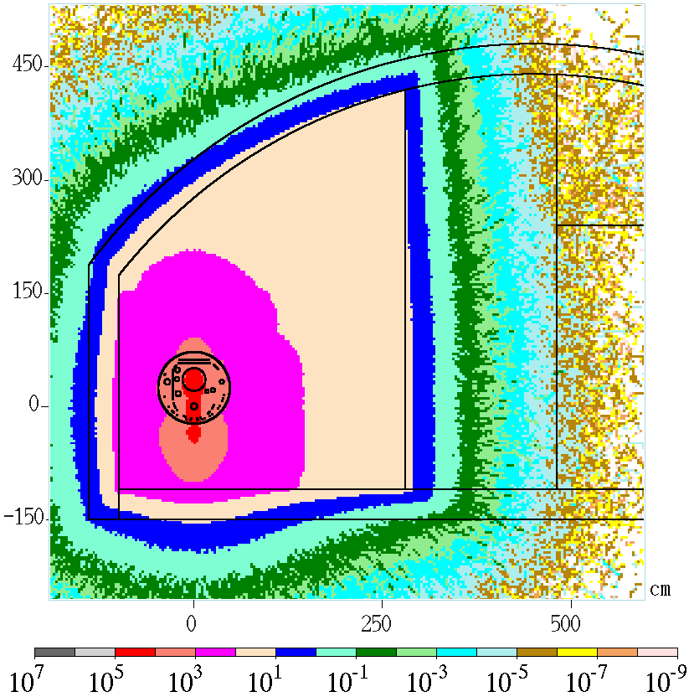
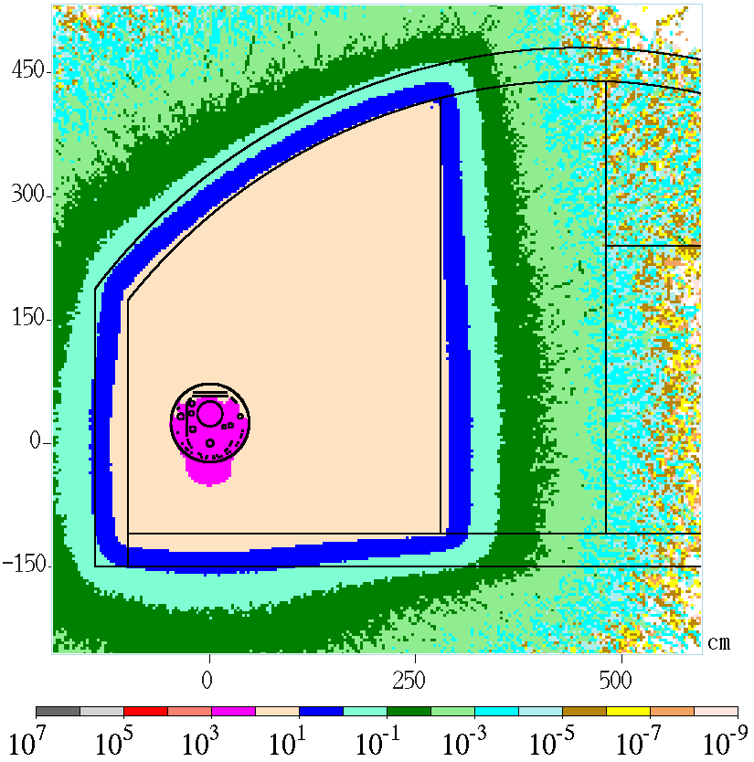
Dose after quad (250GeV): mSv/h
Total dose
Contribution from photons
Contribution from neutrons

Slide 13
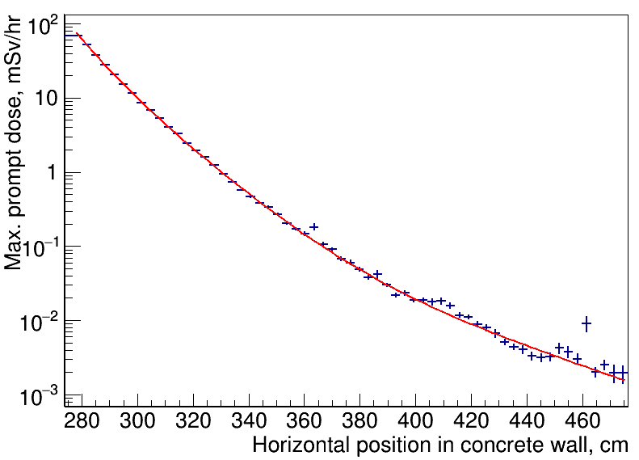
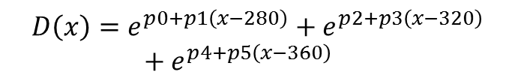
Radiation dose vs. concrete wall thickness
Fit for attenuation curve for prompt dose, mSv/hr
$$D\left(x\right)=e^{p0+p1\left(x−280\right)}+e^{p2+p3\left(x−320\right)}+e^{p4+p5\left(x−360\right)}$$
p0 = 3.42573e+00
p1 = -7.14516e-02
p2 =- 1.68580e+00
P3 = -1.27563e-01
P4 = -3.14138e+00
P5 = -2.89486e-02
25uSv/h (~1.2m)
1.5m
Prompt dose attenuation in concrete wall

Slide 14
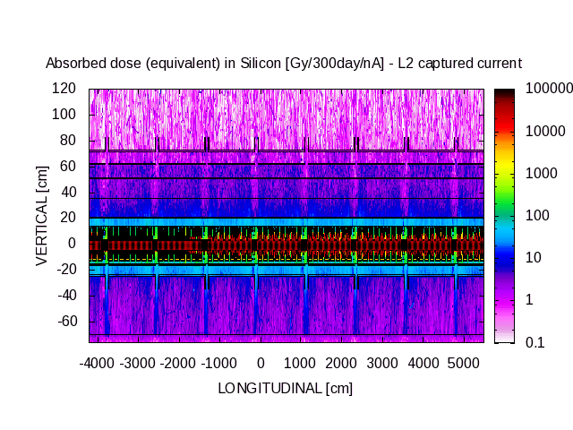

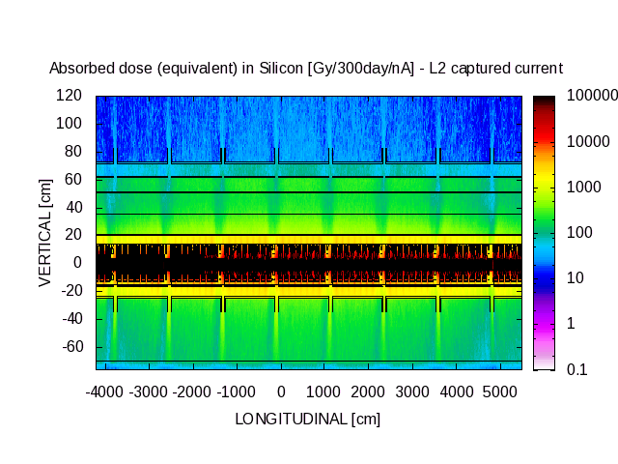
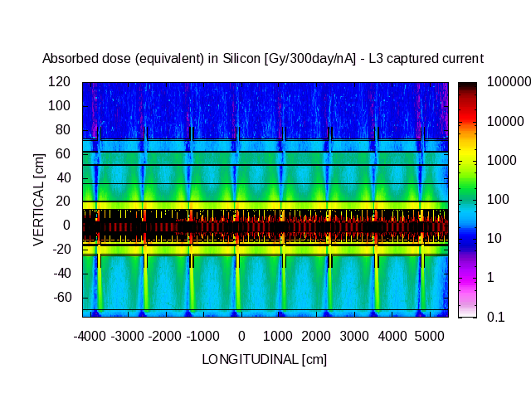
LCLS-II: Effect of quad settings on radiation dose
0 MeV
Vertical [cm]
[Gy/300d/nA]
700 MeV
Vertical [cm]
Settings at 700 MeV are the worst for radiation to the cryomodules as field emission is accelerated but ultimately is lost, depositing most energy
4000 MeV
Vertical [cm]
MSL - 2015
Longitudinal [cm]
M.Santana/SLAC

Slide 15
LCLS-II: 3.9 GHz system design
2CMs (8 cavities each) + 1 spare CM in baseline
16 MV/m; Q0=(1.5-3)e9; 72MV total voltage
Phase= -90-180 deg.
RF power ~ up to 1kW;
Coupler ~2 kW (1.5kW from beam)
Misalignments ~0.5mm

Slide 16
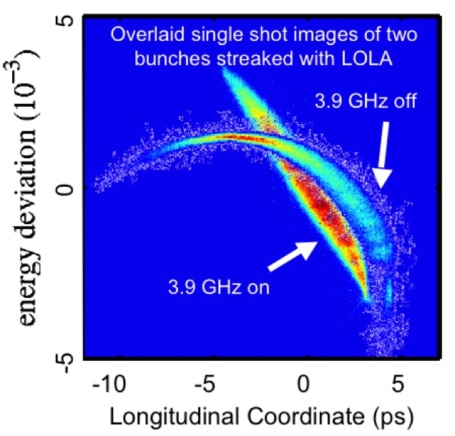
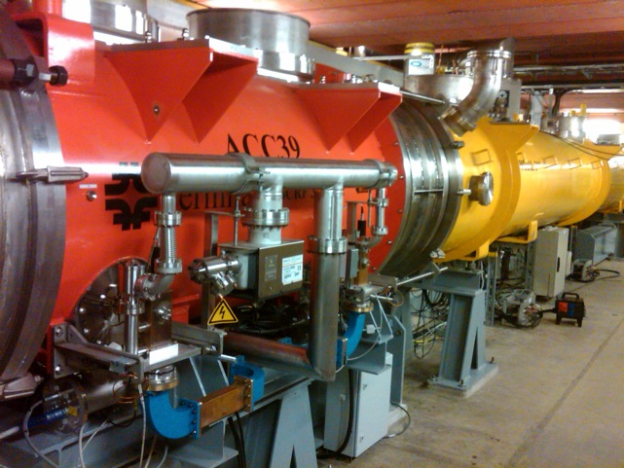
FLASH - ACC39 performance
ACC39 routinely operates at 18.9 to 19.7 MV/m
  Capable of operation at 22 MV/m
    - Limitation set by thermal interlocks – concern about compromising HOM’s on cavities 3 & 5 (trimmed 2-post style)
Amplitude stability ≤ 2x10⁻⁵ pulse-to-pulse
Phase stability ≤ 0.003° pulse-to-pulse
16

Slide 17
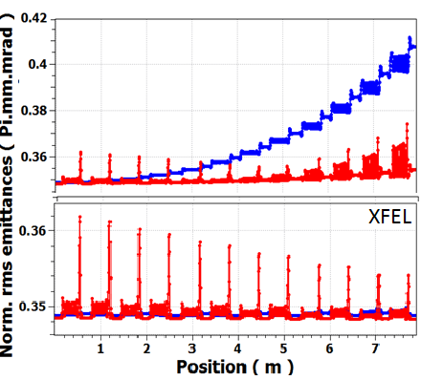
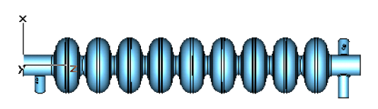
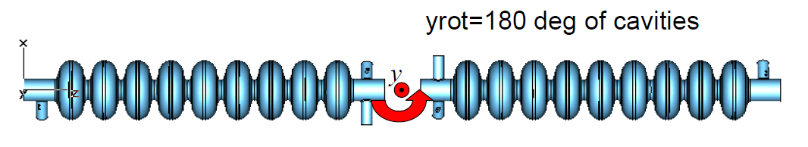
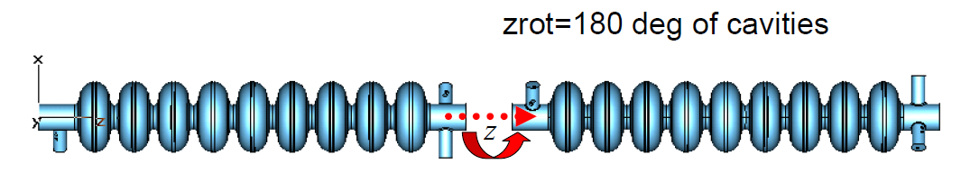
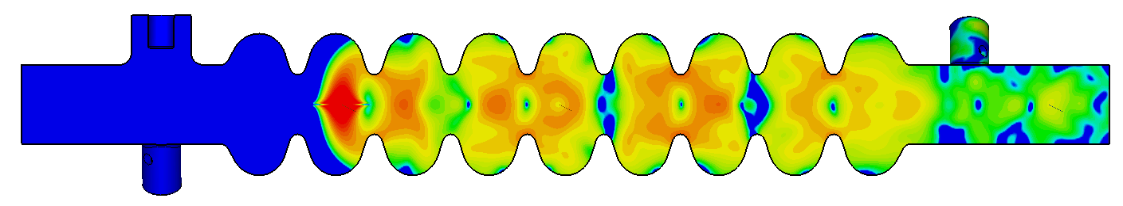
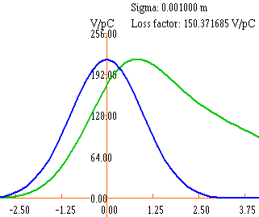
3.9 GHz Cryomodule Options and wakefields
1.3GHz like Cryomodule Layout:
ε_{y}
ε_{x}
FLASH-like Cryomodule Layout:
XFEL/LCLS2 Cryomodule Layout:
Wakesfields:
 | 1.3GHz-like | XFEL/LCLS2
Δε_{x} % | 6 .0 | 0.09
Δε_{y} % | 24.4 | 0.15
Integrated Longitudinal wake in one CM; klossv~v154 V/pC→ 14W in CW for 1mm bunch length (rms), 0.3mA

Slide 18
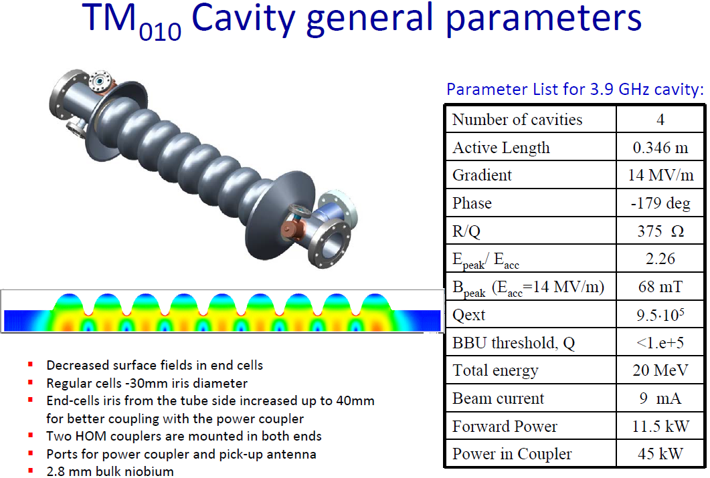
4.8
FLASH
750
Iris Aperture: 30mm vs. 70mm (ratio 2.34)
E_{p}/E_{acc} ; 2.26 vs. 2.0 (13% higher)
H_{p}/E_{acc}(mT/MV/m) 4.86 vs. 4.26 (14% higher)
R/Q (Ohm) 750 vs. 1000
BCS resistance ratio (f²) (9 times higher)
Comparison
3.9 GHz vs. 1.3 GHz:

Slide 19
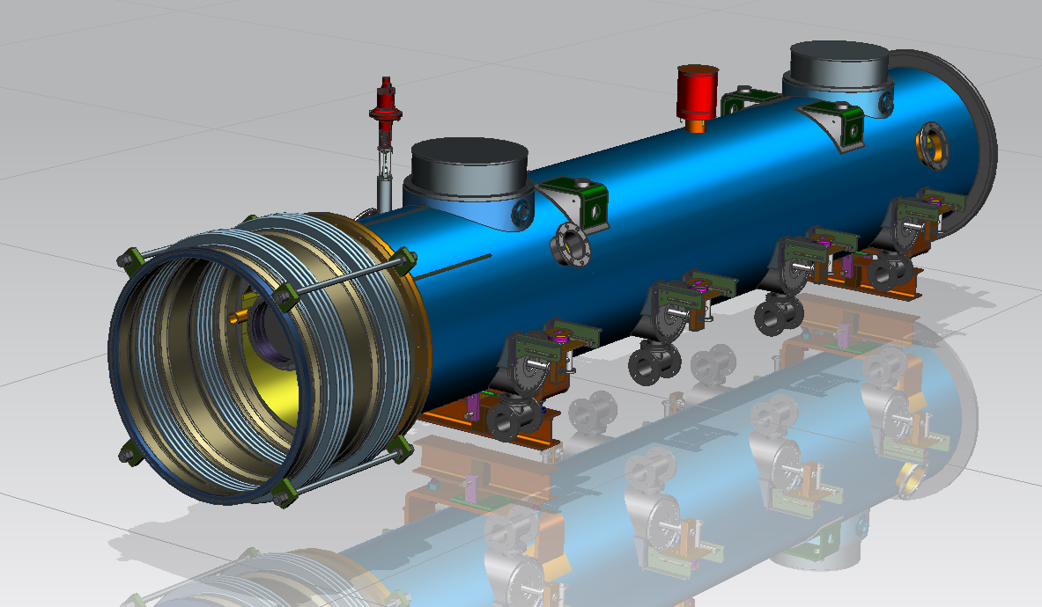
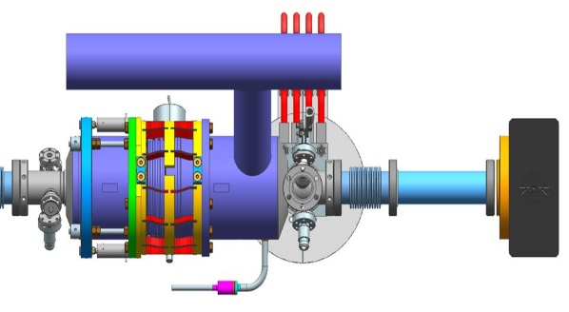
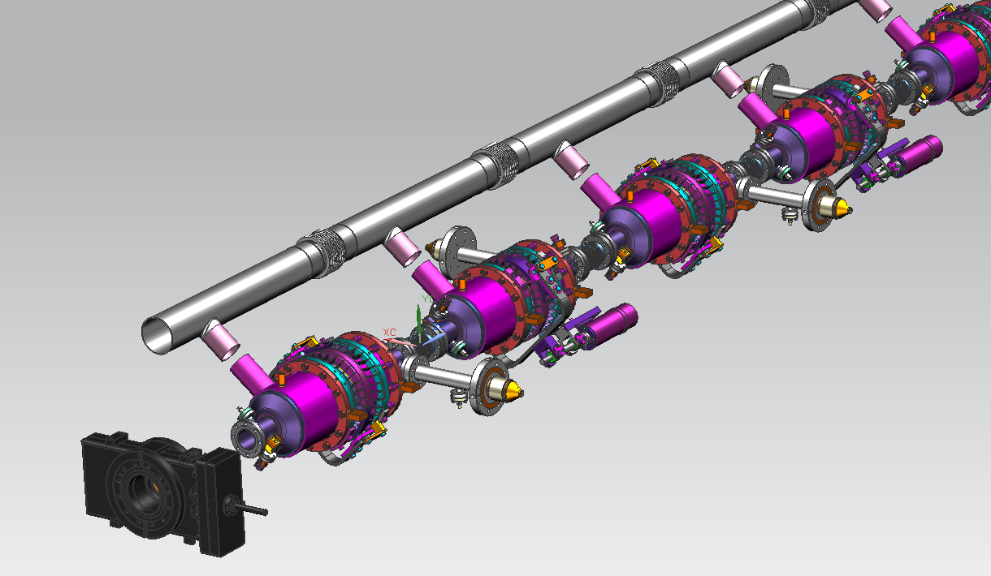
LCLS-II 3.9GHz Cryomodule
8 - 3.9GHz cavities
Power couplers from both sides
2-coldmass supports
Interconnection sliding bellow
38” OD vacuum vessel pipe
One thermo shields:50K
5K intercept
3.9 cavity Style-B
3.9 cavity Style-A

Slide 20
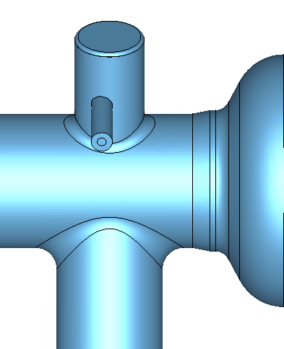
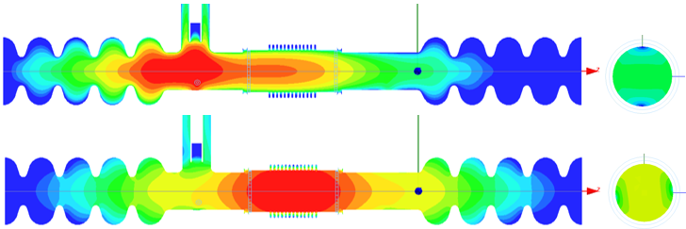
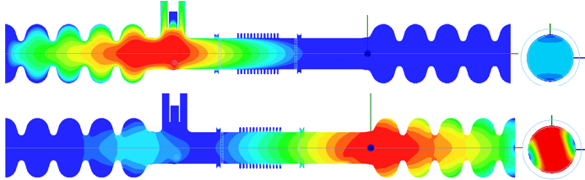
LCLS-II 3.9 GHz cavity design
For LCLS-II few modifications done in FNAL/INFN design to reduce risks and eliminate tuning and heating problems:
        Reduce beam pipe and bellow diameter from 40 to 38mm (shift trapped mode)
        HOM F-part modification possibilities in order to reduce feethru antenna heating (quench limit ~20MV/m in cw)
        Bellows between cavities 43➔38mm
FLASH: Lowest Dipole HOMs. Beam Pipe Ø 40 mm and Bellows Ø 42 mm.
5mm
F = 3.992 GHz, Q_{E} = 3.6e4
F = 4.047 GHz, Q_{E} = 8.0e4
Ø38 mm
LCLS2: Lowest Dipole HOMs. Beam Pipe Ø 38 mm and Bellows Ø 38 mm.
F = 4.092 GHz, Q_{E} = 2.7e4
F = 4.188 GHz, Q_{E} = 7.4e3
  A. Lunin/ T.Khabiboulline
Lowest dipole mode frequency shifted by 100 MHz up away from operating mode frequency.

Slide 21
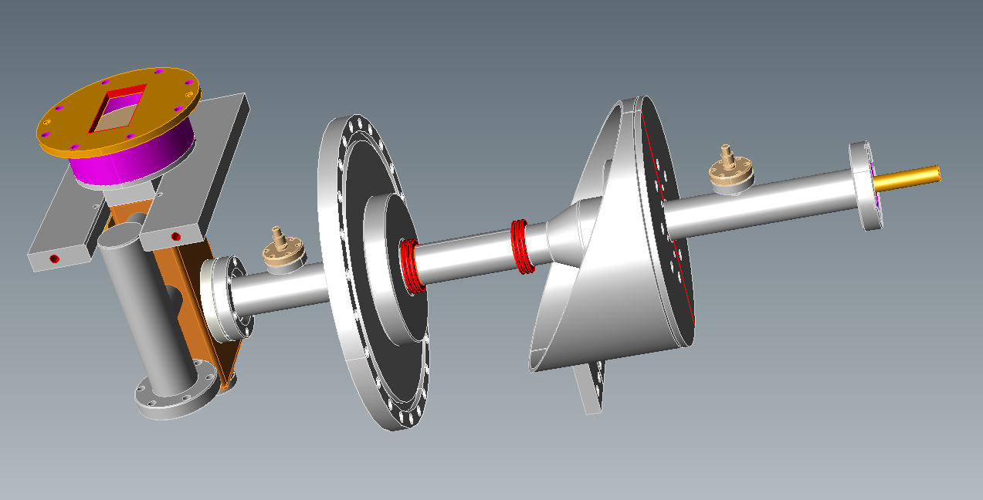
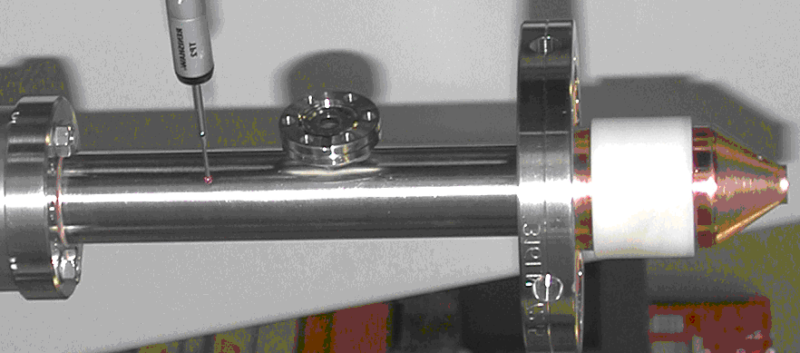


Main Coupler Design
Cold part
Warm part (outer conductor)
Good for 0.5kW average power and 80kW peak power.
Coupler Modifications for 2kW avrg power
Cold part (upper picture)
Dimensions of ceramic window
Length of antenna (Qext=2.9e7)
inner conductor of warm section
  Cu plating increased: 30 →150 um
  Shorter bellows
Warm part (inner conductor) and WG with pillbox window

Slide 22


SS inner conductor and bellows, copper plated
I.Gonin
T=150K
T=320K
T=10K
SS Inner Conductor + bellows plating | T max, K | Losses, 80K | Losses, 4K
30 microns plating | ~1000 | 9.2 | 0.8
100 microns plating | 507 | 9.3 | 0.8
150 microns plating | 427 | 9.4 | 0.8
Pin=2kW TW,
10μm on outer,
RRR=50; ASE,
10% roughness
ε=9.8, tan=3e-4,

Slide 23
Conclusion
FNAL has large experience and great expertise in all aspects of SC system design, prototyping and testing RF and cryogenic components and fully integrated systems (CM).
Beam physics studies is part of our expertise, including lattice design, low emittance beam transport, wakefield effects, beam-based alignment algorithms, etc.
Team is strongly involved in ILC, LCLS-II, PIP-II projects.

