Slide 1
SRF Cavities Resonance Control
FNAL experience
Presented by Yuriy Pischalnikov
for Resonance Control Group
Fermilab- Los Alamos MaRIE Project Meeting
March 9, 2016.

Slide 2
Outline
  Tuner design (1.3GHz & 3.9GHz)
    Parameters of tuner
    Reliability of the tuner- reliable electromechanical actuator & piezo actuator
    ALT test of piezo.. Heating of the piezo (60Hz repetition rate and high amplitude of voltage on piezo… )
  Active Resonance Control
    Developed at FNAL Adaptive Least Square Algorithm for LFD compensation…
    Developed in frame of ILC program… successfully applied for different tuner/cavity system and different RF pulses (1msec; 8 msec, …)
    FNAL algorithm compensate not only “flat-top” but also LFD during “ RF-fill” (DESY algorithm can’t compensate “RF-fill”)
    “60 Hz” repetition rate === microphonics from previous pulse…
Yu.Pischalnikov, FNAL-MaRIE Project Meeting, March 9, 2016

Slide 3
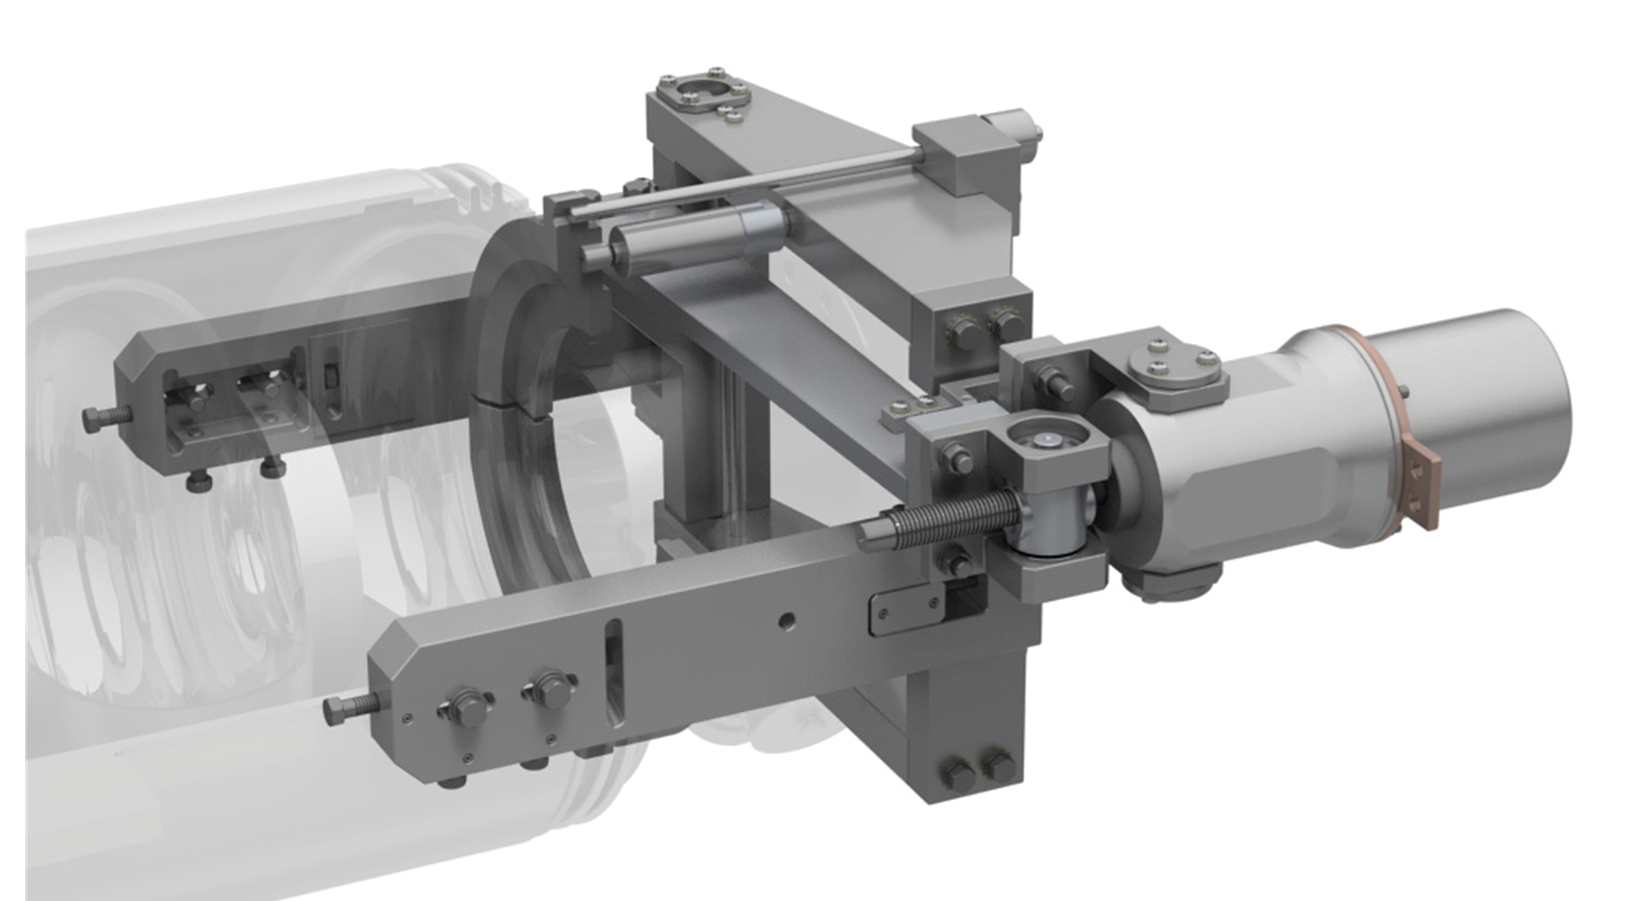
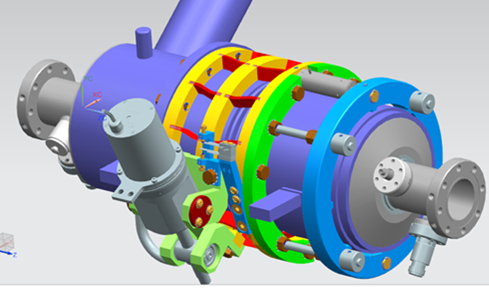
LCLS II SRF Cavity tuners
(designed/tested and manufactured at FNAL)
1.3 GHz
Coarse tuner range – 600kHz
Piezo tuner range – 3 kHz
Coarse tuner
resolution - 1.3Hz/step
Piezo tuner resolution - 0.1Hz
Y. Pischalnikov, et al. “Design and Test of Compact Tuner for Narrow Bandwidth SRF Cavities”, IPAC2015, Richmond, VA, USA
Blade tuner
(adopted from INFN)
& piezo tuner
3.9 GHz
Coarse tuner range – 750kHz
Piezo tuner range – >10 kHz
Coarse tuner
resolution - 10Hz/step
Piezo tuner resolution - 1 Hz
Yu.Pischalnikov, FNAL-MaRIE Project Meeting, March 9, 2016

Slide 4
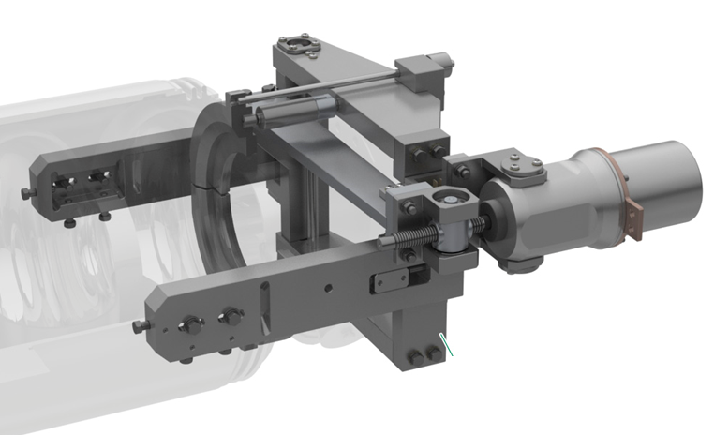
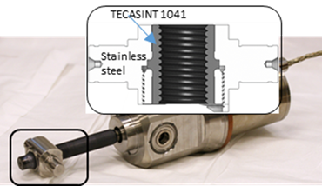
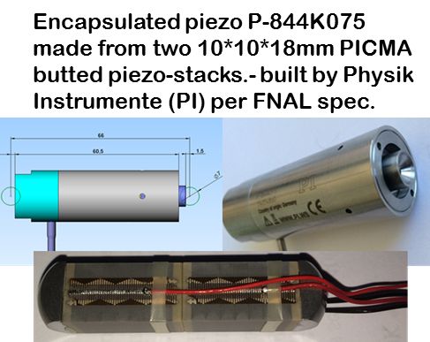
Tuner reliability
(R&D program in collaboration with Phytron and PI (Physics Instrumente) to develop reliable active components for the tuner)
RELIABILITY OF THE LCLS II SRF CAVITY TUNER
Yu.Pischalnikov, et al. SRF 2015
Electromechanical Actuator (LVA 52-LCLS II-UHVC-X1):
- Phytron stepper motor
- Planetary gear box (1:50)
- M12X1 spindle made form titanium
- Traveling nut made from SS with TECASINT-1041
Actuator tested for 30lifetimes of LCLS II
(600year operation)
Yu.Pischalnikov, FNAL-MaRIE Project Meeting, March 9, 2016

Slide 5
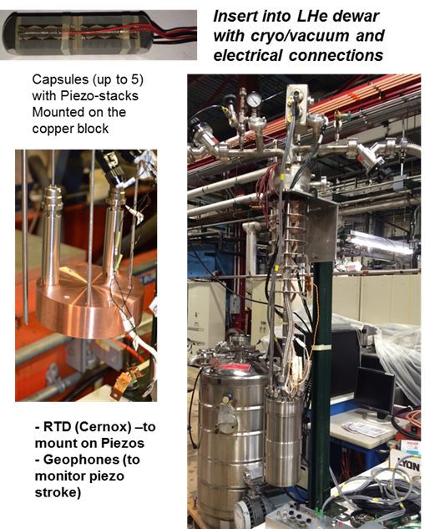
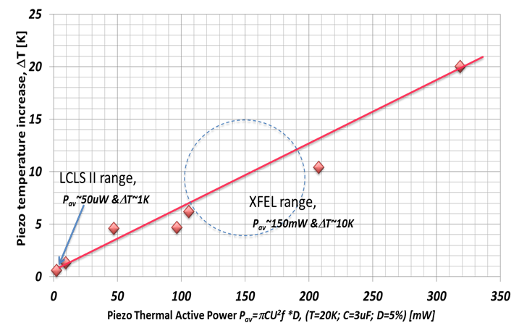

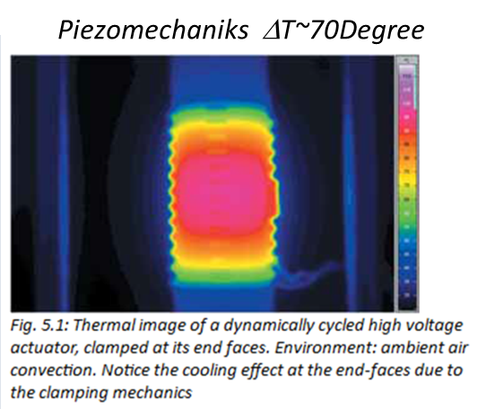
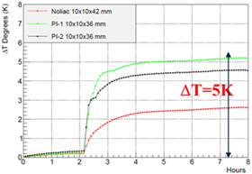
High reliability of tuner components (piezo-actuator)
Accelerated Piezo Lifetime test at FNAL
Designated facility at FNAL to test piezo at the CM environment (insulated vacuum and LHe)
LCLS II Tuner piezo-stacks run for 2.5*1010 pulses (or 125% of LCLS II expected lifetime) without any degradation or overheating
Yu.Pischalnikov, FNAL-MaRIE Project Meeting, March 9, 2016

Slide 6
Requirements to the piezo for operation in XFEL and LCLS II
Impact on the longevity of the piezo
 |  | XFEL/MaRIE | LCLS II | FNAL-test-stand (2month)
 | Operation | 10/60 pulses/sec | CW | CW
 | stimulus pulse, Hz | 200 (2 sinewave per pulse) | 40 | 5000
 | Vpp, V | 120 | 2 | 2
 | piezo stroke,[um] | 5 | 0.2 | 0.2
 | number pulses for 20 years | 1E+10 | 2E+10 | 2E+10
 | total stroke of piezo for 20years, [km] | 60/360 | 5 | 5
 | Piezo-stack motion speed (rms) (mm/s) | 4.5 | 0.02 | 2.2
 | Piezo-stack motion acceleration (rms)(g) | 0.6 | 0.0004 | 7
 | Heat dissipation, [mW] | 90/500 | 0.05 | 6
 | Piezo ΔT raised | 20K/ ~120K | 0.1K | 2K
P_{av}=πCU²f *D, where D is dissipation Factor (~5-20%)
estimated
measured
Yu.Pischalnikov, FNAL-MaRIE Project Meeting, March 9, 2016

Slide 7
FNAL experience in the field of development algorithms for active resonance control
Pulse machine - LFD compensation
  Development and implementation of Adaptive Least Square LFD Compensation Algorithm (for ILC…)/ deployed as part of control at NML (CM2)- 31.5MV/m cavities
  Successfully employed during tests at DESY (FLASH/EeXFEL) at KEK (S1Global) for 4 different type of Tesla tuners
  HINS - Illustrated for SSR1 pulse operation at 4K
  Project X – operation of the 9-cell tesla cavity at 8ms pulse
  PIP II – pulse operation of SSR1 & 650 MHz (most challenging – cavity with bandwidth 20-30Hz )
CW machine - microphonics compensation
  LCLS II project (narrow bandwidth cavity 20Hz and σ_{detuning}~1.5Hz)
  Successfully illustrated at HTS(FNAL) operation of LCLS II cavity with active compensation in the range of σ_{detuning} ~1Hz
    Combination of the several algorithm
      Feed-forward ~E_{acc}² (LFD);
      Feed-back/ slow for df/dp compensation
      Feed-back /fast to compensate external sources vibration
W. Schappert, Y.Pischalnikov, “Adaptive Compensation for Lorentz Force Detuning in Superconducting RF Cavities”. SRF2011, Chicago, USA.
Y. Pischalnikov, et al., “Lorentz Force Compensation for Long Pulses in SRF cavities” IPAC2012, New Orleans, LA, USA.
W.Schappert, et al., “Resonance Control for Narrow-Bandwidth, Superconducting RF Applications”., TUPB095, SRF2015, Whistler, BC, Canada
Yu.Pischalnikov, FNAL-MaRIE Project Meeting, March 9, 2016

Slide 8
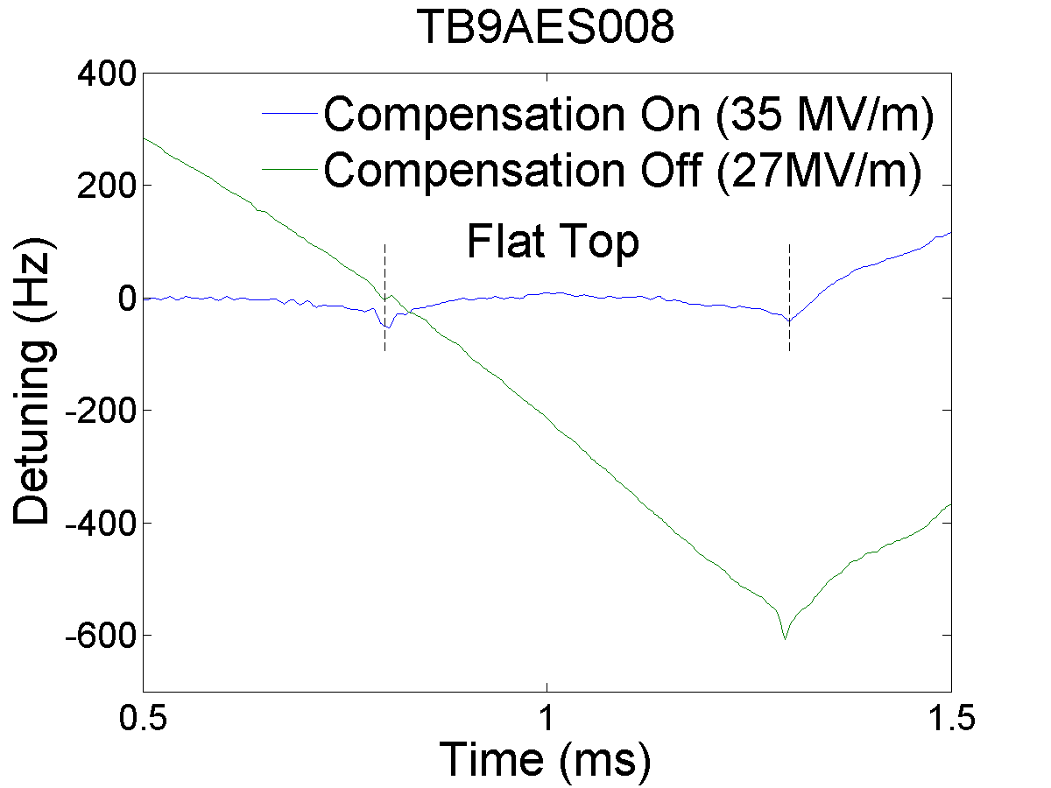
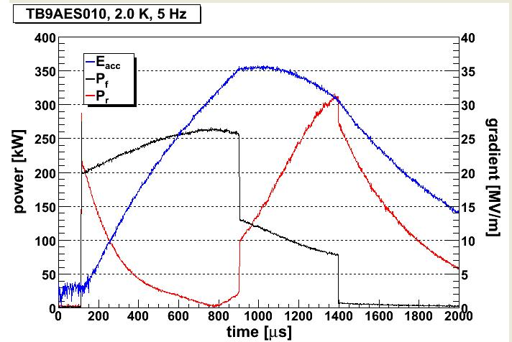
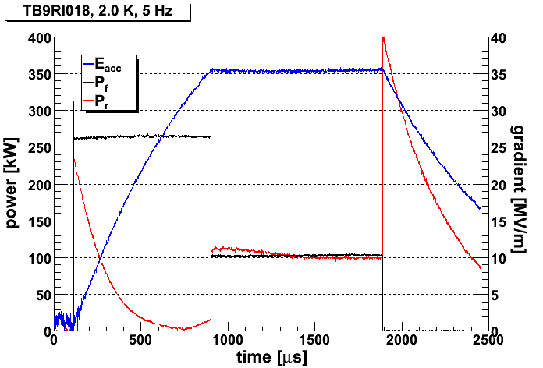
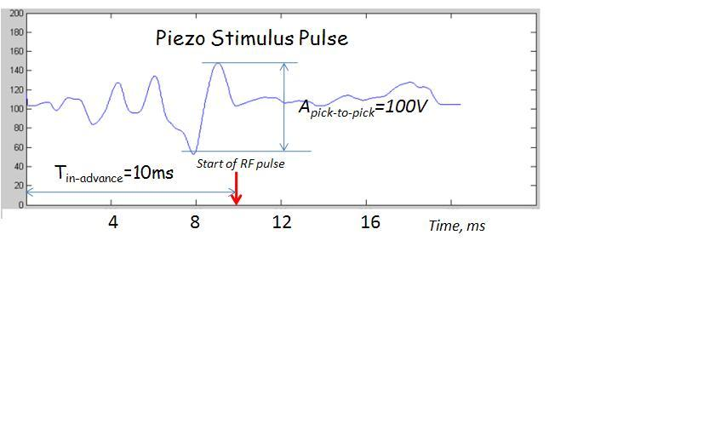

HTS at MDB FNAL (1)
(testing 1.3GHz (9cell) dressed cavities for CM2,3..
LFD during 1,3ms RF-pulse (Fill + FlatTop) was ~2300Hz (50%-50%)
LS LFD compensation -- to less than 20Hz during 1,3ms pulse
Adaptive Least Square LFD Algorithm
Eacc=35MV/m
Open loop operation
Piezo OFF
Piezo ON
Piezo OFF
Piezo ON
Yu.Pischalnikov, FNAL-MaRIE Project Meeting, March 9, 2016

Slide 9
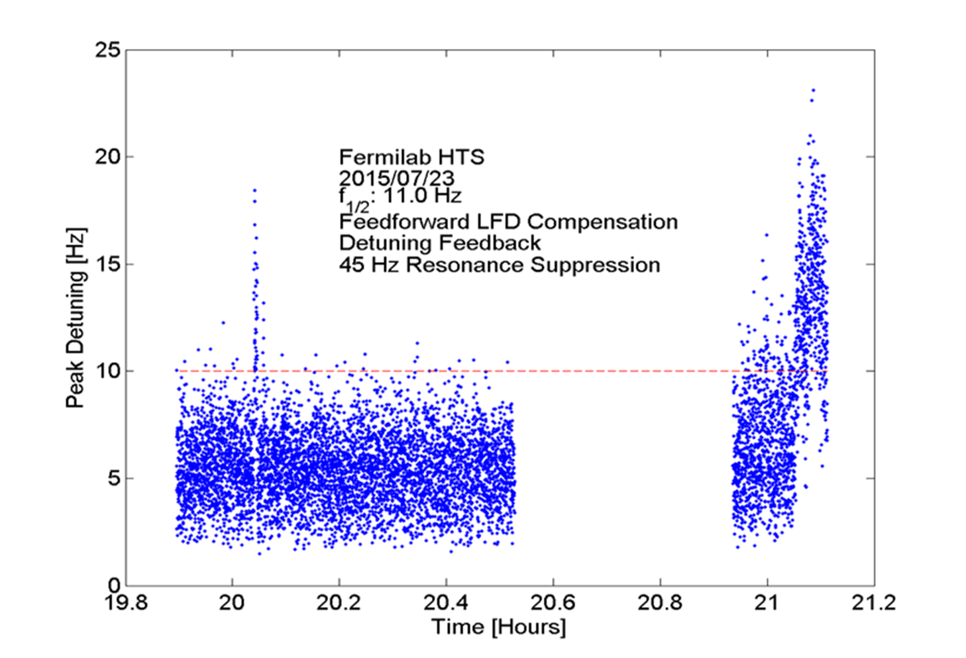
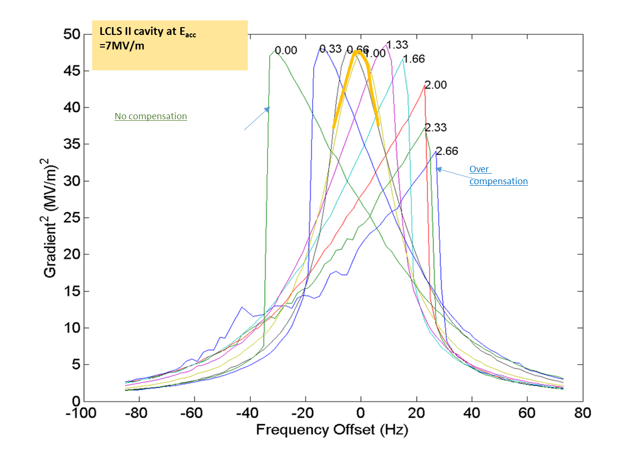
Resonance Control for Narrow Bandwidth SRF Cavities
(LCLS II project)
1. LFD feedforward compensation (piezo drive ~Eacc²)
LCLS II goal
2. Slow feedback compensation (df/dp compensation)
3. Fast feedback – 45Hz resonance suppression
Compensation OFF
Data logging off
Compensation OFF
Yu.Pischalnikov, FNAL-MaRIE Project Meeting, March 9, 2016

Slide 10
Summary (1)
FNAL TD developed significant expertise to design and build SRF cavity tuners/ LCLS II tuners (1,3GHz and 3.9GHz) can serve MaRIE Project “as is”…
Significant efforts contributed to R&D program for tuner reliability
  (collaboration with engineers/ scientists from Phytron and Physics Instrumente (PI) for development of reliable active components)
  Designated program for ALT test of piezo& motor at cold/insulated vacuum environment --- program can be extend to test piezo-stacks for MaRIE Project – concerns for piezo-overheating…
  Rad. Hardness test of the motor & piezo components up to 5*10⁸Rad.
Yu.Pischalnikov, FNAL-MaRIE Project Meeting, March 9, 2016

Slide 11
Summary (2)
FNAL TD/SRFD have broad R&D program for development algorithms for active resonance controls (LCLS II, PIP II)
Resonance Control Group put significant efforts into development of Adaptive Least Square LFD compensation algorithm. Algorithm is quite universal.
Algorithm successfully applied for LFD compensation for different tuner/cavity system (ILC, S1Global, HINS, Project X, PIP II)…
FNAL’s LFD algorithm capable to compensate LFD for any part of the RF-pulse (including “fill”). Standard “half-sine wave” algorithm (deployed at DESY) will not do it…
MaRIE project will significantly benefit from FNAL’s adaptive LFD algorithm to compensate LFD during “fill” portion of RF pulse (operation for 0.9ms “fill” and 0.1ms “flat” and E_{acc}=31.5MV/m → dF_{LFD-fill}~ up to 1000Hz)
60Hz operation can/will create significant microphonics (residual vibration from previous RF-pulse). FNAL Resonance control can contribute to study this effect ( and compensate it)
Yu.Pischalnikov, FNAL-MaRIE Project Meeting, March 9, 2016

Slide 12
Additional Slides

Slide 13
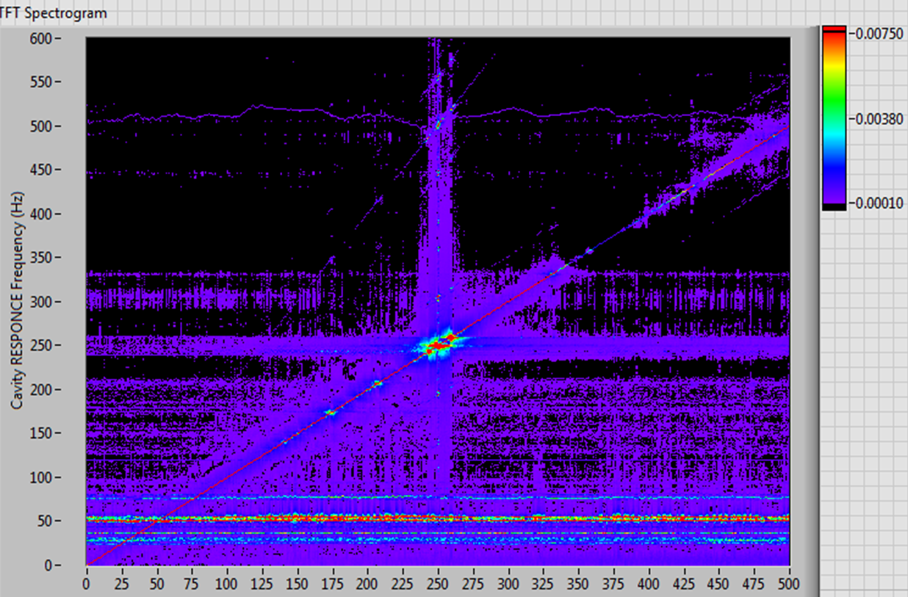
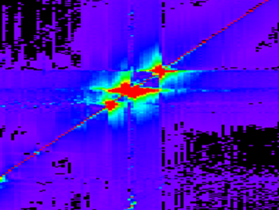
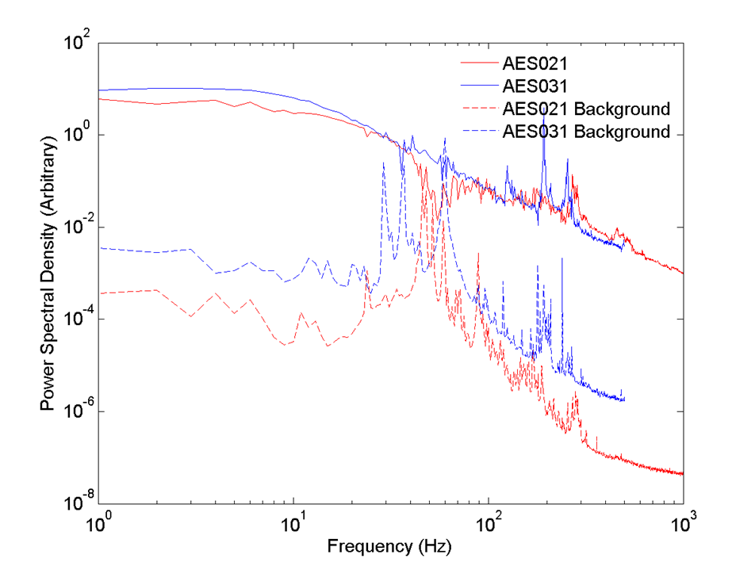
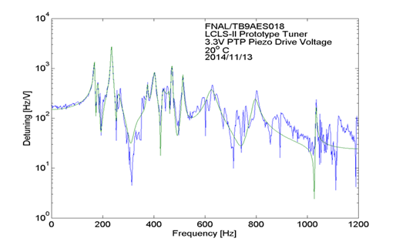
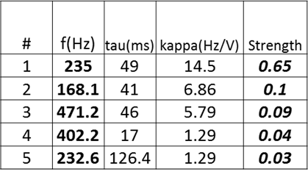
Transfer Function and Field Modulation Measurements
(to build electromechanical model of the cavity/tuner system)
FNAL have facilities and experts to conduct sophisticated tests program for Tuner design verification and cavity/He-vessel/tuner system characterization
(to build electromechanical model /simulator of the cavity tuner system)
Example: LCLS II Project
Drive piezo actuator with stepped frequency sine wave
Modulate cavity drive with stepped frequency sine wave
Two LCLS II Cavity measured at horizontal test stands at FNAL& Cornell
Notable differences between the two cavities

Slide 14
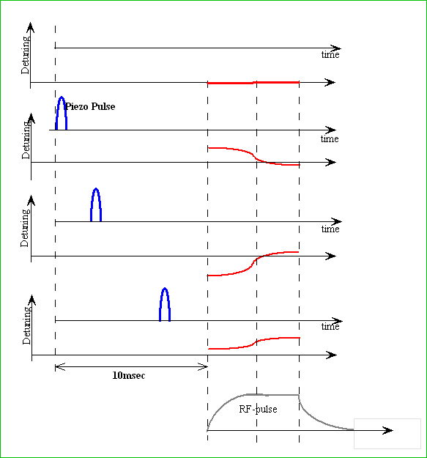
Adaptive Least Square LFD Algorithm
has been developed at Fermilab as a part of SRF Resonance Control R&D program
The response of the cavity frequency to the piezo impulse (TF) can be easily measured when cavity operated in CW-mode.
Since it is often not convenient to connect a pulsed cavity to CW source we developed alternative technique to measure this response (TF) when cavity operated in RF-pulse mode.
“1”
“10”
Piezo/cavity excited be sequence of small (several volts) narrow (1-2ms) pulses at various delay.
The forward, probe and reflected RF waveform recorded at each delay and used to calculate detuning.
[Response Matrix]
“34”
Details of Adaptive LS LFD Algorithm at :
“W. Schappert, Y.Pischalnikov, “Adaptive Lorentz Force Detuning Compensation”. Fermilab Preprint –TM-2476-TD.

Slide 15
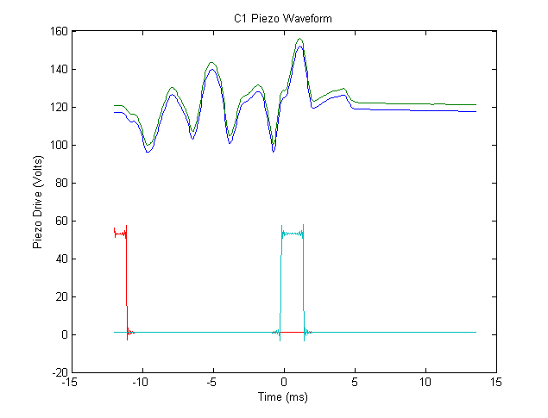
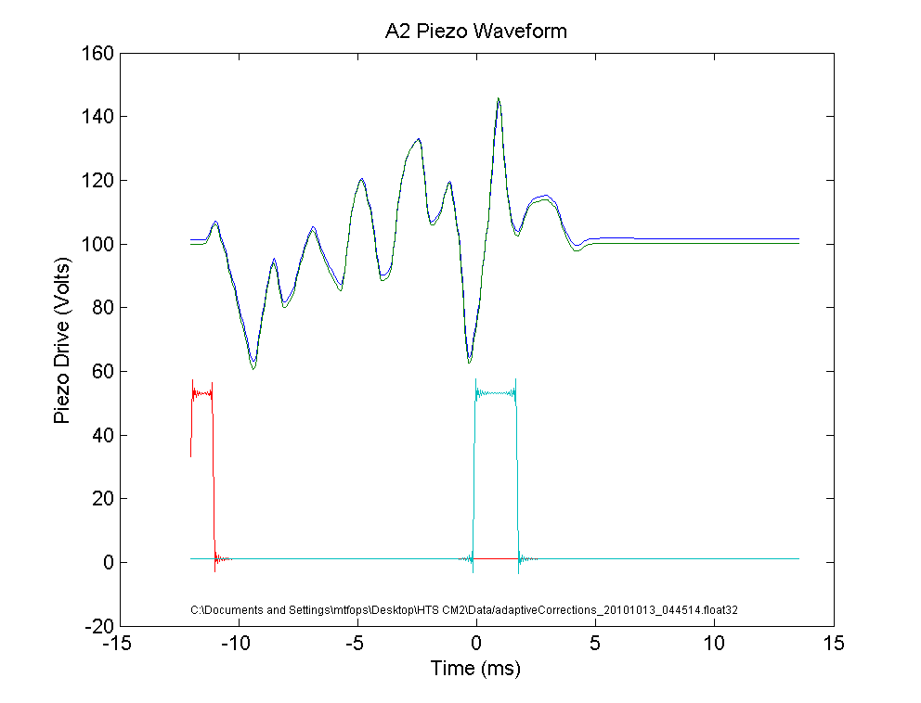
Adaptive LS LFD Algorithm
As operating conditions vary, the RF waveforms can be used to measure any residual detuning. The response matrix can then be used to calculate the incremental waveform required to cancel that residual detuning.
Response Matrix
Piezo Pulse # (or delay)
“1”
“10”
“34”
100Hz
DETUNING
Time during RF pulse
0
Piezo Impulse Calculated by LS LFD algorithm
cavityC1
Blade Tuner
A=70V
Cavity A2
KEK Tuner
Piezo Driver Signal
-100Hz
A=300V
Invert the response matrix and determine combination of pulses needed to cancel out the LFD using LS
Any part of RF pulse could selected for Compensation:
“Fill+FlatTop” only “FlatTop”
Trigger
12ms in-advance
RF gate

Slide 16
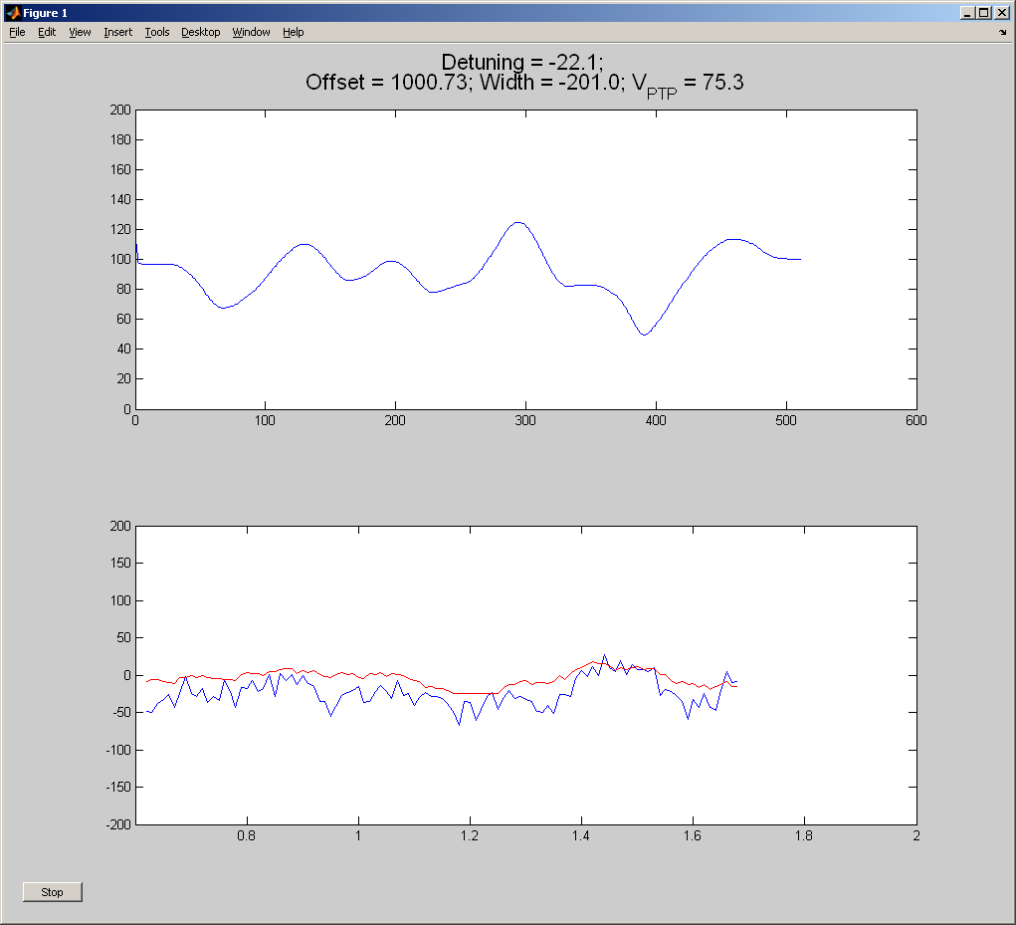
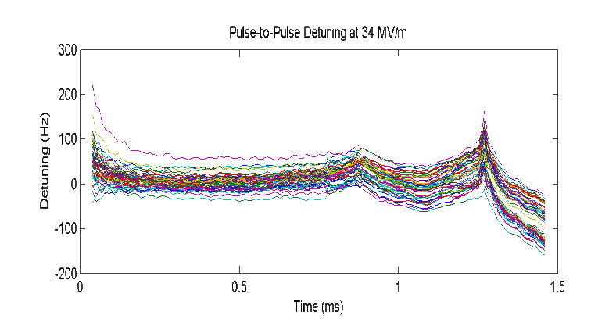
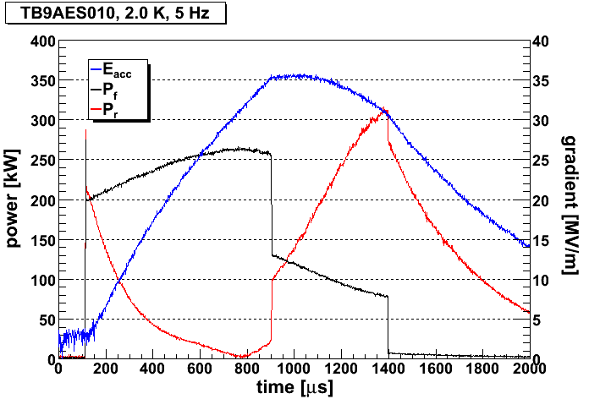
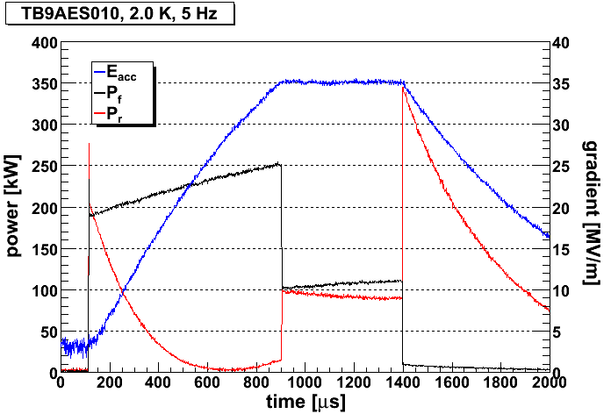
Results of LS LFD Compensation
(at HTS; Eacc~30-35MV/m)
Cavity ACCEL08 Eacc=32MV/m
Piezo Stimulus Pulse
Cavity AES013
Piezo OFF
Piezo ON
Eacc=35MV/m

Slide 17
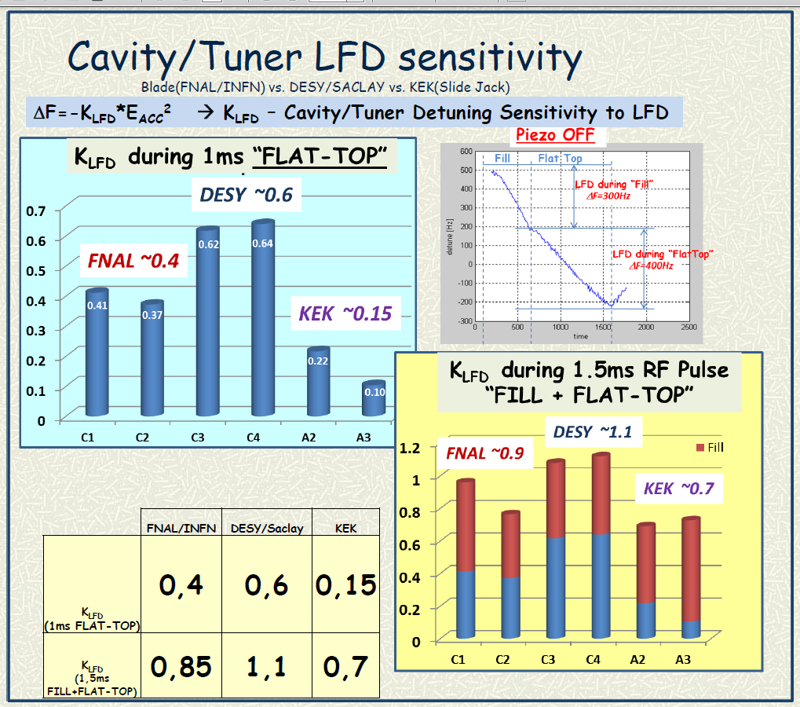
LFD Compensation at S1G (LFD during “fill” and “flat-top”)

Slide 18
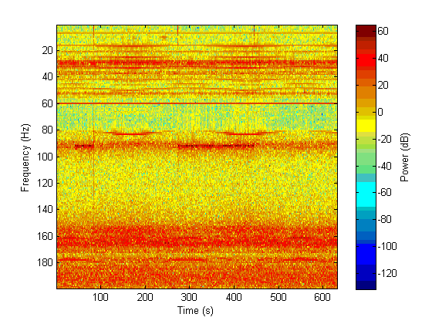
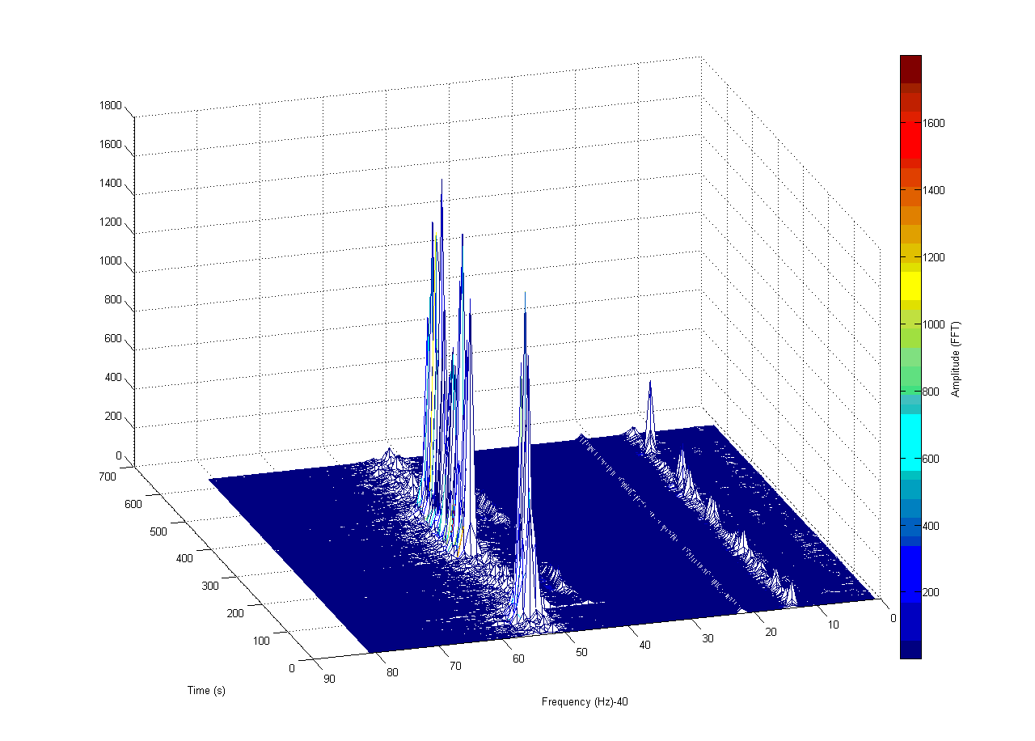
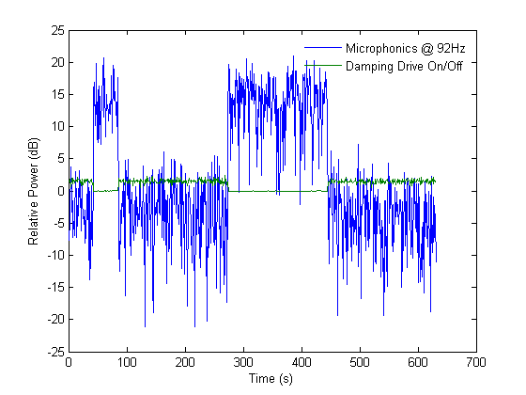
The Piezo tuner actively damped vibrations induced by external sources. An IIR filter bank was used to isolate and reverse the phase of the particular spectral line. The phase reversed signal then fed back to the piezo tuner.
CC2 – FNAL SRF Cavity Resonance Control “sand box”
now is part of Photo-injector for NML Accelerator Physics R&D Facility
    Compensation of mechanical vibrations induced by external mechanical noise sources (e.g. pumps, cranes, etc.).
Active damping reduces the vibration at this frequency
by 15 dB.

