Slide 1
Cryomodule Testing at Fermilab
E. Harms/Accelerator Division
MaRIE Team Visit
9 March 2016

Slide 2
Introduction
Fermilab has grown its SRF infrastructure and become experienced in testing superconducting RF cryomodules
Single cavity, e.g. CC-1, 2
8-cavity cryomodules, e.g. CM-1, 2
Some experience with e⁻ operation
Involvement with LCLS-II is allowing us to develop expertise in testing Cryomodules in a Production environment
New testing facility at CMTF broadens our capabilities into the future

Slide 3
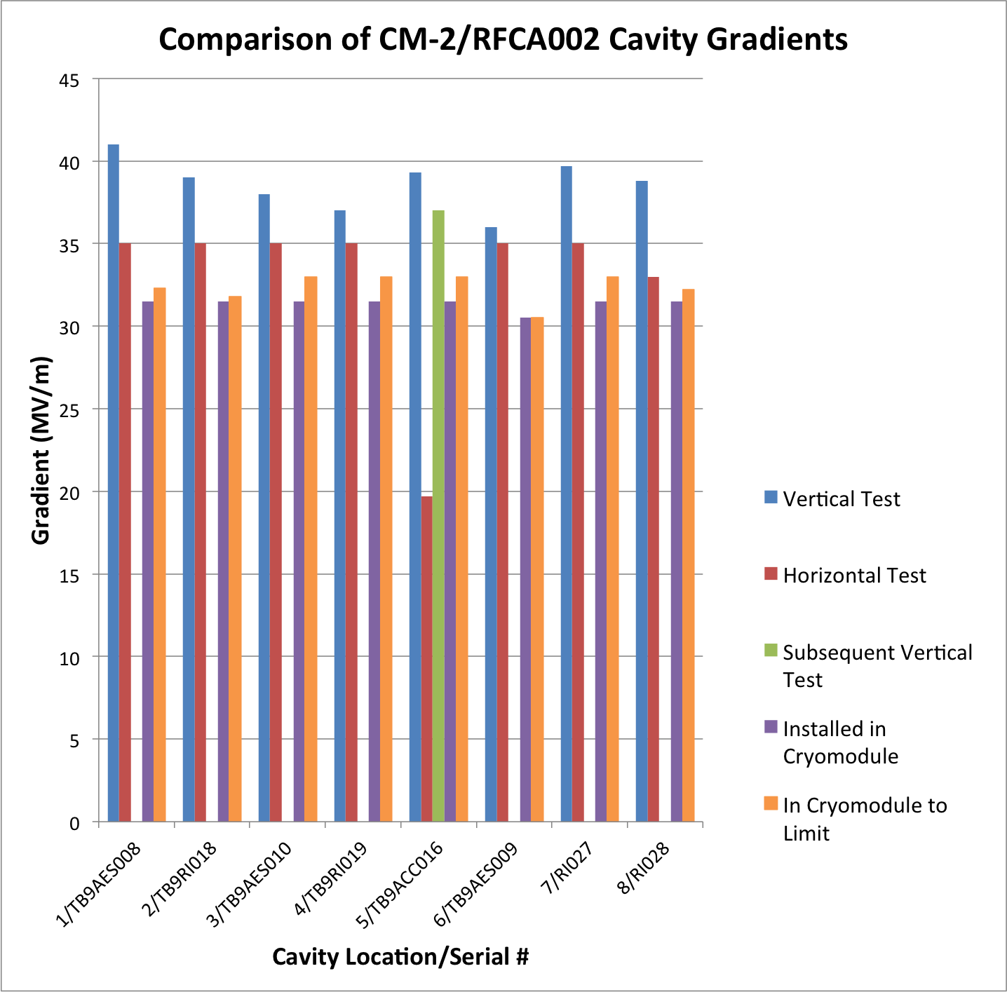
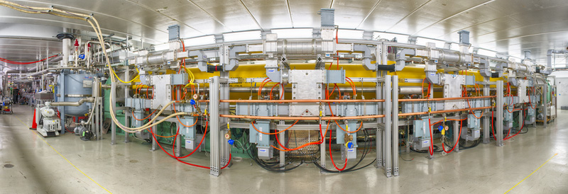
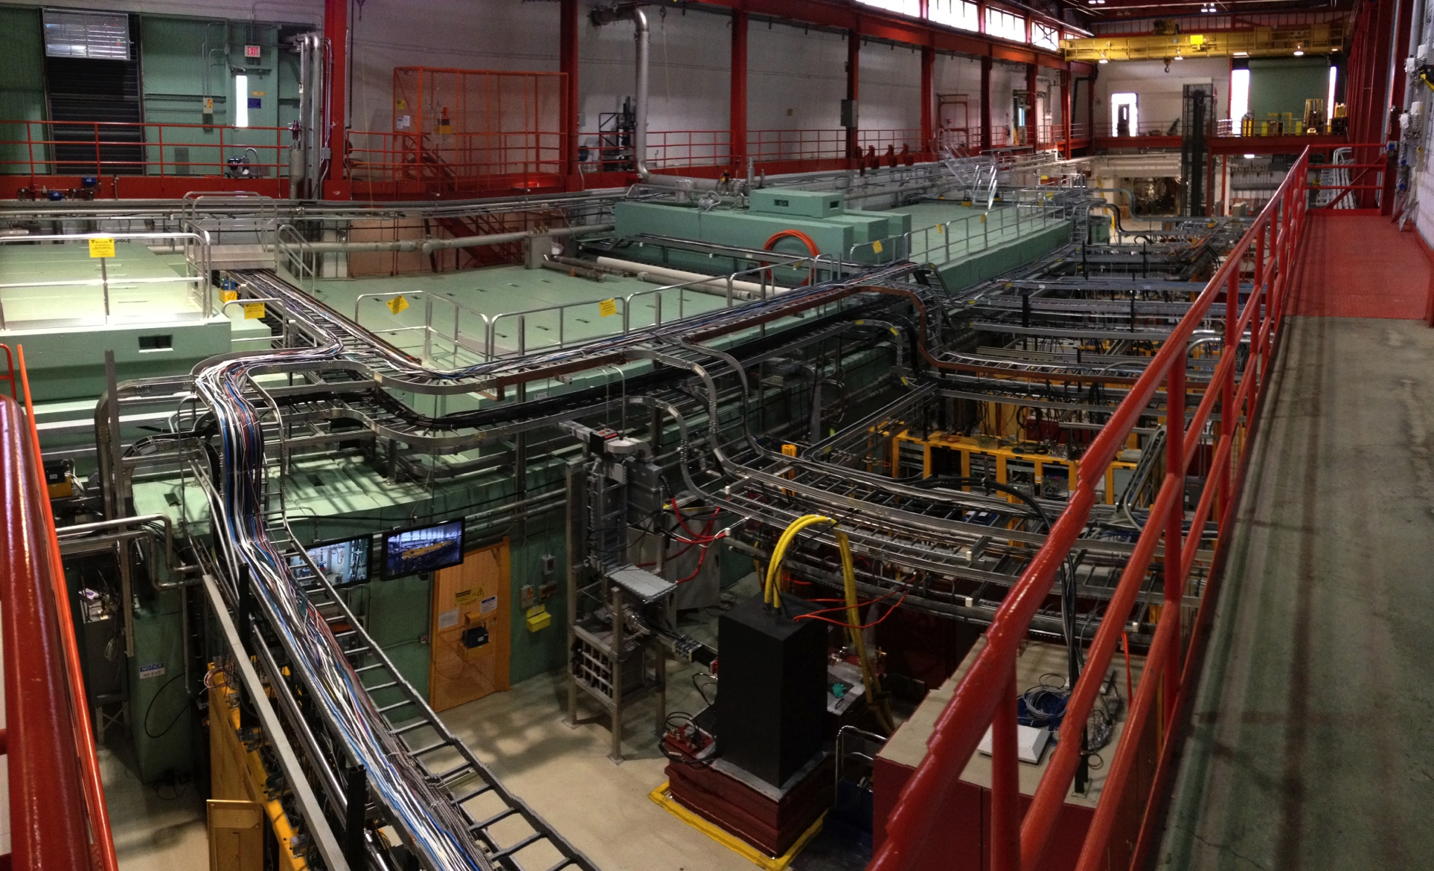
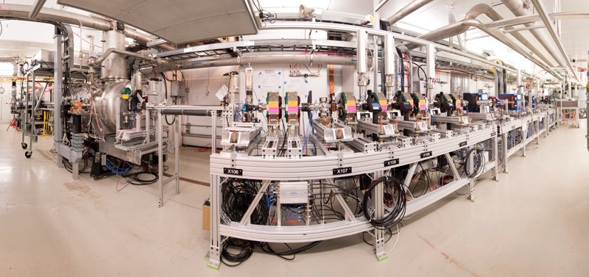
NML/FAST
Originally conceived as an ILC test (with beam) area
Operational 20 MeV electron injector - soon to be 55 MeV
Operational 8-cavity TESLA style cryomodule (2nd one operated here)
Build-up in progress to provide up to 300 MEV electrons, construct IOTA storage ring
Peak CM-2 Cavity Gradients with all 8 powered at once:
Sum = 258.1 MV, Average = 32.2 MV/m (pulsed)

Slide 4
NML/FAST
Valuable experienced gained in
Building a test cave (within an existing facility)
Installing and operating a cryomodule
Rigging & alignment
Vacuum and cryogenics connections and leak checks
Instrumentation/Interlocks
Safety systems
RF systems – low level and high power
Controls including data management/archiving
Developing test protocols
Making repairs – including in situ ones
CM-2 is the first cryomodule to meet the ILC gradient spec (average cavity gradient = 31.5 MV/m)

Slide 5
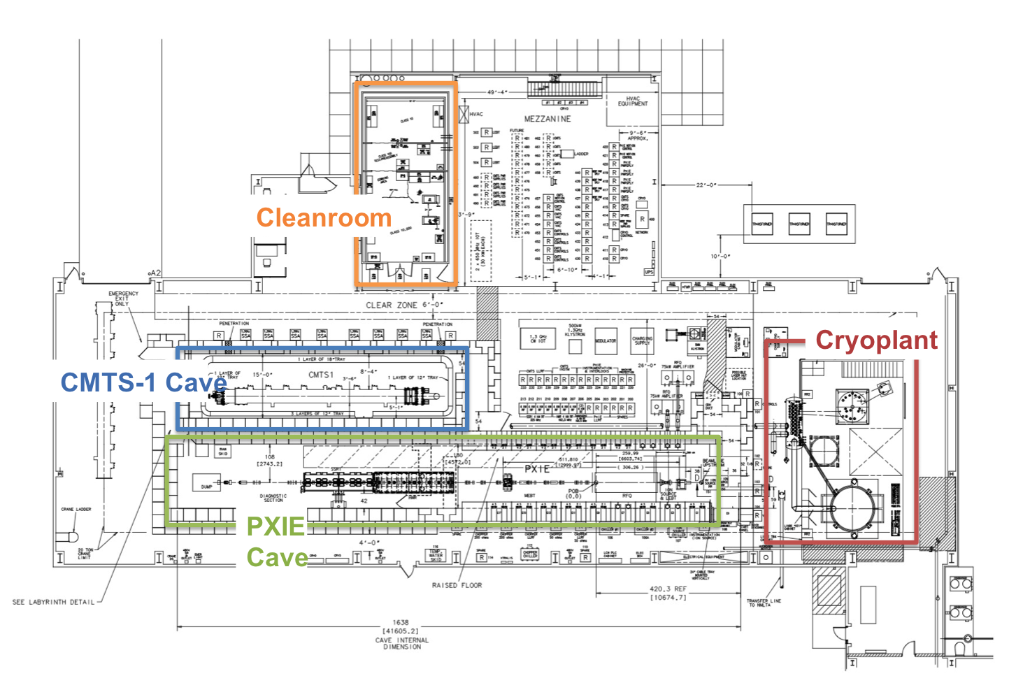
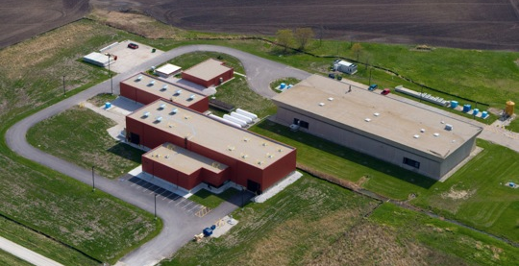
CMTF/CMTS-1
Newest SRF test facility at Fermilab
Nearly ready for LCLS-II Cryomodule testing (April)
Main components include
2 shielded test enclosures: CMTS-1, PIXIE
Cryo plant (500 W @ 2 K) and distribution system
Safety systems, Controls, Interlocks, LLRF, etc.
High Level RF provided by SLAC
Clean room

Slide 6
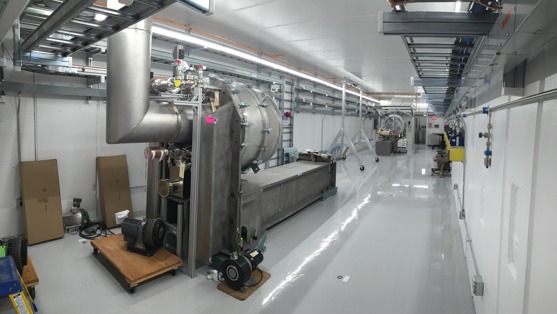
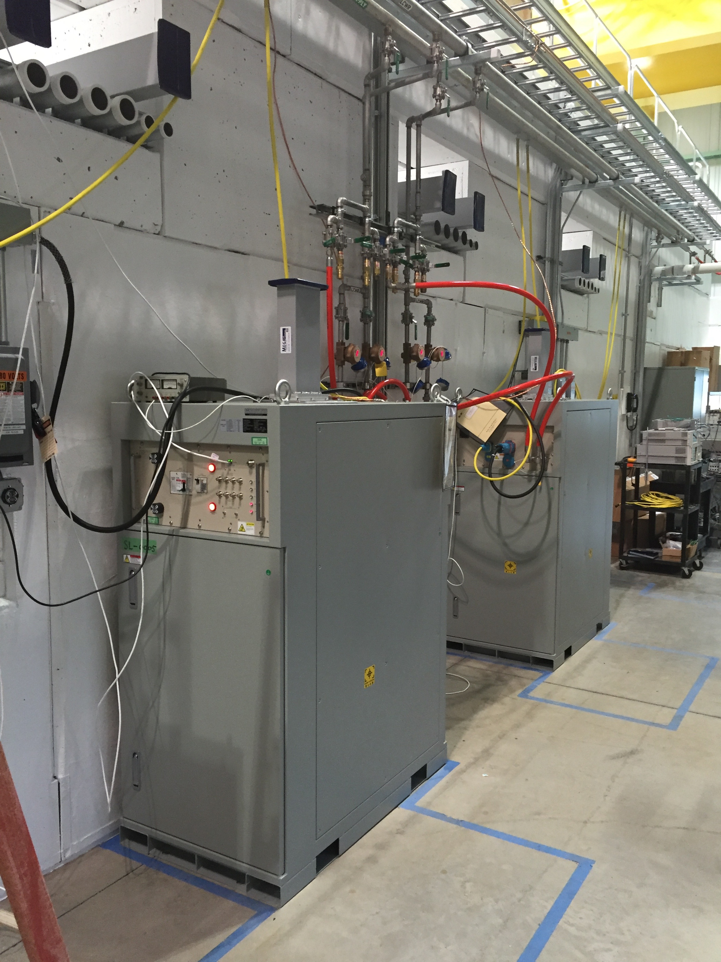
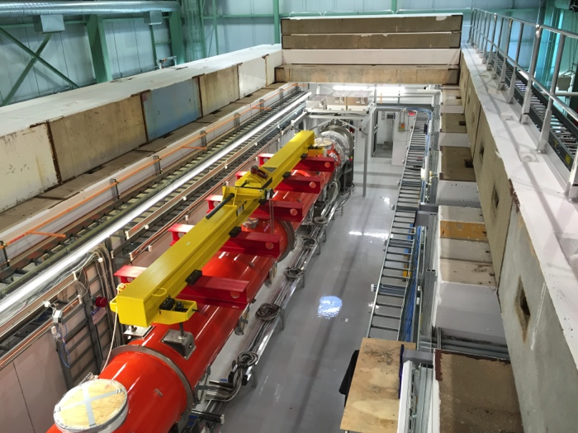
CMTS-1
LCLS-II testing will require
28-day testing turnaround (~11 days of cold operation)
CW operation of cryomodules
Low ambient magnetic environment
Flexibility: both 1.3 & 3.9 GHz cryomodules
Test stand can be repurposed for future needs: PIP-II, etc.

Slide 7
Summary
Fermilab has developed and demonstrated its ability to test fully-built cryomodules
Excellent performance achieved
Mature infrastructure in multiple locations
Capable and well-trained staff in the varied disciplines
Ramping up for LCLS-II Production testing will grow capabilities even more
This afternoon’s tour will allow you to see these facilities

